Slide 1

Impact of Product Modularity in Managing Uncertainty in Project Duration
Northern Illinois University
Department of Technology
Shun Takai

Slide 2
PERT (Program Evaluation and Review Technique)

Slide 3
PERT
PERT (Project Evaluation and Review Technique)
  Method to estimate probability of a project completion before target date
History
  Originated in US Navy’s Polaris Missile System program
  Developed by an operations research team that was formed in 1958 with members from:
    Navy’s Special Project Office
    Booz, Allen, and Hamilton (consulting firm)
    Lockheed Missile Systems (prime contractor)
(Reference) Project Management for Engineering, Business, and Technology, by John M. Nicholas and Herman Steyn, Routledge, 2012, 4th edition

Slide 4
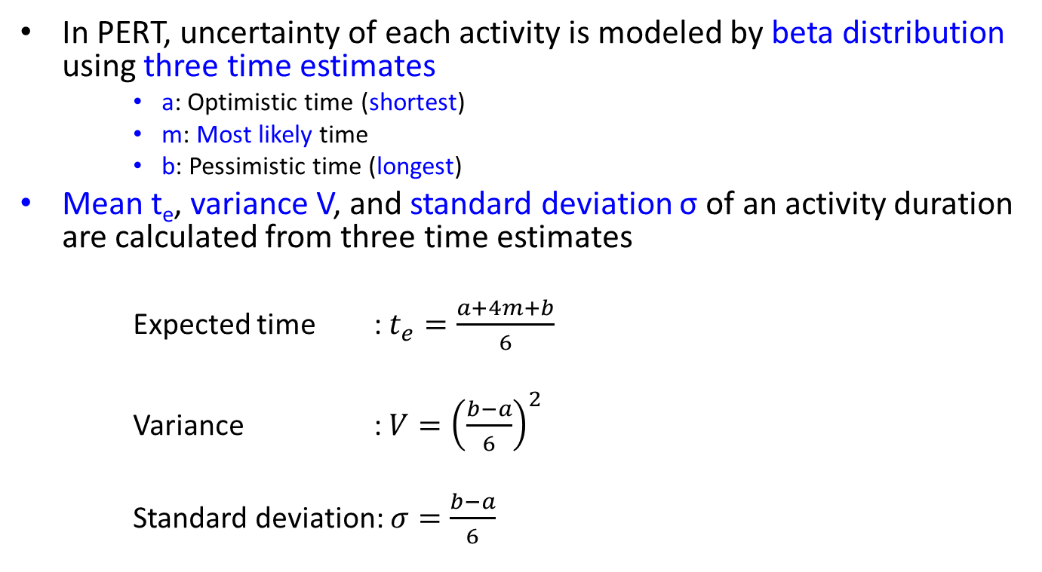
Activity Duration
In PERT, uncertainty of each activity is modeled by beta distribution using three time estimates
    a: Optimistic time (shortest)
    m: Most likely time
    b: Pessimistic time (longest)
Mean t_{e}, variance V, and standard deviation σ of an activity duration are calculated from three time estimates
  Expected time : $t_{e}=\frac{a+4m+b}{6}$
  Variance : $V={\left(\frac{b−a}{6}\right)}^{2}$
  Standard deviation: $σ=\frac{b−a}{6}$
(Reference) Project Management for Engineering, Business, and Technology, by John M. Nicholas and Herman Steyn, Routledge, 2012, 4th edition

Slide 5
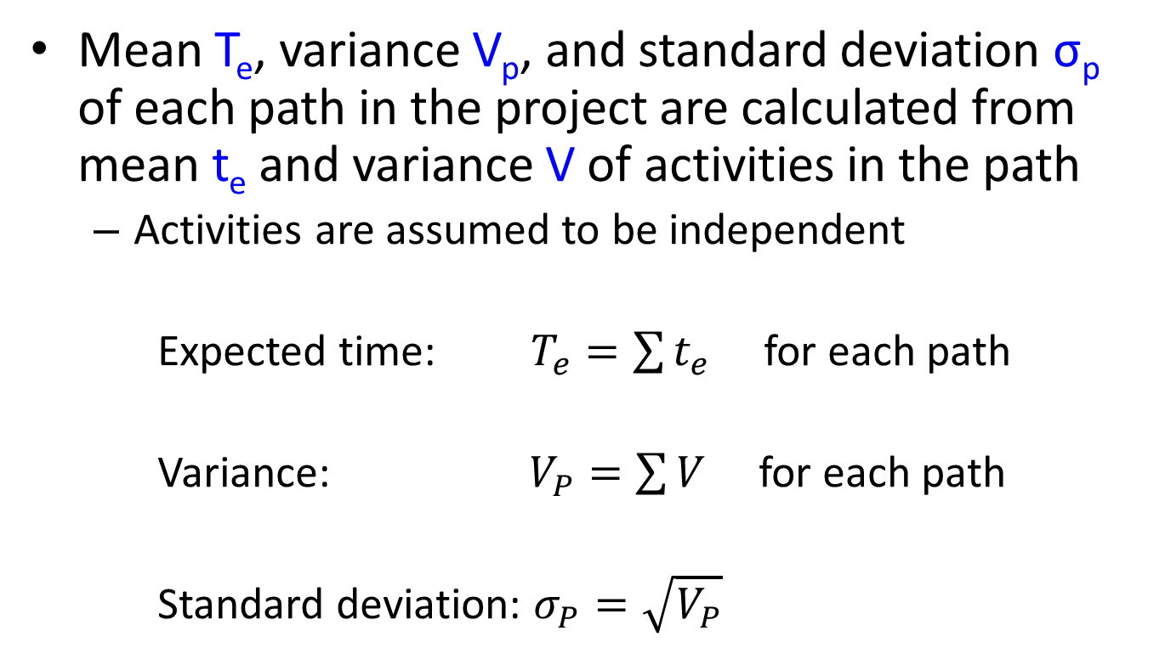
Project Duration
Mean T_{e}, variance V_{p}, and standard deviation σ_{p} of each path in the project are calculated from mean t_{e} and variance V of activities in the path
  Activities are assumed to be independent
  Expected time: $T_{e}=\sum{t_{e}}$ for each path
  Variance: $V_{P}=\sum{V}$ for each path
  Standard deviation: $σ_{P}=\sqrt{V_{P}}$
Path
Activities in the path
(Reference) Project Management for Engineering, Business, and Technology, by John M. Nicholas and Herman Steyn, Routledge, 2012, 4th edition

Slide 6
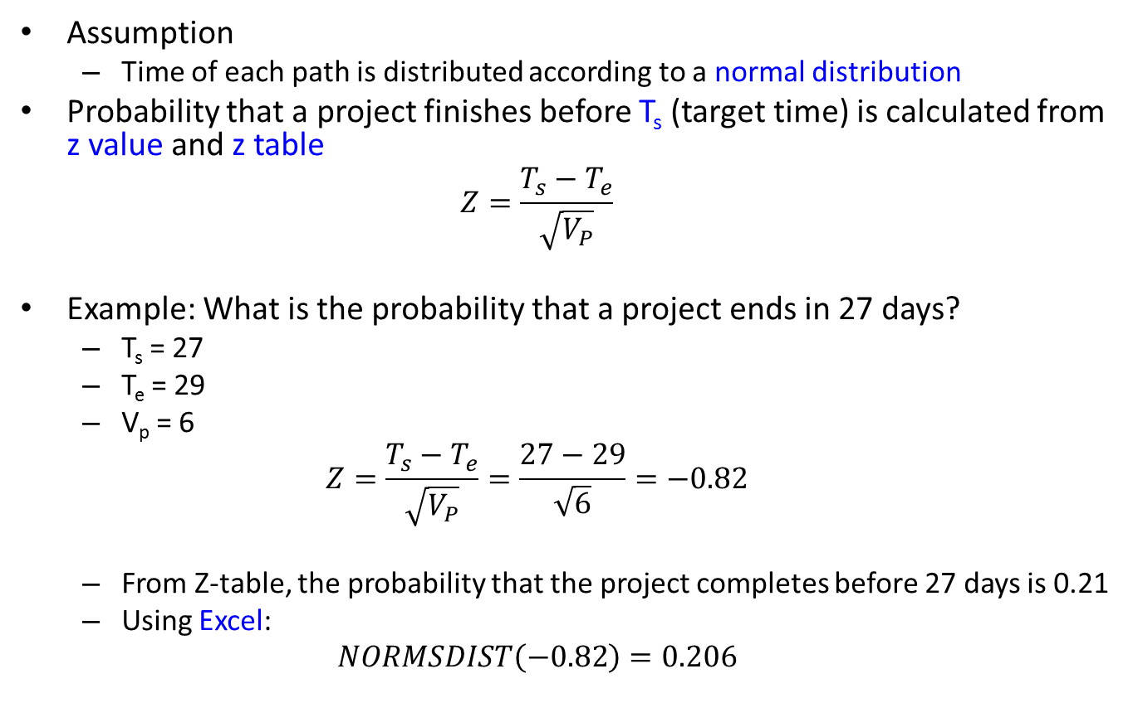
Probability of Project Completion
Assumption
  Time of each path is distributed according to a normal distribution
Probability that a project finishes before T_{s} (target time) is calculated from z value and z table
  $$Z=\frac{T_{s}−T_{e}}{\sqrt{V_{P}}}$$
Example: What is the probability that a project ends in 27 days?
  T_{s} = 27
  T_{e} = 29
  V_{p} = 6
  $$Z=\frac{T_{s}−T_{e}}{\sqrt{V_{P}}}=\frac{27−29}{\sqrt{6}}=−0.82$$
  From Z-table, the probability that the project completes before 27 days is 0.21
  Using Excel:
  $$NORMSDIST\left(−0.82\right)=0.206$$
(Reference) Project Management for Engineering, Business, and Technology, by John M. Nicholas and Herman Steyn, Routledge, 2012, 4th edition

Slide 7
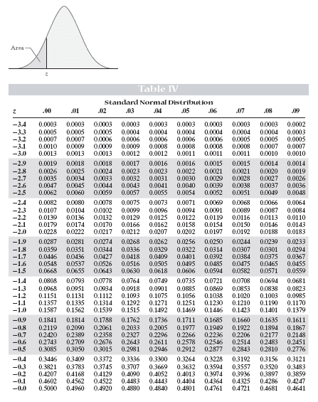
Project
z = -0.82
(Reference) https://faculty.elgin.edu/dkernler/statistics/ch07/7-2.html

Slide 8
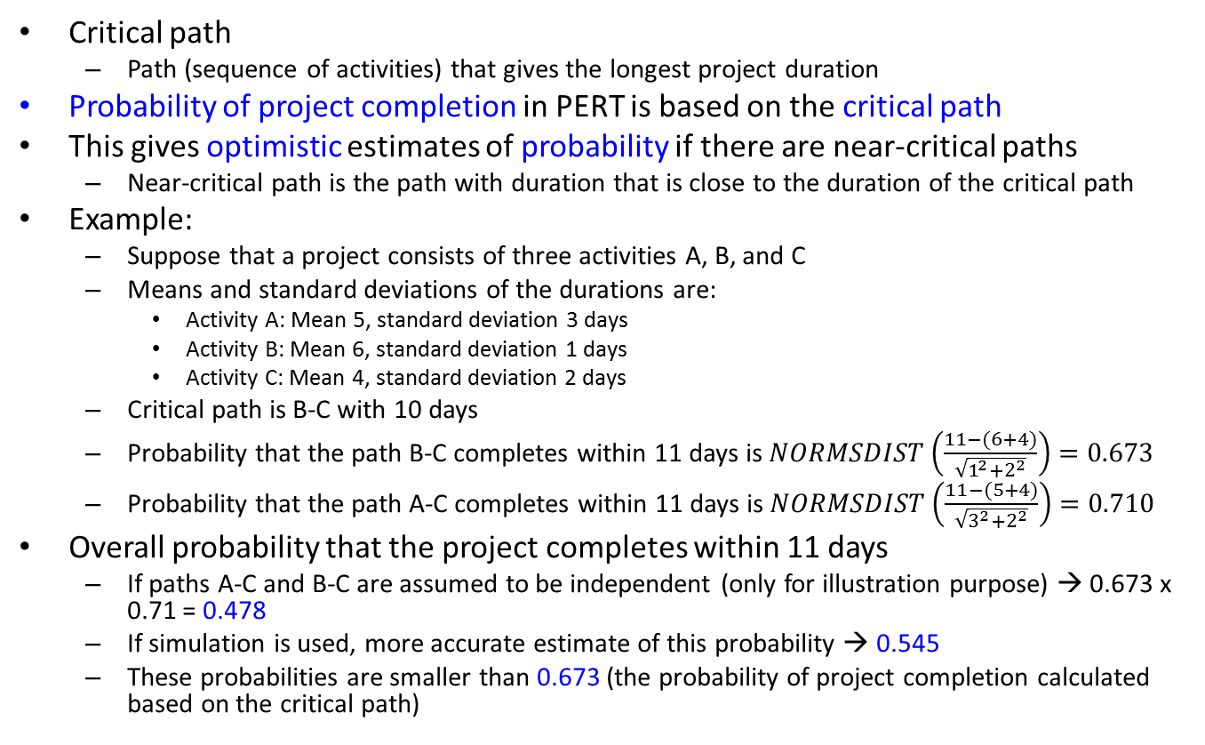
Critical Path
Critical path
  Path (sequence of activities) that gives the longest project duration
Probability of project completion in PERT is based on the critical path
This gives optimistic estimates of probability if there are near-critical paths
  Near-critical path is the path with duration that is close to the duration of the critical path
Example:
  Suppose that a project consists of three activities A, B, and C
  Means and standard deviations of the durations are:
    Activity A: Mean 5, standard deviation 3 days
    Activity B: Mean 6, standard deviation 1 days
    Activity C: Mean 4, standard deviation 2 days
  Critical path is B-C with 10 days
  Probability that the path B-C completes within 11 days is $NORMSDIST\left(\frac{11−(6+4)}{\sqrt{1^{2}+2^{2}}}\right)=0.673$
  Probability that the path A-C completes within 11 days is $NORMSDIST\left(\frac{11−(5+4)}{\sqrt{3^{2}+2^{2}}}\right)=0.710$
Overall probability that the project completes within 11 days
  If paths A-C and B-C are assumed to be independent (only for illustration purpose) → 0.673 x 0.71 = 0.478
  If simulation is used, more accurate estimate of this probability → 0.545
  These probabilities are smaller than 0.673 (the probability of project completion calculated based on the critical path)
(Reference) Project Management for Engineering, Business, and Technology, by John M. Nicholas and Herman Steyn, Routledge, 2012, 4th edition

Slide 9
Benefit of Product Modularization on Project Duration and Uncertainty

Slide 10

Product Modularization
Modularization is product design approach that divides product architecture into modules that can be independently designed, developed, and tested
Example:
  A Common Module Family (CMF) engineering architecture in Renault/Nissan Alliance vehicles
  Vehicle is divided into engine bay, cockpit, front underbody, rear underbody and electrical/electronic architecture
(Reference) http://europe.autonews.com/article/20130619/ANE/306199957/renault-starts-modular-production-with-nissan-in-cost-cutting-drive

Slide 11
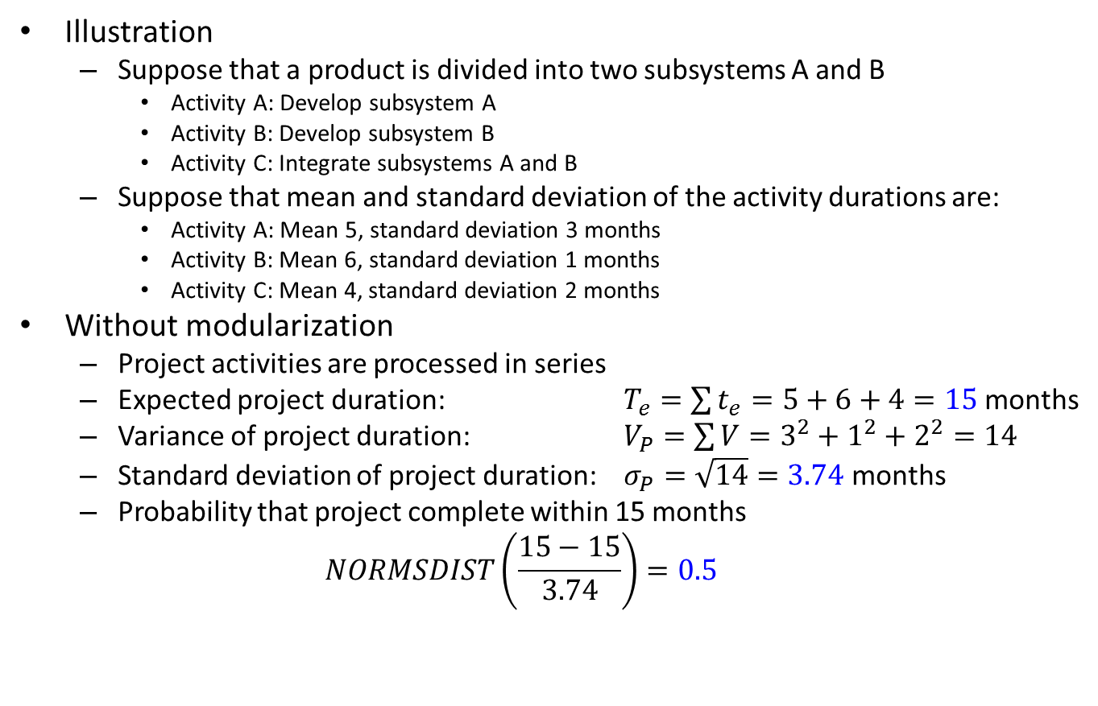
Benefit of Product Modularization
Illustration
  Suppose that a product is divided into two subsystems A and B
    Activity A: Develop subsystem A
    Activity B: Develop subsystem B
    Activity C: Integrate subsystems A and B
  Suppose that mean and standard deviation of the activity durations are:
    Activity A: Mean 5, standard deviation 3 months
    Activity B: Mean 6, standard deviation 1 months
    Activity C: Mean 4, standard deviation 2 months
Without modularization
  Project activities are processed in series
  Expected project duration: $T_{e}=\sum{t_{e}}=5+6+4=15$ months
  Variance of project duration: $V_{P}=\sum{V=3^{2}+1^{2}+2^{2}=14}$
  Standard deviation of project duration: $σ_{P}=\sqrt{14}=3.74$ months
  Probability that project complete within 15 months
  $$NORMSDIST\left(\frac{15−15}{3.74}\right)=0.5$$

Slide 12
Benefit of Product Modularization
With modularization
  Each module is individually designed, developed, and tested
  Then the modules are integrated
    Subsystem A is module A
    Subsystem B is module B
  Activities A and B are performed in parallel
  Activity C is performed when both activities A and B are completed
Impact of product modularization
  Critical path is B-C with 10 months
  Using simulation
    Expected project duration: 10.8 months
    Standard deviation of project duration: 2.55 months
    Overall probability that the project completes within 15 months: 0.94

