Slide 1

Value of Component Commonality in Managing Uncertainty in a Supply Chain
Northern Illinois University
Department of Technology
Shun Takai

Slide 2
Role of Safety Inventory in a Supply Chain

Slide 3
Role of Safety Inventory in a Supply Chain
If demand is certain:
  Daily demand is constant
  We know how long it will take to consume all inventory to satisfy the demand
Illustration
  D=20 (Daily demand)
  Q=100 (Replenishment lot size)
  L=5 (Lead time for inventory replenishment)

Slide 4
Role of Safety Inventory in a Supply Chain
If demand is uncertain:
  Demand may be larger or smaller than the average
  If the demand is large than the average, all inventory may be consumed before next replenishment lot arrives
Illustration
  D=20 (Average daily demand)
  Q=100 (Replenishment lot size)
  L=5 (Lead time for inventory replenishment)

Slide 5
Role of Safety Inventory in a Supply Chain
Safety inventory is used to account for uncertainty that:
  Demand may be larger than the average (or forecasted)
Illustration
  D=20 (Average daily demand)
  Q=100 (Replenishment lot size)
  L=5 (Lead time for inventory replenishment)
  ss=50 (Safety inventory)

Slide 6
Determining Appropriate Level of Safety Inventory

Slide 7
Trade-Off in Safety Inventory Decisions
Large amount of safety inventory
  Increases product availability (reduces product shortage); thus increases profit
  Increases inventory holding costs; thus reduces profit
Key questions in safety inventory decisions are:
  What is the appropriate level of safety inventory?
  What actions to take to reduce safety inventory while maintaining product availability?
(Reference) Supply Chain Management: Strategy, Planning, and Operation. Sunil Chopra and Peter Meindl. (2013) 5th Edition. Boston, MA: Pearson Prentice-Hall.

Slide 8
Determining Appropriate Level of Safety Inventory
Safety inventory is determined by:
  Demand and supply uncertainties
  Product availability
If uncertainty of demand or supply increases:
  Safety inventory increases
If product availability increases:
  Safety inventory increases
(Reference) Supply Chain Management: Strategy, Planning, and Operation. Sunil Chopra and Peter Meindl. (2013) 5th Edition. Boston, MA: Pearson Prentice-Hall.

Slide 9
Demand Uncertainty

Slide 10
Measuring Demand Uncertainty
Demand in each period (e.g., daily or weekly demand) is modeled by:
  D_{i}: average demand per period
  σ_{i}: standard deviation of demand per period (e.g., forecast error)
  i = 1, 2, 3, …, L
Notation is simplified if uncertainty of demand in each period is identical
  D: average demand per period
  σ_{D}: standard deviation of demand per period
Lead time is the time between when an order is placed and when the order is received
  L: lead time
(Reference) Supply Chain Management: Strategy, Planning, and Operation. Sunil Chopra and Peter Meindl. (2013) 5th Edition. Boston, MA: Pearson Prentice-Hall.

Slide 11
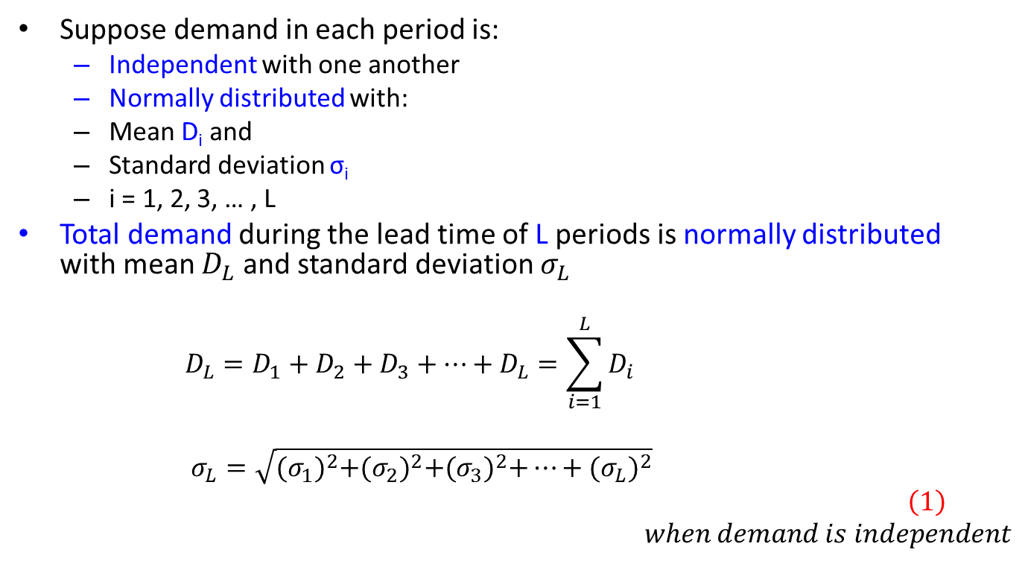
Measuring Demand Uncertainty
Suppose demand in each period is:
  Independent with one another
  Normally distributed with:
  Mean D_{i} and
  Standard deviation σ_{i}
  i = 1, 2, 3, … , L
Total demand during the lead time of L periods is normally distributed with mean $D_{L}$ and standard deviation $σ_{L}$
  $$D_{L}=D_{1}+D_{2}+D_{3}+…+D_{L}=\sum_{i=1}^{L}{D_{i}}$$
  $$σ_{L}=\sqrt{{(σ_{1})}^{2}+{(σ_{2})}^{2}+{(σ_{3})}^{2}+…+{(σ_{L})}^{2}}$$
  $$\left(1\right)$$
  $$when demand is independent$$
(Reference) Supply Chain Management: Strategy, Planning, and Operation. Sunil Chopra and Peter Meindl. (2013) 5th Edition. Boston, MA: Pearson Prentice-Hall.

Slide 12
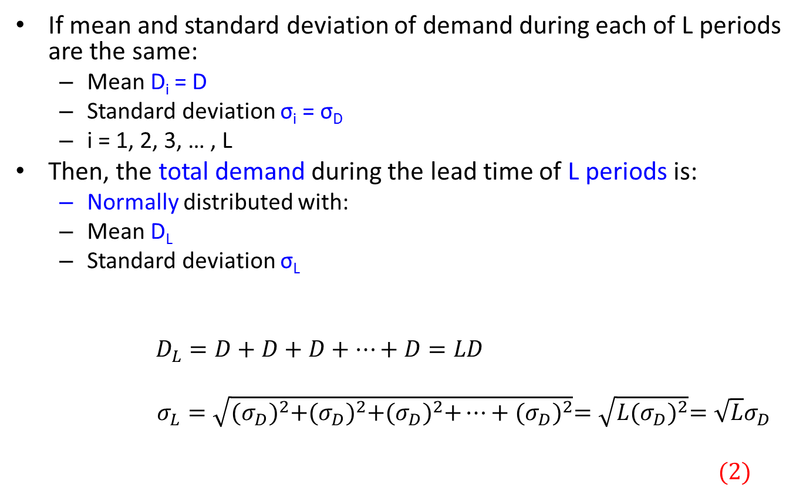
Measuring Demand Uncertainty
If mean and standard deviation of demand during each of L periods are the same:
  Mean D_{i} = D
  Standard deviation σ_{i} = σ_{D}
  i = 1, 2, 3, … , L
Then, the total demand during the lead time of L periods is:
  Normally distributed with:
  Mean D_{L}
  Standard deviation σ_{L}
  $$D_{L}=D+D+D+…+D=LD$$
  $σ_{L}=\sqrt{{(σ_{D})}^{2}+{(σ_{D})}^{2}+{(σ_{D})}^{2}+…+{(σ_{D})}^{2}}=\sqrt{L{(σ_{D})}^{2}}=\sqrt{L}σ_{D}$
  $$(2)$$
L terms
L terms
(Reference) Supply Chain Management: Strategy, Planning, and Operation. Sunil Chopra and Peter Meindl. (2013) 5th Edition. Boston, MA: Pearson Prentice-Hall.

Slide 13
Product Availability and Replenishment Policy

Slide 14
Product Availability and Replenishment Policy
Product availability
  Ability to satisfy customer order from inventory
A stockout occurs when:
  Customer order is not satisfied due to no inventory
Example: cycle service level (CSL)
  Proportion of replenishment cycles that end without stockout
    Replenishment cycle is the interval between the arrival of two successive replenishment lots
  Equivalent to probability of replenishment cycle without stockout
Replenishment policy consists of:
  Timing of reorder
  Quantity of reorder
Example: continuous review policy
  Inventory is continuously monitored
  Lot size Q is ordered when the inventory reaches the reorder point (ROP)
  Lot size is same
  Time between order may change
(Reference) Supply Chain Management: Strategy, Planning, and Operation. Sunil Chopra and Peter Meindl. (2013) 5th Edition. Boston, MA: Pearson Prentice-Hall.

Slide 15
Evaluating CSL Given a Replenishment Policy
Continuous review replenishment policy is assumed
  Q: reorder lot size
  L: replenishment lead time (number of weeks)
Weekly demand
  Normally distributed with:
  Mean D and
  Standard deviation σ_{D}
Two cases are discussed next
  Safety inventory given a replenishment policy
  CSL given a replenishment policy
(Reference) Supply Chain Management: Strategy, Planning, and Operation. Sunil Chopra and Peter Meindl. (2013) 5th Edition. Boston, MA: Pearson Prentice-Hall.

Slide 16
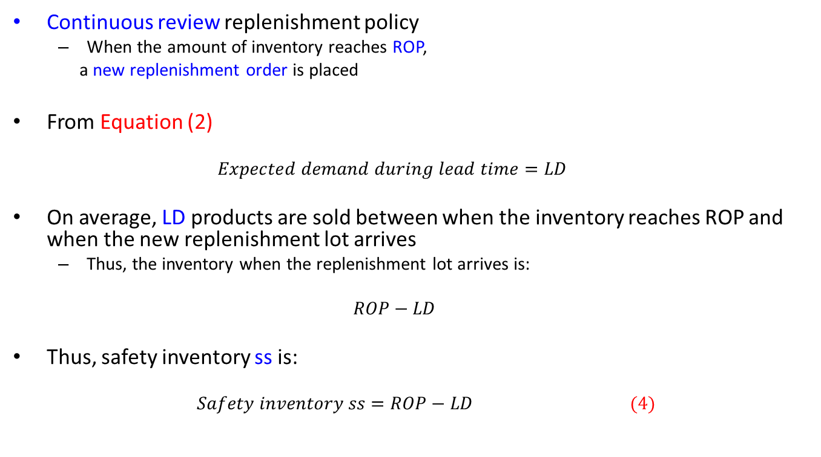
Safety Inventory Given a Replenishment Policy
Continuous review replenishment policy
  When the amount of inventory reaches ROP,
  a new replenishment order is placed
From Equation (2)
  $$Expected demand during lead time=LD$$
On average, LD products are sold between when the inventory reaches ROP and when the new replenishment lot arrives
  Thus, the inventory when the replenishment lot arrives is:
  $$ROP−LD$$
Thus, safety inventory ss is:
  $$Safety inventory ss=ROP−LD (4)$$
(Reference) Supply Chain Management: Strategy, Planning, and Operation. Sunil Chopra and Peter Meindl. (2013) 5th Edition. Boston, MA: Pearson Prentice-Hall.

Slide 17
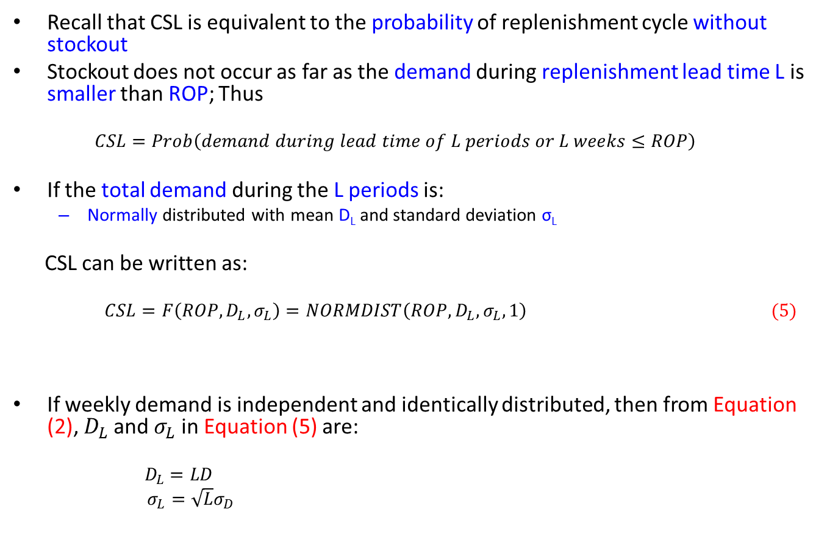
CSL Given a Replenishment Policy
Recall that CSL is equivalent to the probability of replenishment cycle without stockout
Stockout does not occur as far as the demand during replenishment lead time L is smaller than ROP; Thus
  $$CSL=Prob\left(demand during lead time of L periods or L weeks≤ROP\right)$$
If the total demand during the L periods is:
  Normally distributed with mean D_{L} and standard deviation σ_{L}
CSL can be written as:
  $CSL=F\left(ROP, D_{L},σ_{L}\right)=NORMDIST\left(ROP, D_{L},σ_{L},1\right) (5)$
If weekly demand is independent and identically distributed, then from Equation (2), $D_{L}$and $σ_{L}$ in Equation (5) are:
  $$D_{L}=LD$$
  $σ_{L}=\sqrt{L}σ_{D}$
Excel function (“NORM.DIST” instead of “NORMDIST” is used in Excel 2010)
(Reference) Supply Chain Management: Strategy, Planning, and Operation. Sunil Chopra and Peter Meindl. (2013) 5th Edition. Boston, MA: Pearson Prentice-Hall.

Slide 18
Safety Inventory Given Desired CSL
Companies often choose replenishment policies to achieve desired levels of product availability
Thus, appropriate level of safety inventory needs to be calculated to achieve the desired level of product availability (e.g., in terms of CSL)
Next
  Safety inventory given desired CSL is discussed
(Reference) Supply Chain Management: Strategy, Planning, and Operation. Sunil Chopra and Peter Meindl. (2013) 5th Edition. Boston, MA: Pearson Prentice-Hall.

Slide 19
Safety Inventory Given Desired CSL
Goal
  For continuous review replenishment policy,
  Calculate appropriate safety inventory that achieves the desired CSL
Assumption
  L: lead time
  CSL: desired cycle service level
  D_{L}: mean demand during lead time
  σ_{L}: standard deviation of demand during lead time
(Reference) Supply Chain Management: Strategy, Planning, and Operation. Sunil Chopra and Peter Meindl. (2013) 5th Edition. Boston, MA: Pearson Prentice-Hall.

Slide 20
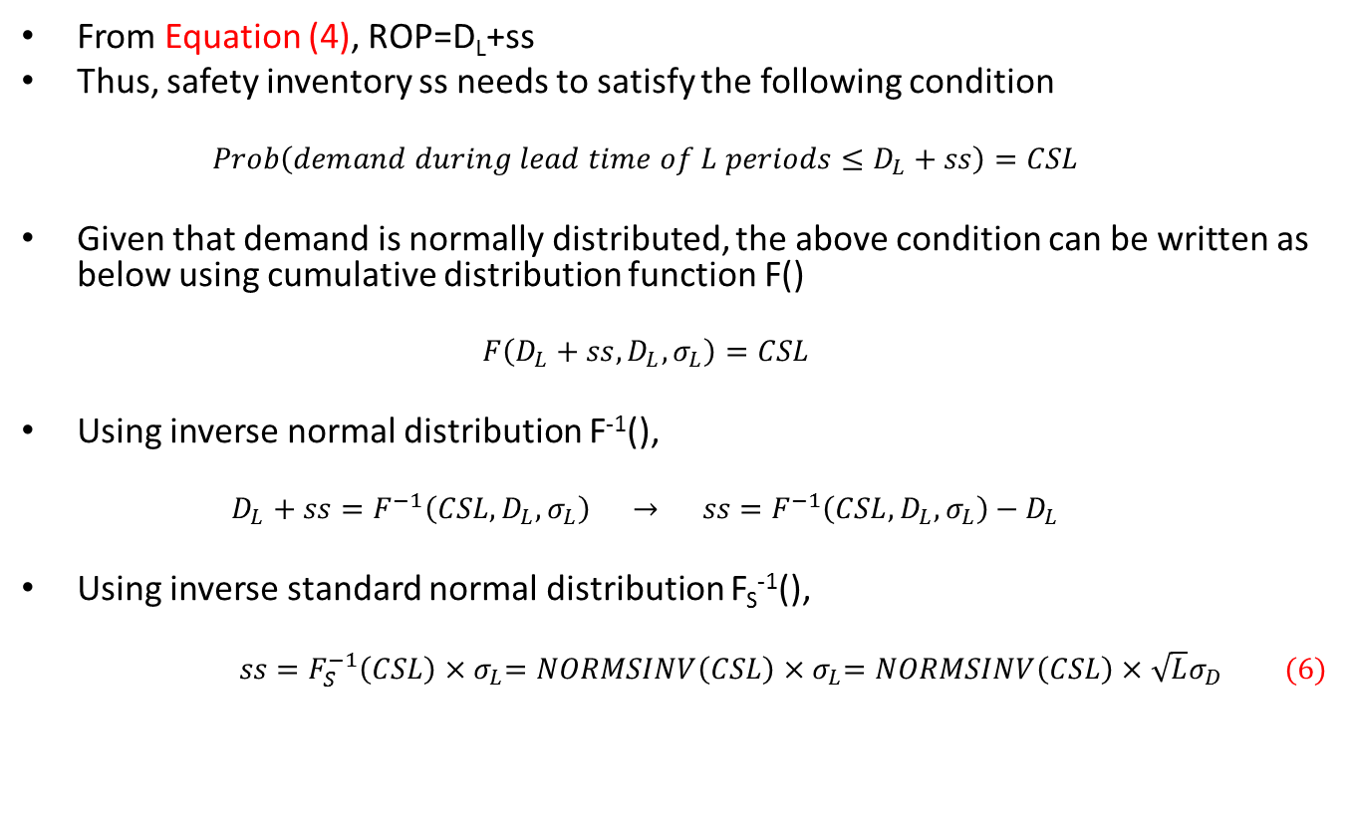
Safety Inventory Given Desired CSL
From Equation (4), ROP=D_{L}+ss
Thus, safety inventory ss needs to satisfy the following condition
  $$Prob\left(demand during lead time of L periods≤D_{L}+ss\right)=CSL$$
Given that demand is normally distributed, the above condition can be written as below using cumulative distribution function F()
  $$F\left(D_{L}+ss,D_{L},σ_{L}\right)=CSL$$
Using inverse normal distribution F⁻¹(),
  $$D_{L}+ss=F^{−1}\left(CSL,D_{L},σ_{L}\right) → ss=F^{−1}\left(CSL,D_{L},σ_{L}\right)−D_{L}$$
Using inverse standard normal distribution F_{S}⁻¹(),
  $ss=F_{S}^{−1}\left(CSL\right){×σ}_{L}=NORMSINV\left(CSL\right){×σ}_{L}=NORMSINV\left(CSL\right)×\sqrt{L}σ_{D} (6)$
Excel function (“NORM.S.INV” instead of “NORMSINV” is used in Excel 2010)
(Reference) Supply Chain Management: Strategy, Planning, and Operation. Sunil Chopra and Peter Meindl. (2013) 5th Edition. Boston, MA: Pearson Prentice-Hall.

Slide 21
Impact of Product Design on Safety Inventory – Value of Component Commonality

Slide 22
Component Commonality
Component commonality is a key to increasing product variety without reducing product availability or without increasing component inventory too much
If product variety in a supply chain is large, the variety and amount of components in the supply chain can be significantly large
Use of common components in multiple products enables a company to:
  Aggregate component demand and
  Reduce component inventory
If a distinct component is used in each product:
  Demand for the component is the same as demand for the finished product in which the component is used
If the same component is used in multiple products:
  Demand for the component is the same as the aggregate demand of all the finished products in which the component is used
(Reference) Supply Chain Management: Strategy, Planning, and Operation. Sunil Chopra and Peter Meindl. (2013) 5th Edition. Boston, MA: Pearson Prentice-Hall.

Slide 23
Postponement
Postponement is to delay product differentiation or customization until near the time of product sales
Component commonality is the key enabler of product postponement
Supply chains with and without postponement are graphically compared below
Component A
Product A
No postponement
Component B
Product B
Component C
Product C
Demand aggregation
Product A
With postponement
Common component D
Product B
Product C
(Reference) Supply Chain Management: Strategy, Planning, and Operation. Sunil Chopra and Peter Meindl. (2013) 5th Edition. Boston, MA: Pearson Prentice-Hall.

Slide 24
Value of Component Commonality
Value of component commonality and postponement comes from:
  Reduction of safety inventory by demand aggregation
Consider the following conditions
  k: number of products
  D_{i}: mean weekly demand of product i
    i = 1, …, k
  σ_{i}: standard deviation of weekly demand of product i
    i = 1, …, k
  L: replenishment lead time
  CSL: cycle service level
  D_{L}: mean demand during lead time
  σ_{L}: standard deviation of demand during lead time
  H: unit inventory holding cost 𝐻=ℎ𝐶
  C: product cost per unit
  h: inventory holding cost per year as a fraction of product cost
(Reference) Supply Chain Management: Strategy, Planning, and Operation. Sunil Chopra and Peter Meindl. (2013) 5th Edition. Boston, MA: Pearson Prentice-Hall.

Slide 25
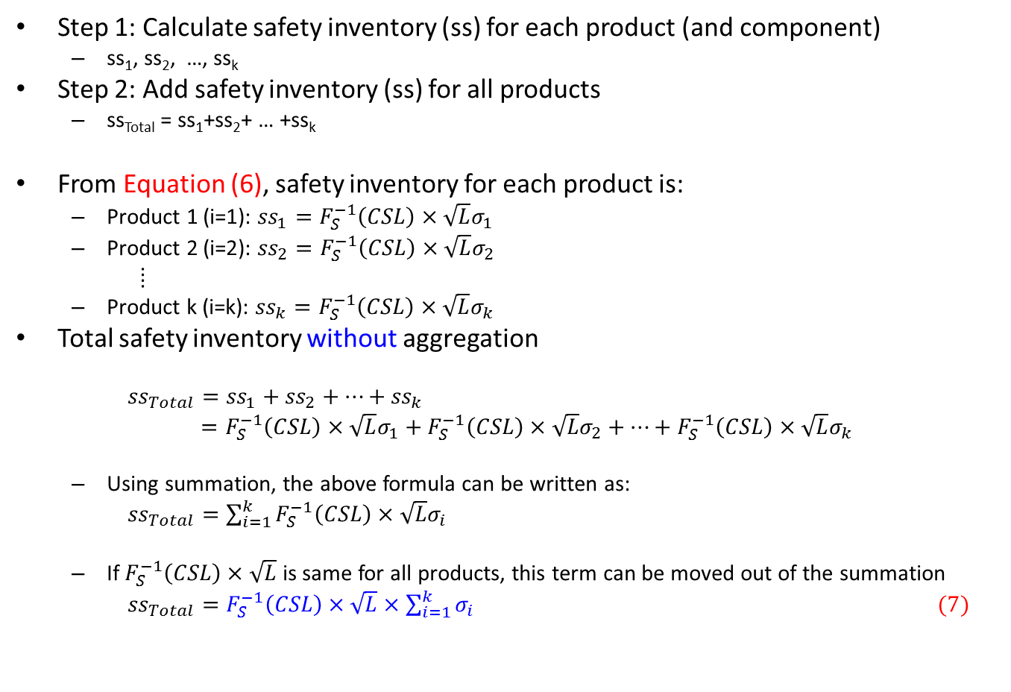
Safety Inventory without Aggregation
Step 1: Calculate safety inventory (ss) for each product (and component)
  ss₁, ss₂, …, ss_{k}
Step 2: Add safety inventory (ss) for all products
  ss_{Total} = ss₁+ss₂+ … +ss_{k}
From Equation (6), safety inventory for each product is:
  Product 1 (i=1): ${ss}_{1}=F_{S}^{−1}\left(CSL\right)×\sqrt{L}σ_{1}$
  Product 2 (i=2): ${ss}_{2}=F_{S}^{−1}\left(CSL\right)×\sqrt{L}σ_{2}$
  ⁞
  Product k (i=k): ${ss}_{k}=F_{S}^{−1}\left(CSL\right)×\sqrt{L}σ_{k}$
Total safety inventory without aggregation
  ${ss}_{Total}={ss}_{1}+{ss}_{2}+…+{ss}_{k}$
  $=F_{S}^{−1}\left(CSL\right)×\sqrt{L}σ_{1}+F_{S}^{−1}\left(CSL\right)×\sqrt{L}σ_{2}+…+F_{S}^{−1}\left(CSL\right)×\sqrt{L}σ_{k}$
  Using summation, the above formula can be written as:
  ${ss}_{Total}=\sum_{i=1}^{k}{F_{S}^{−1}\left(CSL\right)×\sqrt{L}σ_{i}}$
  If $F_{S}^{−1}\left(CSL\right)×\sqrt{L}$ is same for all products, this term can be moved out of the summation
  ${ss}_{Total}=F_{S}^{−1}\left(CSL\right)×\sqrt{L}×\sum_{i=1}^{k}{σ_{i}} (7)$
(Source) Supply Chain Management: Strategy, Planning, and Operation. Sunil Chopra and Peter Meindl. (2013) 5th Edition. Boston, MA: Pearson Prentice-Hall.

Slide 26
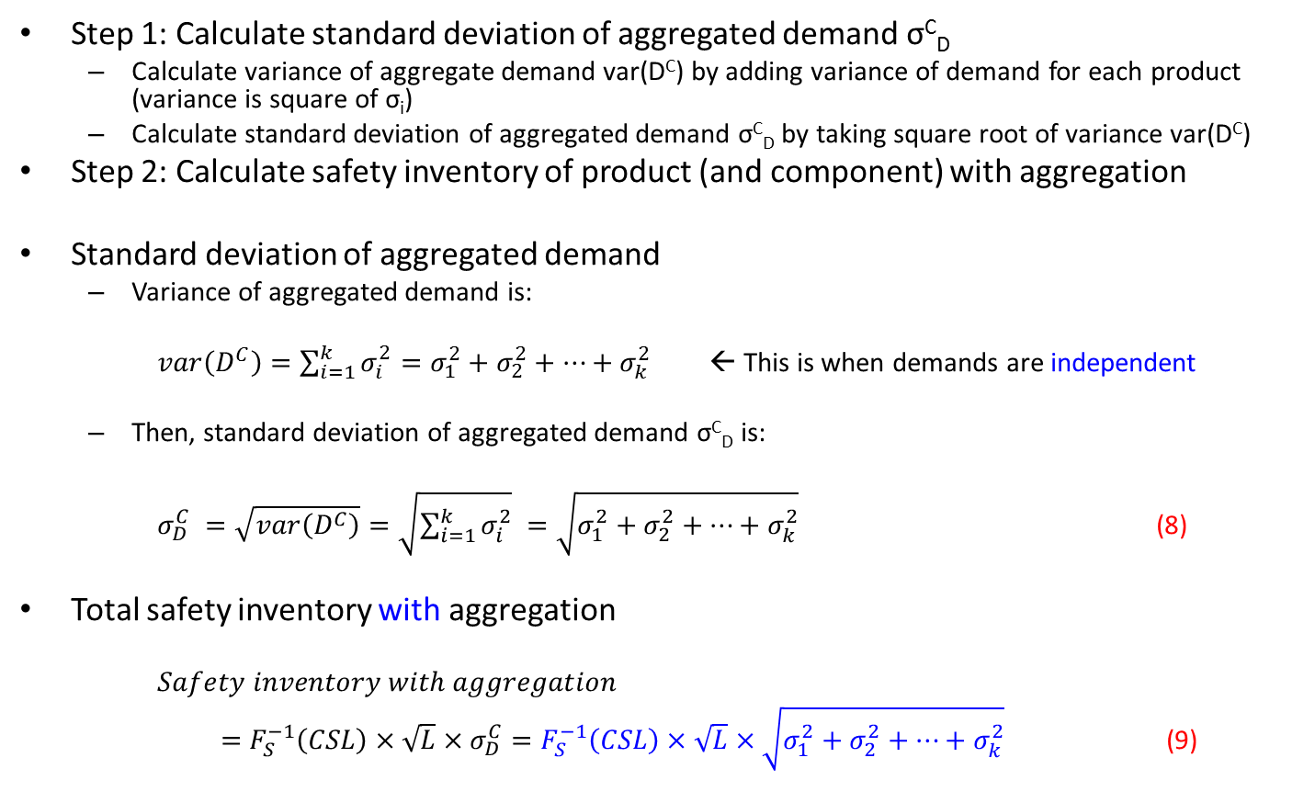
Safety Inventory with Aggregation
Step 1: Calculate standard deviation of aggregated demand σ^{C}_{D}
  Calculate variance of aggregate demand var(D^{C}) by adding variance of demand for each product (variance is square of σ_{i})
  Calculate standard deviation of aggregated demand σ^{C}_{D} by taking square root of variance var(D^{C})
Step 2: Calculate safety inventory of product (and component) with aggregation
Standard deviation of aggregated demand
  Variance of aggregated demand is:
  $var\left(D^{C}\right)=\sum_{i=1}^{k}{σ_{i}^{2}}=σ_{1}^{2}+σ_{2}^{2}+…+σ_{k}^{2}$ ← This is when demands are independent
  Then, standard deviation of aggregated demand σ^{C}_{D} is:
  $σ_{D}^{C} =\sqrt{var\left(D^{C}\right)}=\sqrt{\sum_{i=1}^{k}{σ_{i}^{2}}} =\sqrt{σ_{1}^{2}+σ_{2}^{2}+…+σ_{k}^{2}}$ (8)
Total safety inventory with aggregation
  $Safety inventory with aggregation$
  $=F_{S}^{−1}\left(CSL\right)×\sqrt{L}×σ_{D}^{C}=F_{S}^{−1}\left(CSL\right)×\sqrt{L}×\sqrt{σ_{1}^{2}+σ_{2}^{2}+…+σ_{k}^{2}}$(9)
(Source) Supply Chain Management: Strategy, Planning, and Operation. Sunil Chopra and Peter Meindl. (2013) 5th Edition. Boston, MA: Pearson Prentice-Hall.

Slide 27
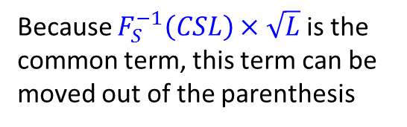
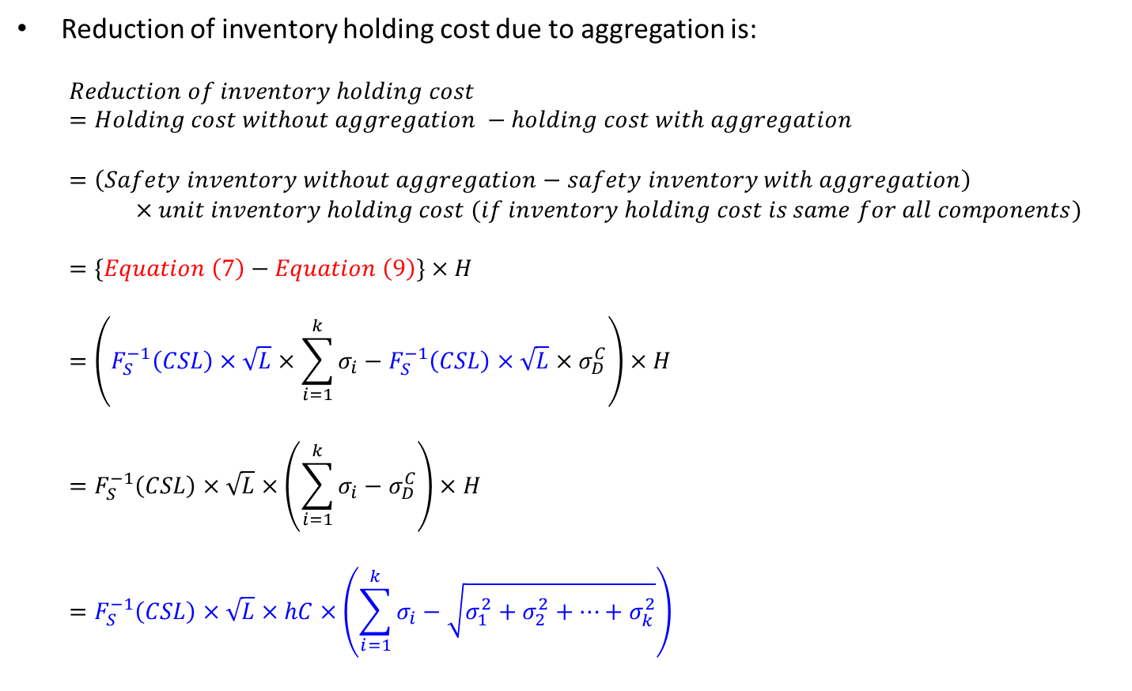
Reduction in Inventory Holding Cost
Reduction of inventory holding cost due to aggregation is:
  $$Reduction of inventory holding cost$$
  $$=Holding cost without aggregation −holding cost with aggregation$$
  $$=\left(Safety inventory without aggregation−safety inventory with aggregation\right)$$
  $×unit inventory holding cost (if inventory holding cost is same for all components)$
  $$=\{Equation \left(7\right)−Equation \left(9\right)\}×H$$
  $$=\left(F_{S}^{−1}\left(CSL\right)×\sqrt{L}×\sum_{i=1}^{k}{σ_{i}}−F_{S}^{−1}\left(CSL\right)×\sqrt{L}{×σ}_{D}^{C}\right)×H$$
  $$=F_{S}^{−1}\left(CSL\right)×\sqrt{L}×\left(\sum_{i=1}^{k}{σ_{i}}−σ_{D}^{C}\right)×H$$
  $$=F_{S}^{−1}\left(CSL\right)×\sqrt{L}×hC×\left(\sum_{i=1}^{k}{σ_{i}}−\sqrt{σ_{1}^{2}+σ_{2}^{2}+…+σ_{k}^{2}}\right)$$
Because $F_{S}^{−1}\left(CSL\right)×\sqrt{L}$ is the common term, this term can be moved out of the parenthesis
(Source) Supply Chain Management: Strategy, Planning, and Operation. Sunil Chopra and Peter Meindl. (2013) 5th Edition. Boston, MA: Pearson Prentice-Hall.

Slide 28
Problem

Slide 29
Question
An electric bike company e-Motion designs, makes, and sells three models, EM-100, EM-200, and EM-300, with the following weekly demand
  EM-100: average of 10, standard deviation of 4
  EM-200: average of 20, standard deviation of 8
  EM-300: average of 5, standard deviation of 1
Currently, motor with different nominal output is used in each model
  EM-100: 250 watt motor
  EM-200: 500 watt motor
  EM-300: 350 watt motor
  Lead time of all these motors are 4 weeks (no standard deviation of lead time)
e-Motion operates with continuous review replenishment policy
Questions
  If e-Motion wishes to achieve 99% cycle service level (CSL),
  (1-1) What is the safety inventory of each motor?
  If e-Motion decides to use 500 watt motor for all models while achieving 99% CSL,
  (1-2) What is the safety inventory of the motor?
  If inventory holding cost of each motor is $60 per unit per year,
  (1-3) How much inventory holding cost will e-Motion save by using common motor?

Slide 30
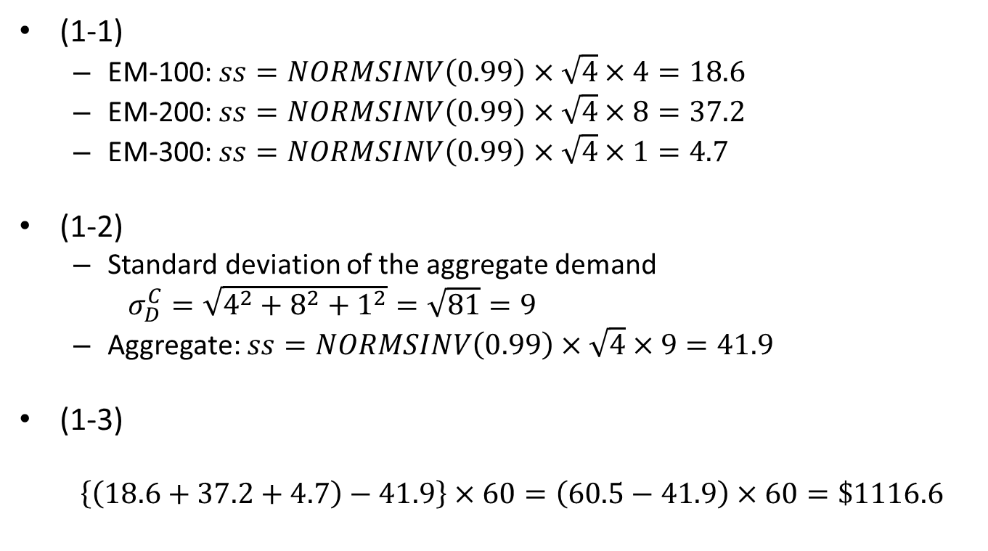
Answer
(1-1)
  EM-100: $ss=NORMSINV\left(0.99\right)×\sqrt{4}×4=18.6$
  EM-200: $ss=NORMSINV\left(0.99\right)×\sqrt{4}×8=37.2$
  EM-300: $ss=NORMSINV\left(0.99\right)×\sqrt{4}×1=4.7$
(1-2)
  Standard deviation of the aggregate demand
  $σ_{D}^{C}=\sqrt{4^{2}+8^{2}+1^{2}}=\sqrt{81}=9$
  Aggregate: $ss=NORMSINV\left(0.99\right)×\sqrt{4}×9=41.9$
(1-3)
  $$\left\{\left(18.6+37.2+4.7\right)−41.9\right\}×60=\left(60.5−41.9\right)×60=\$1116.6$$

