Slide 1

Uncertainty in Mechanics of Materials

Slide 2
Outline
Uncertainty in mechanics of materials
Why consider uncertainty
Basics of uncertainty
Uncertainty analysis in mechanics of materials
Examples
Applications
2

Slide 3
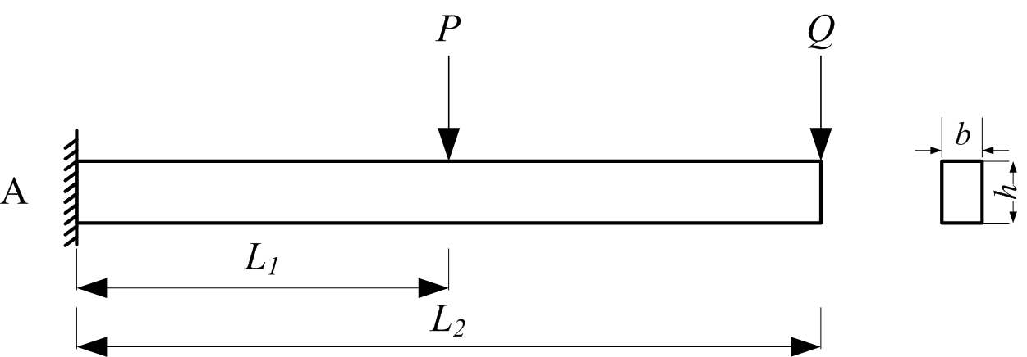
Uncertainty in Mechanics of Materials
Example
Given: P=100 kN, Q=40 kN, L₁ =0.5 m, L₂ =1 m, b=0.1 m, h=0.2 m
Find: The maximum normal stress S_{max}
Solution: S_{max}=135 MPa
In reality, all the input variables are random. So is S_{max}.
S_{max} will fluctuate around 135 MPa.
3

Slide 4
Where Does Uncertainty Come From?
4
Manufacturing impression
  Dimensions of a mechanism
  Material properties
Environment
  Loading
  Temperature
  Different users

Slide 5
Why Consider Uncertainty?
5
We know the true solution.
We know the effect of uncertainty.
We can make more reliable decisions.
  If we know uncertainties in the above beam problem, we can design a better beam so that its likelihood of failure will be low and its performance will be not affected by the uncertainties.

Slide 6
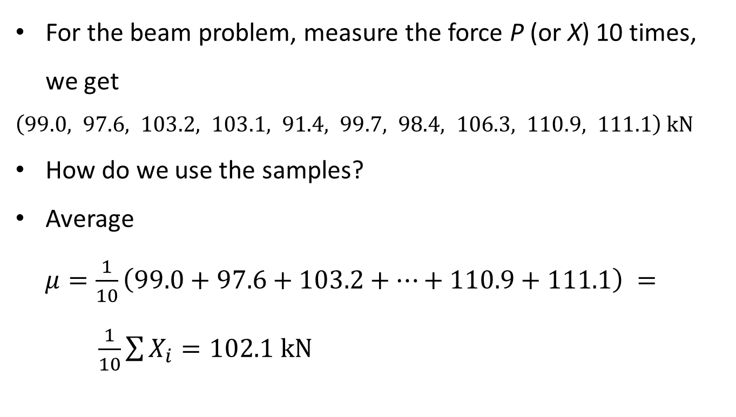
How Do We Model Uncertainty?
For the beam problem, measure the force P (or X) 10 times,
we get $\left(99.0, 97.6, 103.2, 103.1, 91.4, 99.7, 98.4, 106.3, 110.9, 111.1\right) kN$
How do we use the samples?
Average
$μ=\frac{1}{10}\left(99.0+97.6+103.2+…+110.9+111.1\right) = \frac{1}{10}\sum{X_{i}=102.1 kN}$
6

Slide 7
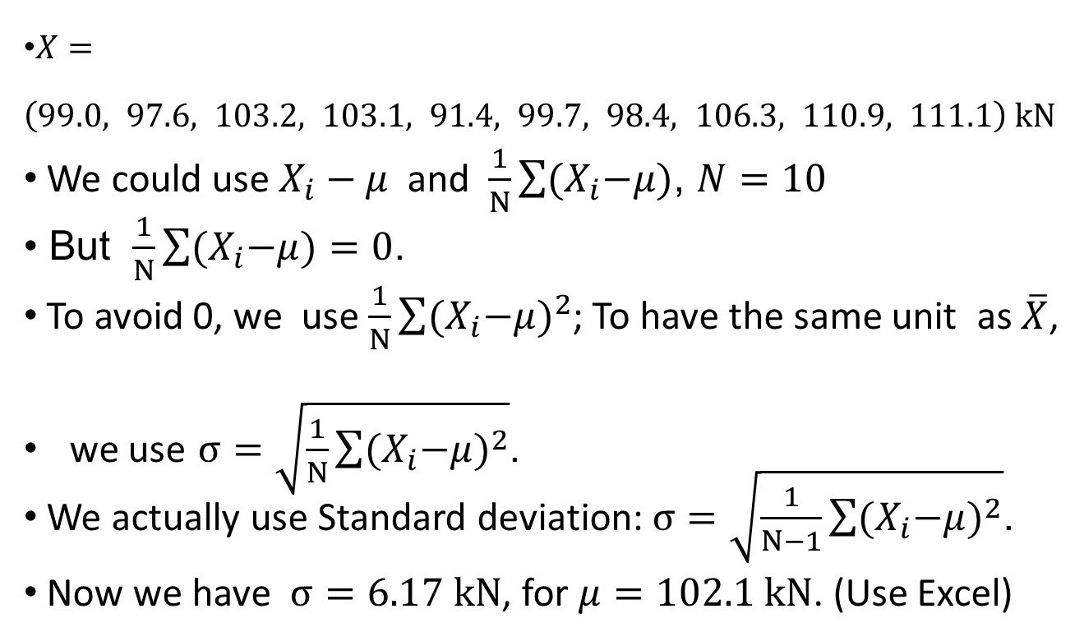
How Do We Measure the Dispersion?
$X=\left(99.0, 97.6, 103.2, 103.1, 91.4, 99.7, 98.4, 106.3, 110.9, 111.1\right) kN$
We could use $X_{i}−μ$and $\frac{1}{N}\sum{{(X}_{i}−μ)}$, $N=10$
But $\frac{1}{N}\sum{{(X}_{i}−μ})=0$.
To avoid 0, we use $\frac{1}{N}\sum{{{(X}_{i}−μ)}^{2}}$; To have the same unit as $\overline{X}$,
we use $σ=\sqrt{\frac{1}{N}\sum{{{(X}_{i}−μ)}^{2}}}$.
We actually use Standard deviation: $σ=\sqrt{\frac{1}{N−1}\sum{{{(X}_{i}−μ)}^{2}}}$.
Now we have $σ=6.17 kN$, for $μ=102.1 kN$. (Use Excel)
7

Slide 8
More about Standard Deviation (std)
8
It indicates how data spread around the mean.
It is always non-negative.
High std means
  High dispersion
  High uncertainty
  High risk

Slide 9
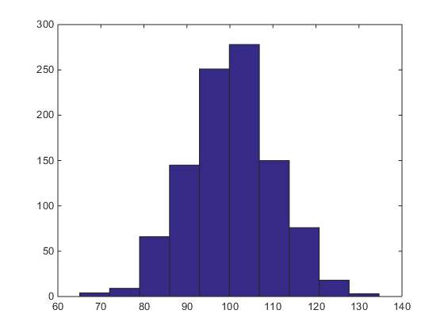
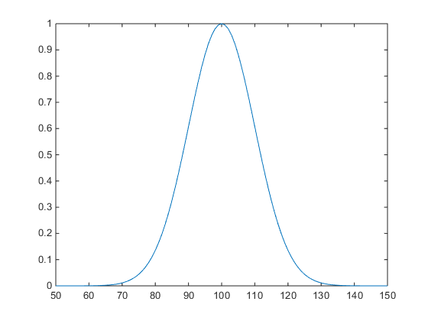
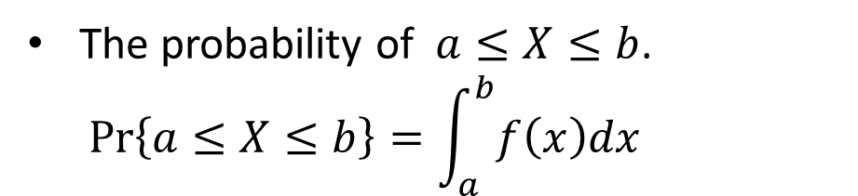
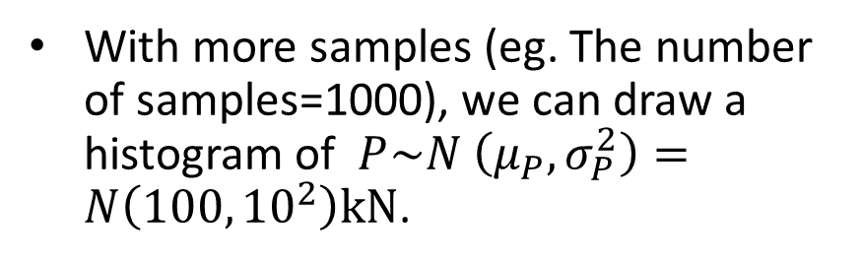
Probability Distribution
With more samples (eg. The number of samples=1000), we can draw a histogram of $P\sim N \left(μ_{P},σ_{P}^{2}\right)=N\left(100,{10}^{2}\right)kN$.
If y-axis is frequency and the number of samples is infinity, we get a probability density function (PDF) .
The probability of $a≤X≤b$.
$$Pr\left\{a≤X≤b\right\}=\int_{a}^{b}{f\left(x\right)dx}$$
9

Slide 10
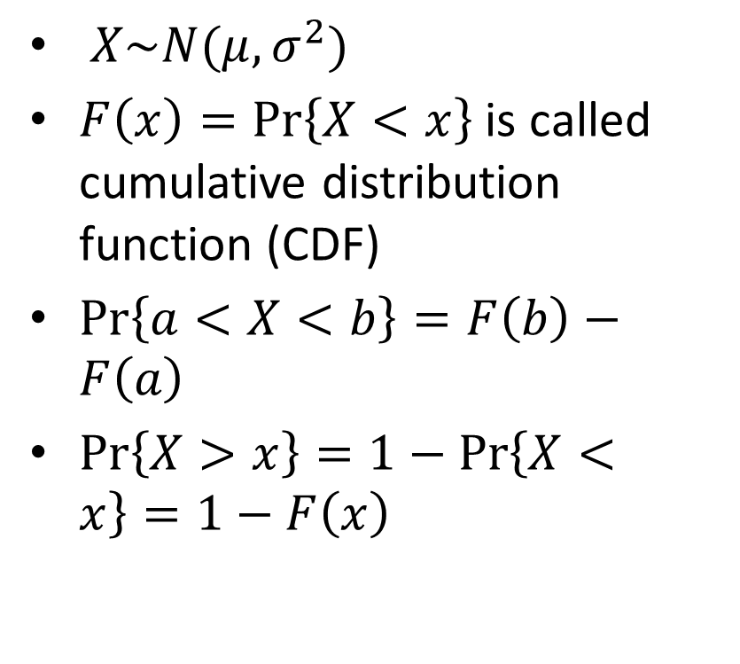
Normal Distribution
$X\sim N(μ,σ^{2})$
$F\left(x\right)=Pr\left\{X<x\right\}$ is called cumulative distribution function (CDF)
$Pr\left\{a<X<b\right\}=F\left(b\right)−F\left(a\right)$
$Pr\left\{X>x\right\}=1−Pr\left\{X<x\right\}=1−F\left(x\right)$
10

Slide 11

11
Use Excel
  NORMDIST(x,mean,std,cumulative)
  cumulative=true

Slide 12
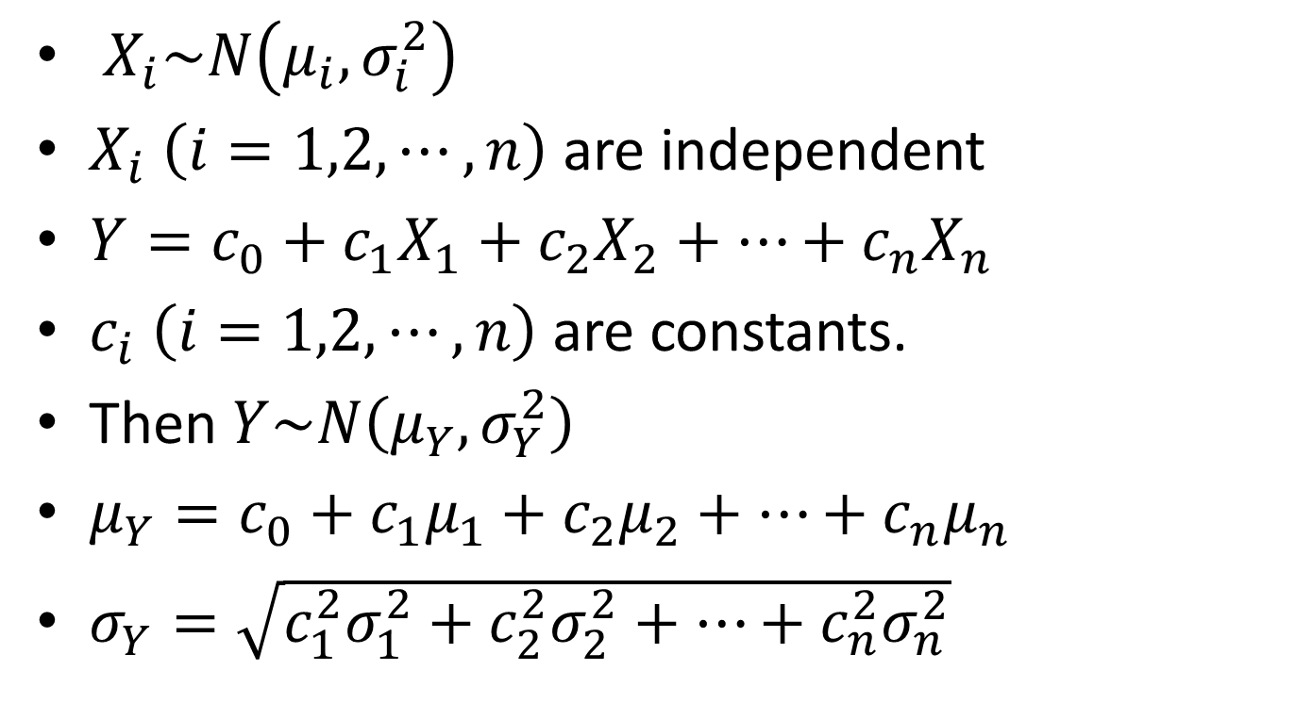
More Than One Random Variables
$X_{i}\sim N\left(μ_{i},σ_{i}^{2}\right)$
$X_{i}$ $\left(i=1,2,⋯,n\right)$ are independent
$Y=c_{0}+c_{1}X_{1}+c_{2}X_{2}+⋯+c_{n}X_{n}$
$c_{i} \left(i=1,2,⋯,n\right)$ are constants.
Then $Y\sim N\left(μ_{Y},σ_{Y}^{2}\right)$
$μ_{Y}=c_{0}+c_{1}μ_{1}+c_{2}μ_{2}+⋯+c_{n}μ_{n}$
$σ_{Y}=\sqrt{c_{1}^{2}σ_{1}^{2}+c_{2}^{2}σ_{2}^{2}+⋯+c_{n}^{2}σ_{n}^{2}}$
12

Slide 13
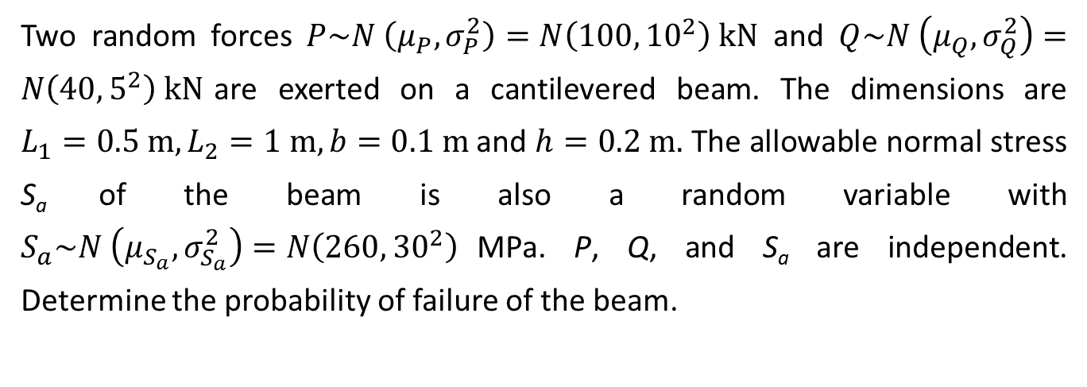
Example
Two random forces $P\sim N \left(μ_{P},σ_{P}^{2}\right)=N\left(100,{10}^{2}\right) kN$ and $Q\sim N \left(μ_{Q},σ_{Q}^{2}\right)=N\left(40,5^{2}\right) kN$are exerted on a cantilevered beam. The dimensions are $L_{1}=0.5 m,L_{2}=1 m, b=0.1 m$and $h=0.2 m.$ The allowable normal stress S_{a} of the beam is also a random variable with $S_{a}\sim N \left(μ_{S_{a}},σ_{S_{a}}^{2}\right)=N\left(260,{30}^{2}\right)$MPa. P, Q, and S_{a} are independent. Determine the probability of failure of the beam.
13

Slide 14
Moment Diagram
14

Slide 15
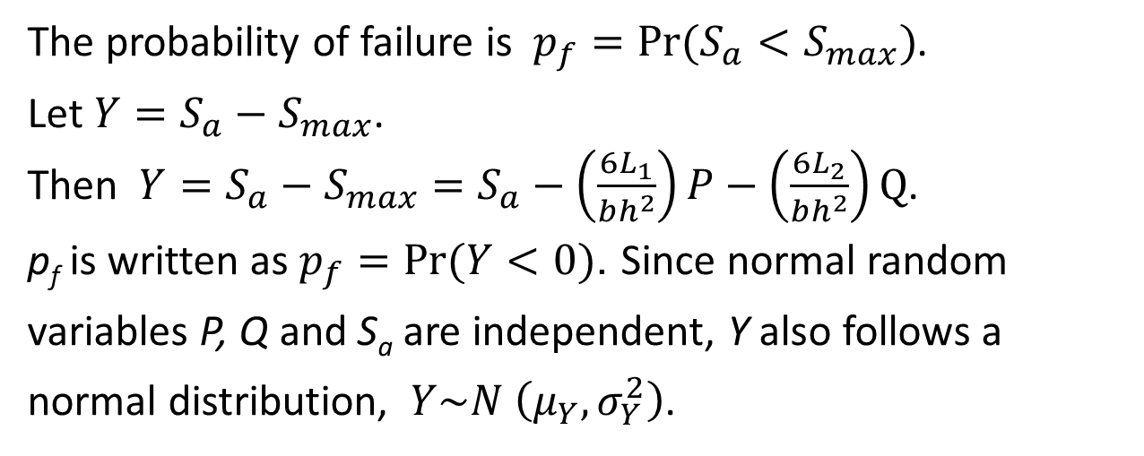
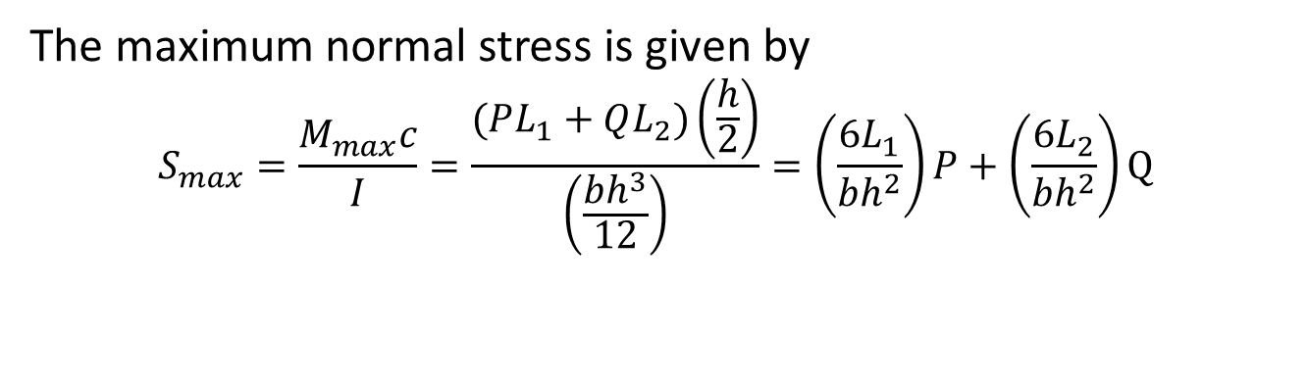
The maximum normal stress is given by
$$S_{max}=\frac{M_{max}c}{I}=\frac{(PL_{1}+QL_{2})\left(\frac{h}{2}\right)}{\left(\frac{bh^{3}}{12}\right)}=\left(\frac{6L_{1}}{bh^{2}}\right)P+\left(\frac{6L_{2}}{bh^{2}}\right)Q$$
The probability of failure is $p_{f}=Pr(S_{a}<S_{max})$.
Let ${Y=S}_{a}−S_{max}$.
Then ${Y=S}_{a}−S_{max}=S_{a}−\left(\frac{6L_{1}}{bh^{2}}\right)P−\left(\frac{6L_{2}}{bh^{2}}\right)Q$.
p_{f} is written as $p_{f}=Pr(Y<0)$. Since normal random
variables P, Q and S_{a} are independent, Y also follows a
normal distribution, $Y\sim N \left(μ_{Y},σ_{Y}^{2}\right)$.
15

Slide 16
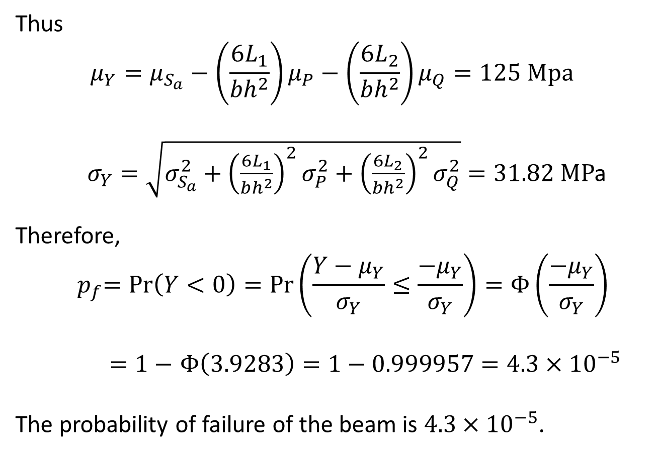
Thus
$$μ_{Y}=μ_{S_{a}}−\left(\frac{6L_{1}}{bh^{2}}\right)μ_{P}−\left(\frac{6L_{2}}{bh^{2}}\right)μ_{Q}=125 Mpa$$
$σ_{Y}=\sqrt{σ_{S_{a}}^{2}+{\left(\frac{6L_{1}}{bh^{2}}\right)}^{2}σ_{P}^{2}+{\left(\frac{6L_{2}}{bh^{2}}\right)}^{2}σ_{Q}^{2}}=31.82 MP$a
Therefore,
$${ p}_{f}=Pr\left(Y<0\right)=Pr\left(\frac{Y−μ_{Y}}{σ_{Y}}≤\frac{−μ_{Y}}{σ_{Y}}\right)=Φ\left(\frac{−μ_{Y}}{σ_{Y}}\right)$$
$=1−$ $Φ\left(3.9283\right)=1−0.999957=4.3×{10}^{−5}$
The probability of failure of the beam is $4.3×{10}^{−5}$.
16

Slide 17
Conclusions
Uncertainty is ubiquitous in engineering, including applications of mechanics of materials.
Uncertainty is usually modeled by probability theory.
Considering uncertainty promotes high reliability, robustness, and safety.

Slide 18
Assignment
18
On Blackboard.
More readings: http://web.mst.edu/~dux/repository/ce110/ce110.html

