Slide 1
Deal with Uncertainty in Dynamics

Slide 2
Outline
Uncertainty in dynamics
Why consider uncertainty
Basics of uncertainty
Uncertainty analysis in dynamics
Examples
Applications

Slide 3
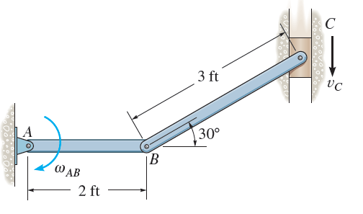
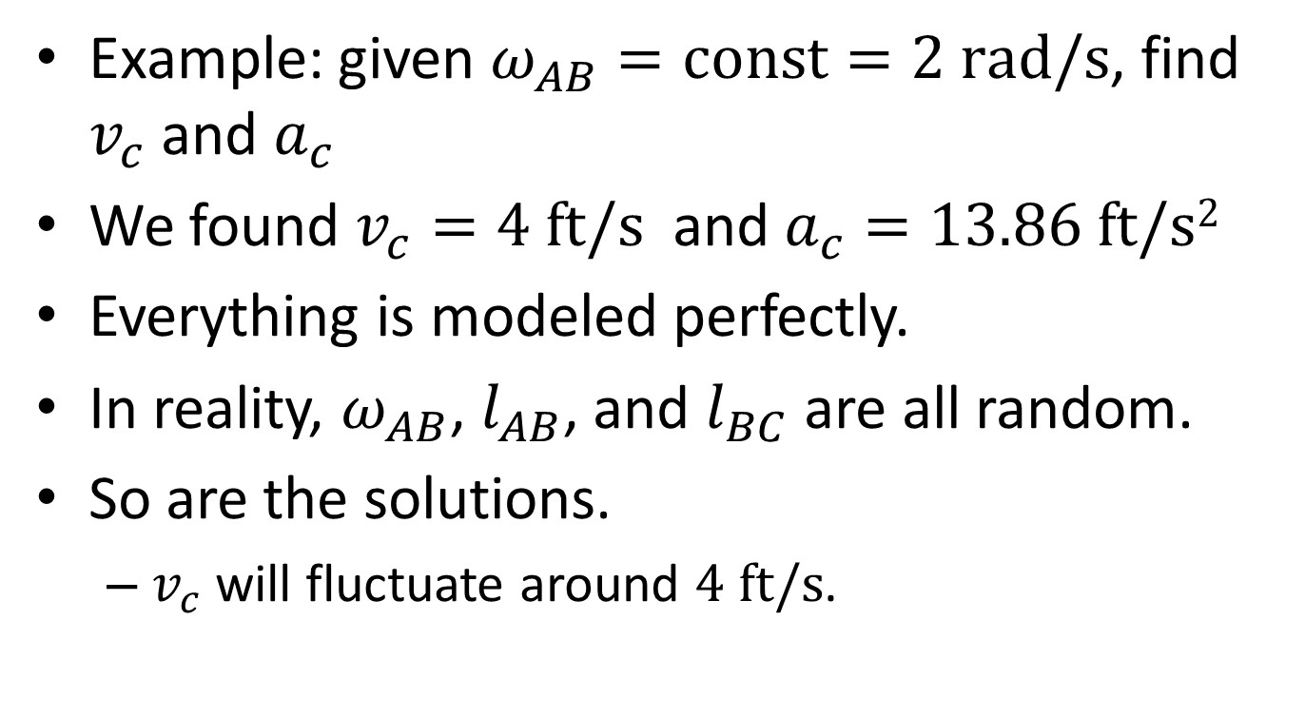
Uncertainty in Dynamics
Example: given $ω_{AB}=const=2 rad/s$, find $v_{c}$ and $a_{c}$
We found $v_{c}=4 ft/s$ and $a_{c}=13.86 ft/s2$
Everything is modeled perfectly.
In reality, $ω_{AB}$, $l_{AB}$, and $l_{BC}$ are all random.
So are the solutions.
  $v_{c}$ will fluctuate around $4 ft/s$.

Slide 4
Where Does Uncertainty Come From?
Manufacturing impression
  Dimensions of a mechanism
  Material properties
Environment
  Loading
  Temperature
  Different users

Slide 5
Why Consider Uncertainty?
We know the true solution.
We know the effect of uncertainty.
We can make more reliable decisions.
  If we know uncertainty in the traffic to the airport, we can better plan our trip and have lower chance of missing flights.

Slide 6
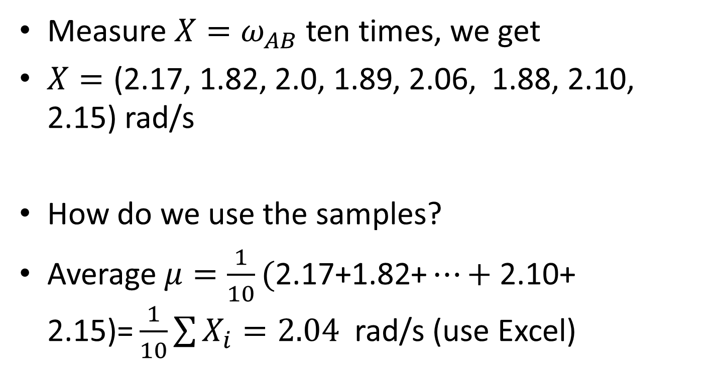
How Do We Model Uncertainty?
Measure ${X=ω}_{AB}$ ten times, we get
$X=\text{(2.17, 1.82, 2.0, 1.89, 2.06, 1.88, 2.10, 2.15)}$ rad/s
How do we use the samples?
Average $μ=\frac{1}{10}\text{(}\text{2.17}\text{+}\text{1.82}\text{+}…+\text{2.10}\text{+ }\text{2.15}\text{)=}\frac{1}{10}\sum{X_{i}=2.04}$ rad/s (use Excel)

Slide 7
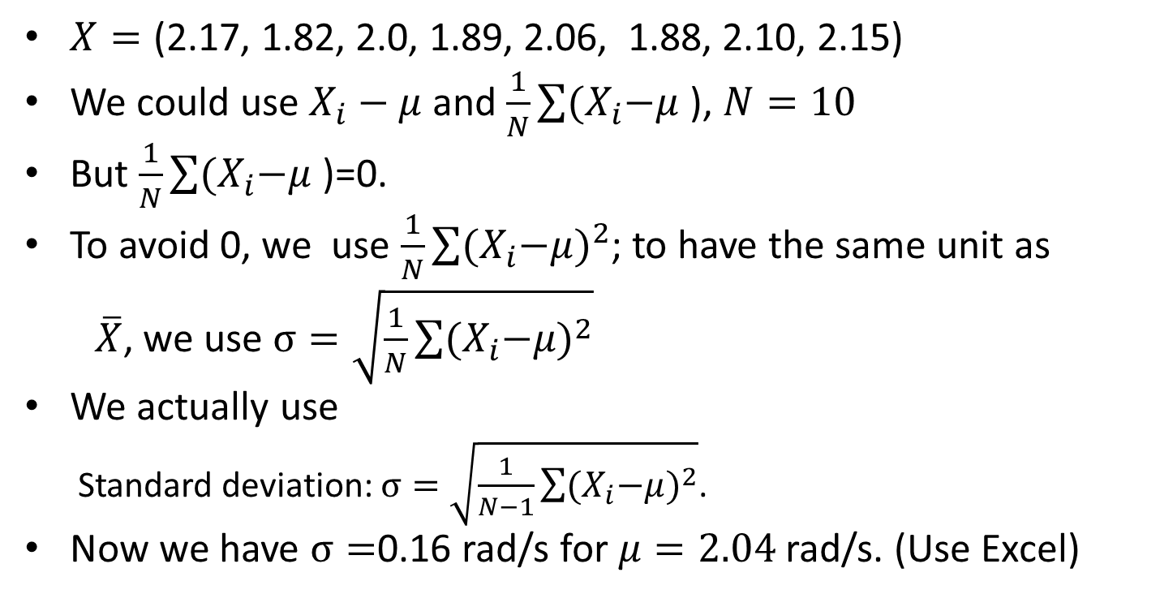
How Do We Measure the Dispersion?
$X=\text{(2.17, 1.82, 2.0, 1.89, 2.06, 1.88, 2.10, 2.15)}$
We could use $X_{i}−μ$and $\frac{1}{N}\sum{{(X}_{i}−μ}$ ), $N=10$
But $\frac{1}{N}\sum{{(X}_{i}−μ}$ )=0.
To avoid 0, we use $\frac{1}{N}\sum{{{(X}_{i}−μ)}^{2}}$; to have the same unit as
$\overline{X}$, we use $σ=\sqrt{\frac{1}{N}\sum{{{(X}_{i}−μ)}^{2}}}$
We actually use
  Standard deviation: $σ=\sqrt{\frac{1}{N−1}\sum{{{(X}_{i}−μ)}^{2}}}$.
Now we have $σ=$0.16 rad/s for $μ=2.04$ rad/s. (Use Excel)

Slide 8
More about Standard Deviation (std)
It indicates how data spread around the mean.
It is always non-negative.
High std means
  High dispersion
  High uncertainty
  High risk

Slide 9
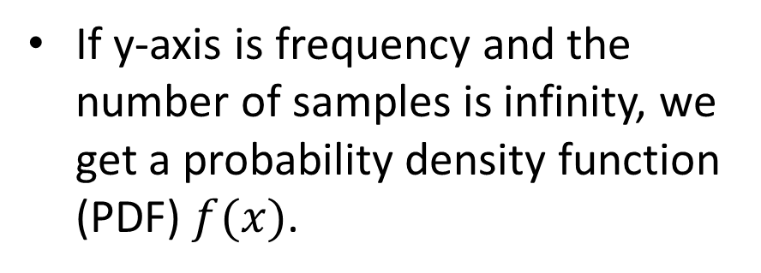
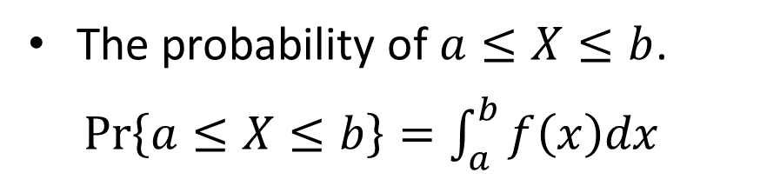
Probability Distribution
With more samples, we can draw a histogram.
If y-axis is frequency and the number of samples is infinity, we get a probability density function (PDF) $f(x)$.
The probability of $a≤X≤b$.
$Pr\left\{a≤X≤b\right\}=\int_{a}^{b}{f\left(x\right)dx}$

Slide 10
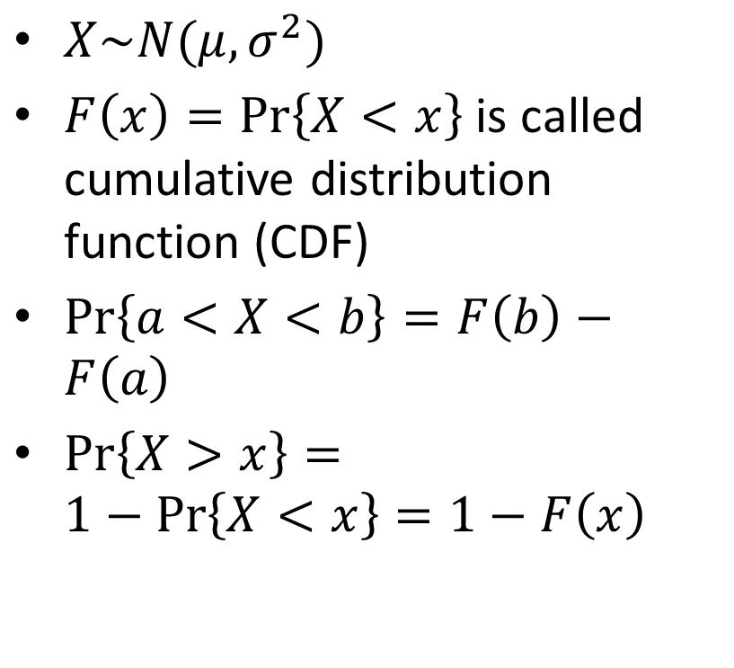
Normal Distribution
$X\sim N(μ,σ^{2})$
$F\left(x\right)=Pr\left\{X<x\right\}$ is called cumulative distribution function (CDF)
$Pr\left\{a<X<b\right\}=F\left(b\right)−F\left(a\right)$
$Pr\left\{X>x\right\}=1−Pr\left\{X<x\right\}=1−F\left(x\right)$

Slide 11

How to Calculate $F\left(x\right)$?
Use Excel
  NORMDIST(x,mean,std,cumulative)
  cumulative=true

Slide 12
Example 1
1 | 62.2
2 | 58.2
3 | 70.9
4 | 64.9
5 | 68.3
6 | 67.9
7 | 67.1
8 | 63.0
9 | 63.2
10 | 65.5
11 | 62.3
12 | 62.8
13 | 72.9
14 | 67.2
15 | 62.1
16 | 66.8
17 | 62.5
18 | 61.6
19 | 66.0
20 | 70.8
Average speeds (mph) of 20 drivers from S&T to STL airport were recoded.
The average speed is normally distributed.
  Mean =? Std = ?
  What is the probability that a person gets to the airport in 2 hrs if d = 120 mile?

Slide 13
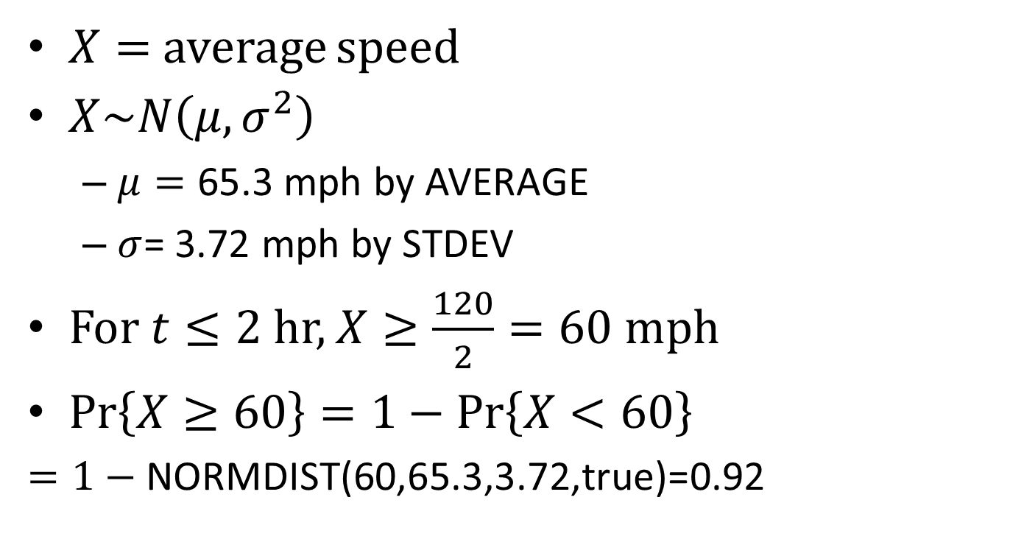
Solution: Use Excel
$X=$ average speed
$X\sim N\left(μ,σ^{2}\right)$
  $μ=\text{65.}\text{3}$ mph by AVERAGE
  $σ$= 3.72 mph by STDEV
For $t≤2$ hr, $X≥\frac{120}{2}=60$ mph
$Pr\left\{X≥60\right\}=1−Pr\left\{X<60\right\}$
  $=1−\text{NORMDIST}\text{(60,65.3,3.72,}\text{true}\text{)=}$0.92

Slide 14
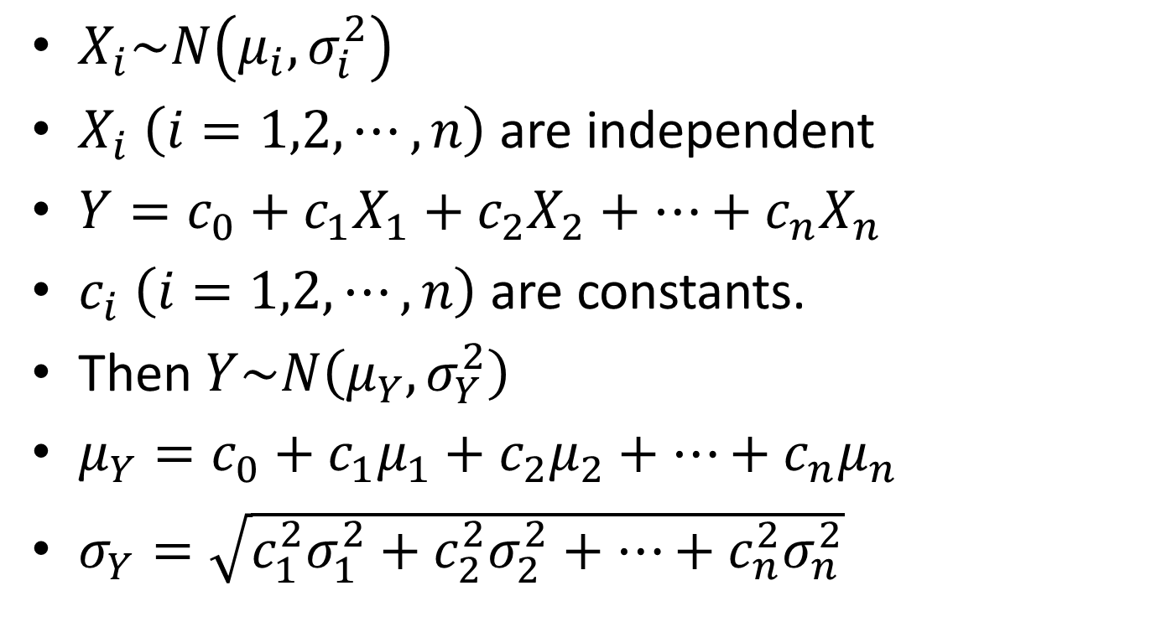
More Than One Random Variables
$X_{i}\sim N\left(μ_{i},σ_{i}^{2}\right)$
$X_{i}$ $\left(i=1,2,⋯,n\right)$ are independent
$Y=c_{0}+c_{1}X_{1}+c_{2}X_{2}+⋯+c_{n}X_{n}$
$c_{i} \left(i=1,2,⋯,n\right)$ are constants.
Then $Y\sim N\left(μ_{Y},σ_{Y}^{2}\right)$
$μ_{Y}=c_{0}+c_{1}μ_{1}+c_{2}μ_{2}+⋯+c_{n}μ_{n}$
$σ_{Y}=\sqrt{c_{1}^{2}σ_{1}^{2}+c_{2}^{2}σ_{2}^{2}+⋯+c_{n}^{2}σ_{n}^{2}}$

Slide 15
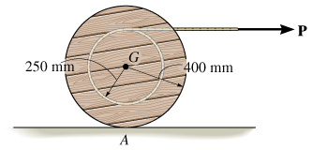
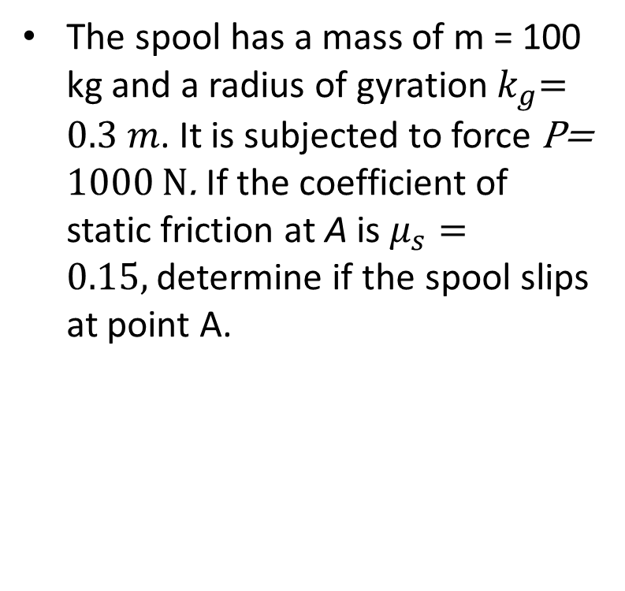
Example 2
The spool has a mass of m = 100 kg and a radius of gyration${ k}_{g}=0.3 m$. It is subjected to force P= 1000 N. If the coefficient of static friction at A is $μ_{s}=0.15,$determine if the spool slips at point A.

Slide 16
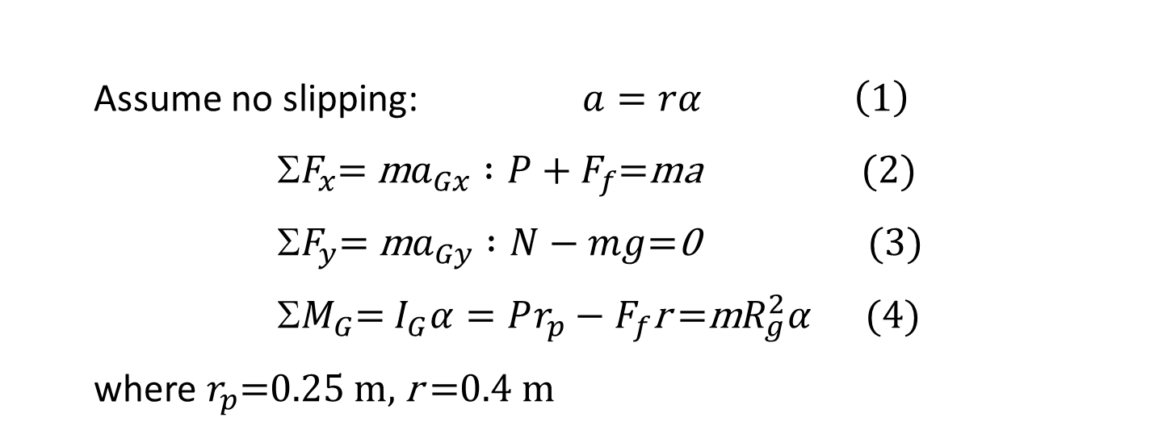
mg
α
P
G
G
a
y
F_{f}
x
N
FBD
KD
Assume no slipping: $a=rα \left(1\right)$
Σ$F_{x}$= m$a_{Gx} :P+F_{f}$=ma (2)
Σ$F_{y}$= m$a_{Gy} :N−mg$=0 (3)
Σ$M_{G}$= $I_{G}α=Pr_{p}−F_{f}$r =m$R_{g}^{2}α$(4)
where $r_{p}$=0.25 m, r =0.4 m

Slide 17
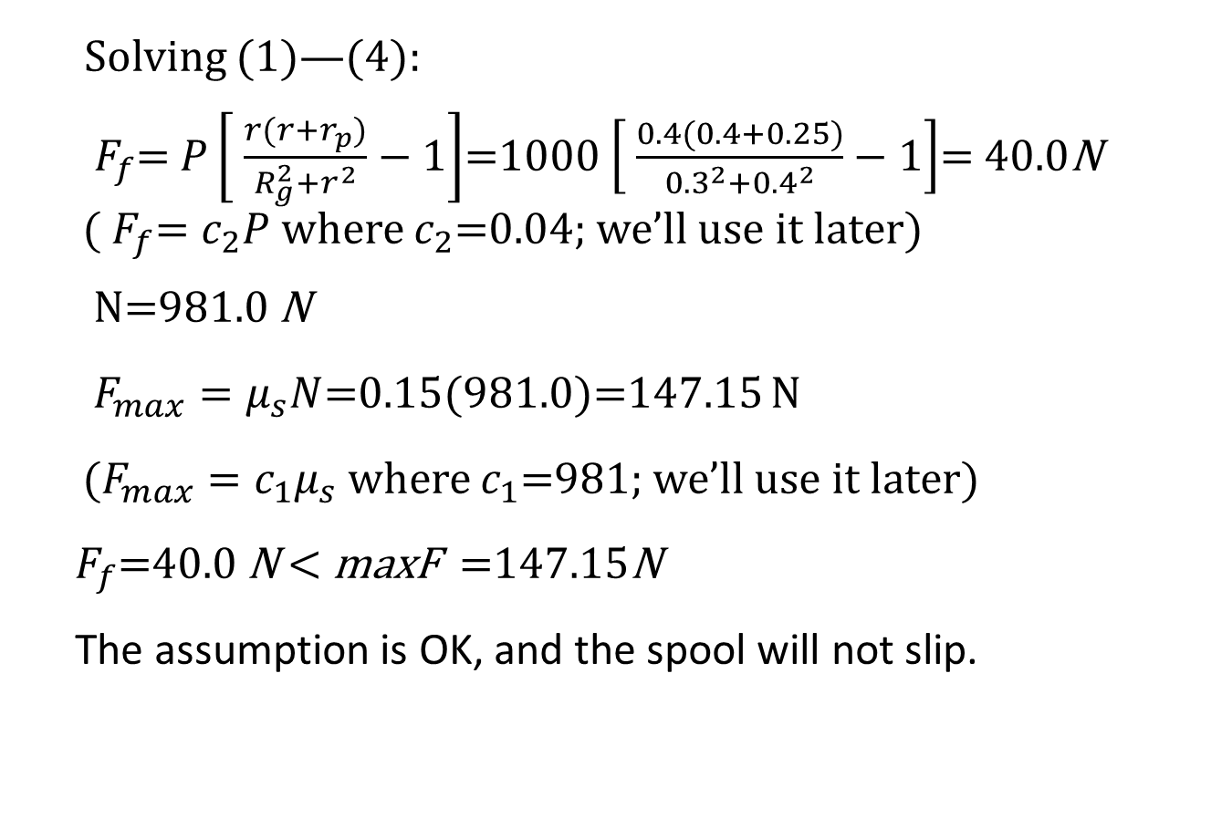
Solving (1)—(4):
${ F}_{f}$= $P\left[ \frac{r(r+r_{p})}{R_{g}^{2}+r^{2}}−1\right]$=1000 $\left[ \frac{0.4(0.4+0.25)}{{0.3}^{2}+{0.4}^{2}}−1\right]$= 40.0N (${ F}_{f}=c_{2}P$ where $c_{2}$=0.04; we’ll use it later)
N=981.0 N
$F_{max}=μ_{s}N$=0.15(981.0)=147.15 N
($F_{max}=c_{1}μ_{s}$ where $c_{1}$=981; we’ll use it later)
$F_{f}$=40.0 N < maxF =147.15N
The assumption is OK, and the spool will not slip.

Slide 18
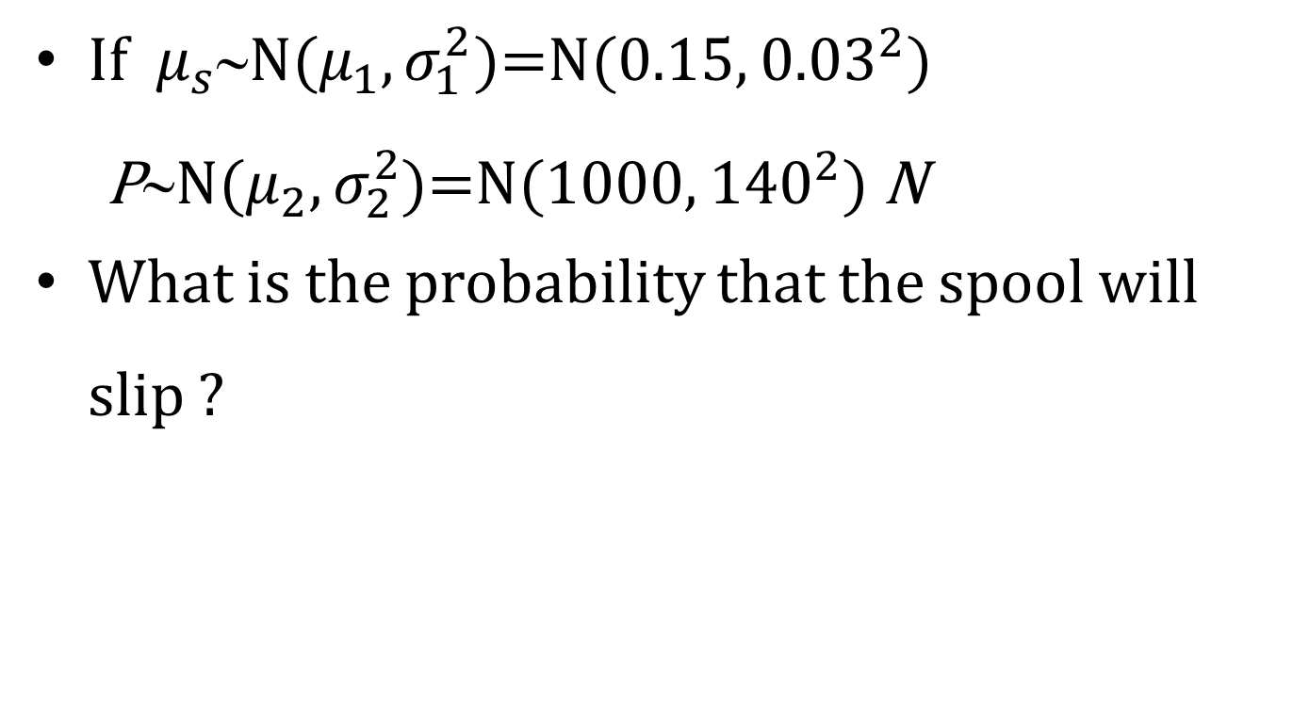
When Consider Uncertainty
If ${ μ}_{s}$∼N($μ_{1},σ_{1}^{2}$)=N(0.15, ${0.03}^{2}$)
P∼N($μ_{2},σ_{2}^{2}$)=N(1000, ${140}^{2}$) N
What is the probability that the spool will slip ?

Slide 19
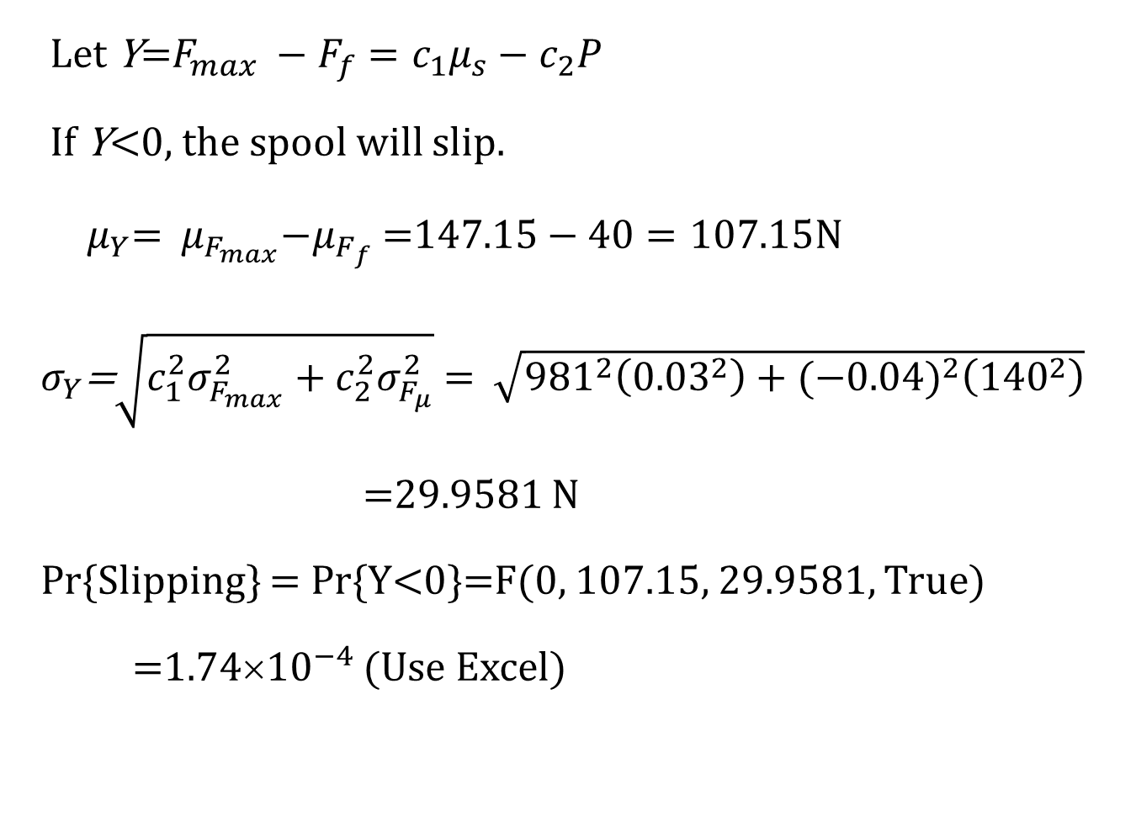
Let Y=$F_{max} −F_{f}=c_{1}μ_{s}−c_{2}P$
If Y<0, the spool will slip.
${ μ}_{Y}$= ${ μ}_{F_{max}}−μ_{F_{f}}$=$147.15−40=107.15N$
${ σ}_{Y}$=$\sqrt{c_{1}^{2}σ_{F_{max}}^{2}+c_{2}^{2}σ_{F_{μ}}^{2}}$ = $\sqrt{{981}^{2}\left({0.03}^{2}\right)+{(−0.04)}^{2}\left({140}^{2}\right)}$
=29.9581 N
Pr{Slipping} = Pr{Y<0}=F(0, 107.15, 29.9581, True)
=1.74×${10}^{−4}$ (Use Excel)

Slide 20
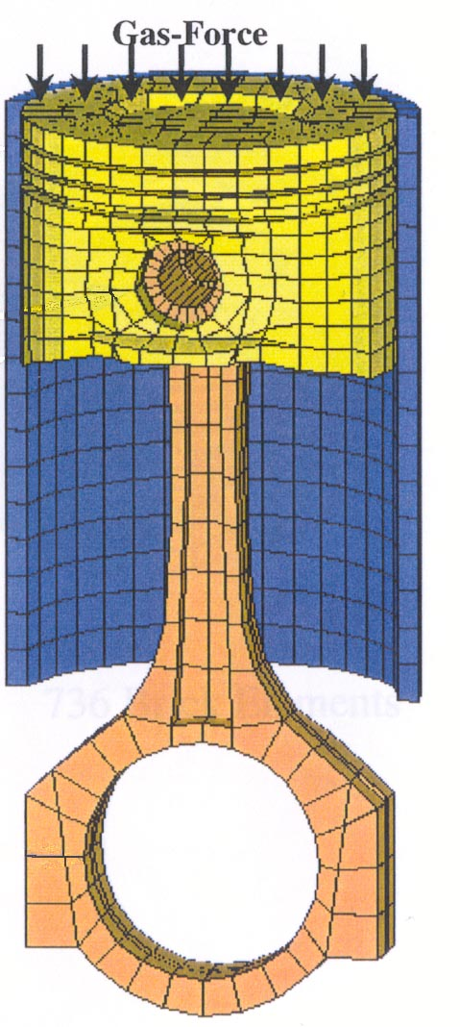
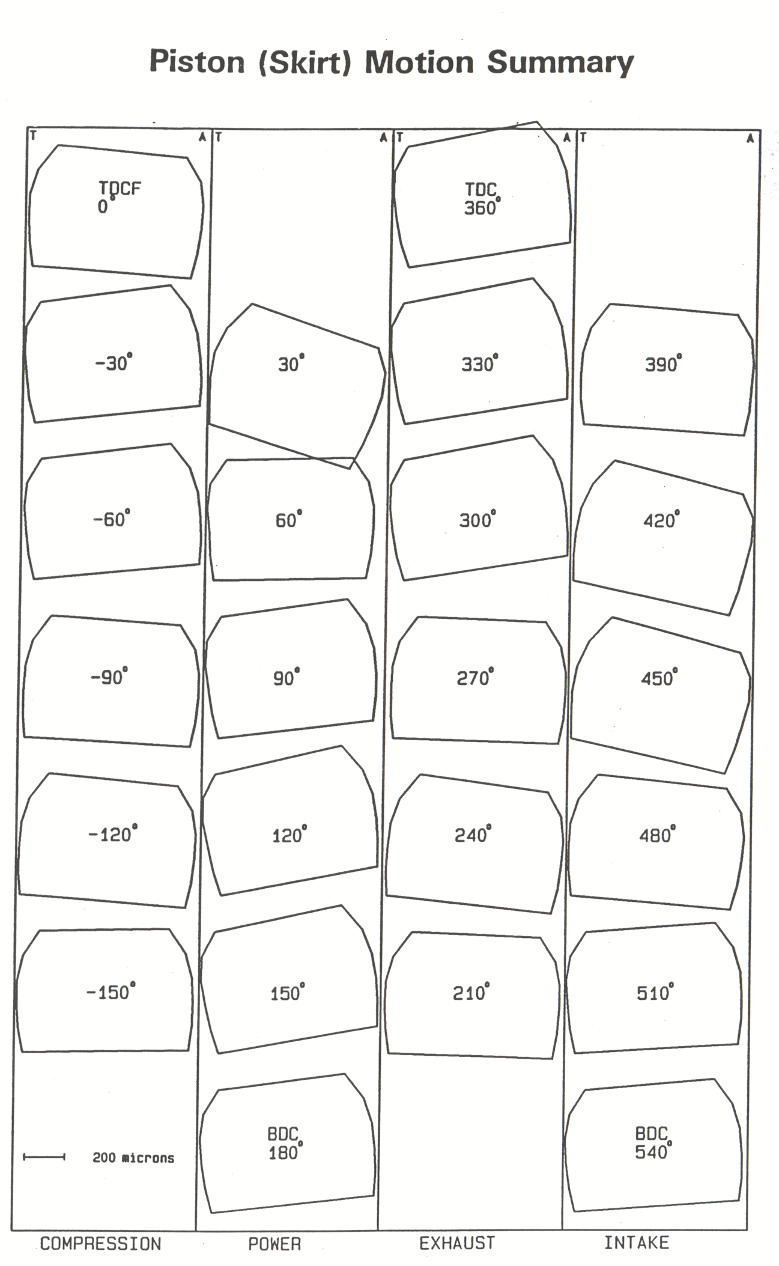
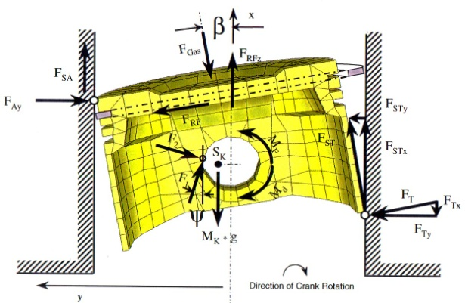
Engine Robust Design

Slide 21
Result Analysis
The mean noise reduced by 0.5%.
The standard deviation reduced by 62.5%.

Slide 22
Assignment
On Blackboard.

