Slide 1
Machine Design Under Uncertainty

Slide 2
Outline
Uncertainty in mechanical components
Why consider uncertainty
Basics of uncertainty
Uncertainty analysis for machine design
Examples
Conclusions

Slide 3
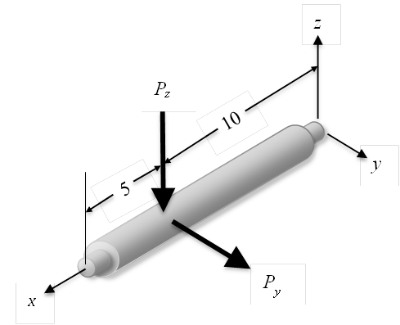
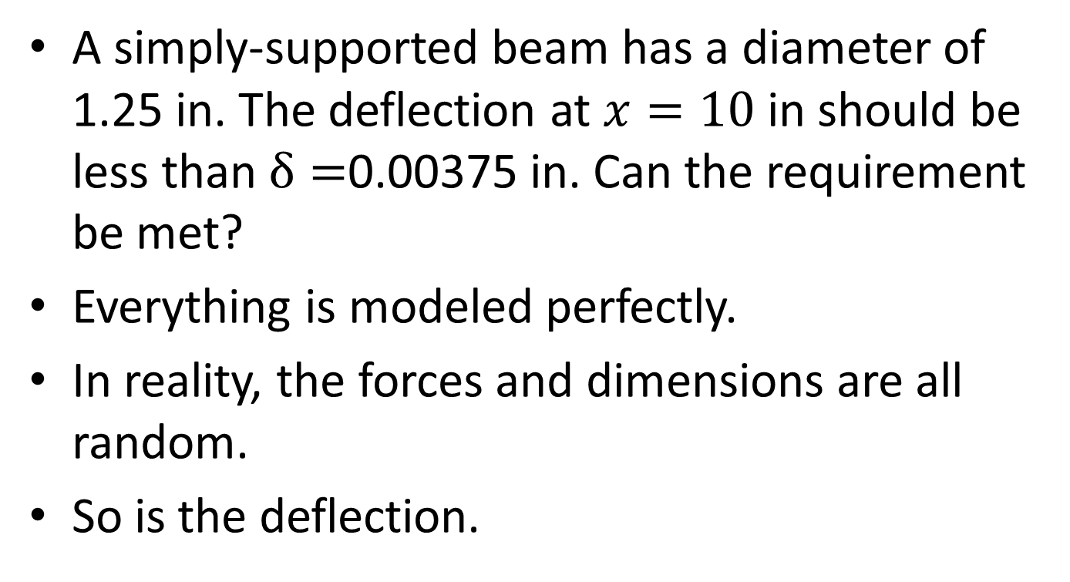
Uncertainty in Mechanical Components
A simply-supported beam has a diameter of 1.25 in. The deflection at $x=10$ in should be less than $δ=$0.00375 in. Can the requirement be met?
Everything is modeled perfectly.
In reality, the forces and dimensions are all random.
So is the deflection.

Slide 4
Where Does Uncertainty Come From?
Manufacturing impression
  Dimensions of a component
  Material properties
Environment
  Loading
  Temperature
  Different users

Slide 5
Why Consider Uncertainty?
We know the true solution.
We know the effect of uncertainty.
We can make more reliable decisions.

Slide 6
How Do We Model Uncertainty?
We use probability distributions to model parameters with uncertainty.

Slide 7
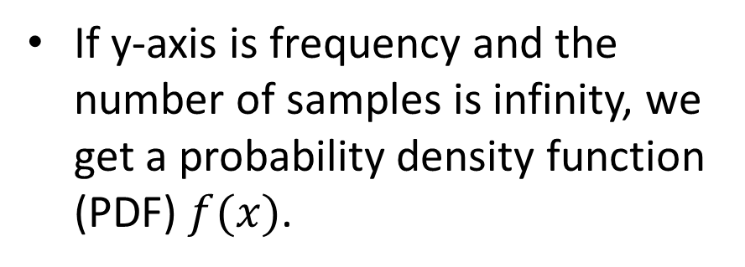
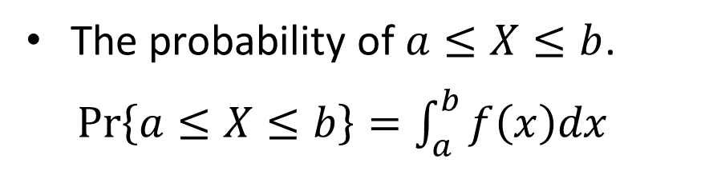
Probability Distribution
With more samples, we can draw a histogram.
If y-axis is frequency and the number of samples is infinity, we get a probability density function (PDF) $f(x)$.
The probability of $a≤X≤b$.
$Pr\left\{a≤X≤b\right\}=\int_{a}^{b}{f\left(x\right)dx}$

Slide 8
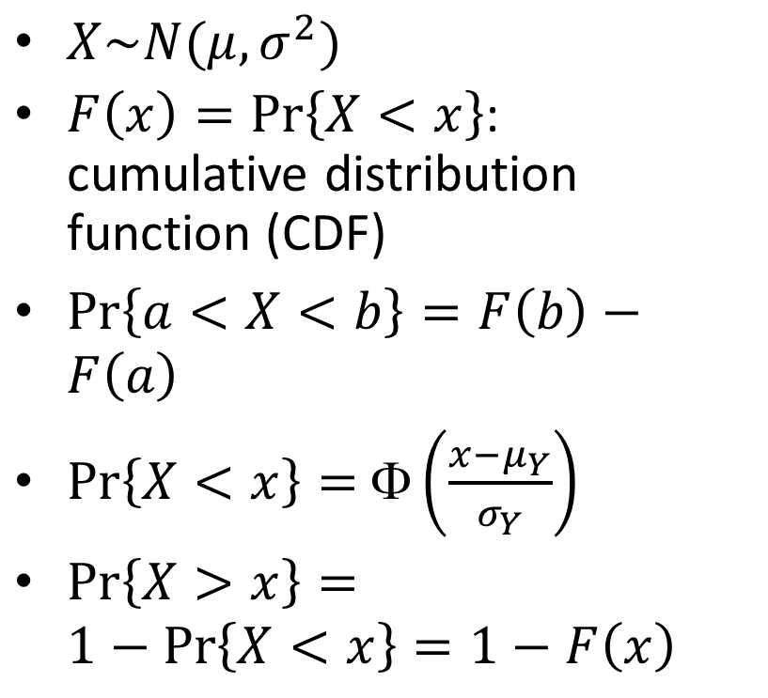
Normal Distribution
$X\sim N(μ,σ^{2})$
$F\left(x\right)=Pr\left\{X<x\right\}$: cumulative distribution function (CDF)
$Pr\left\{a<X<b\right\}=F\left(b\right)−F\left(a\right)$
$Pr\left\{X<x\right\}=$ $\left(\frac{x−μ_{Y}}{σ_{Y}}\right)$
$Pr\left\{X>x\right\}=1−Pr\left\{X<x\right\}=1−F\left(x\right)$

Slide 9
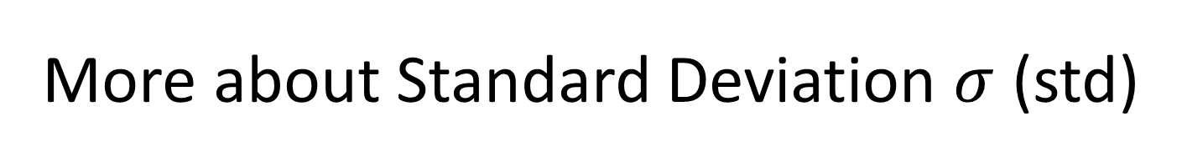
More about Standard Deviation $σ$ (std)
It indicates how data spread around the mean.
It is always non-negative.
High std means
  High dispersion
  High uncertainty
  High risk

Slide 10
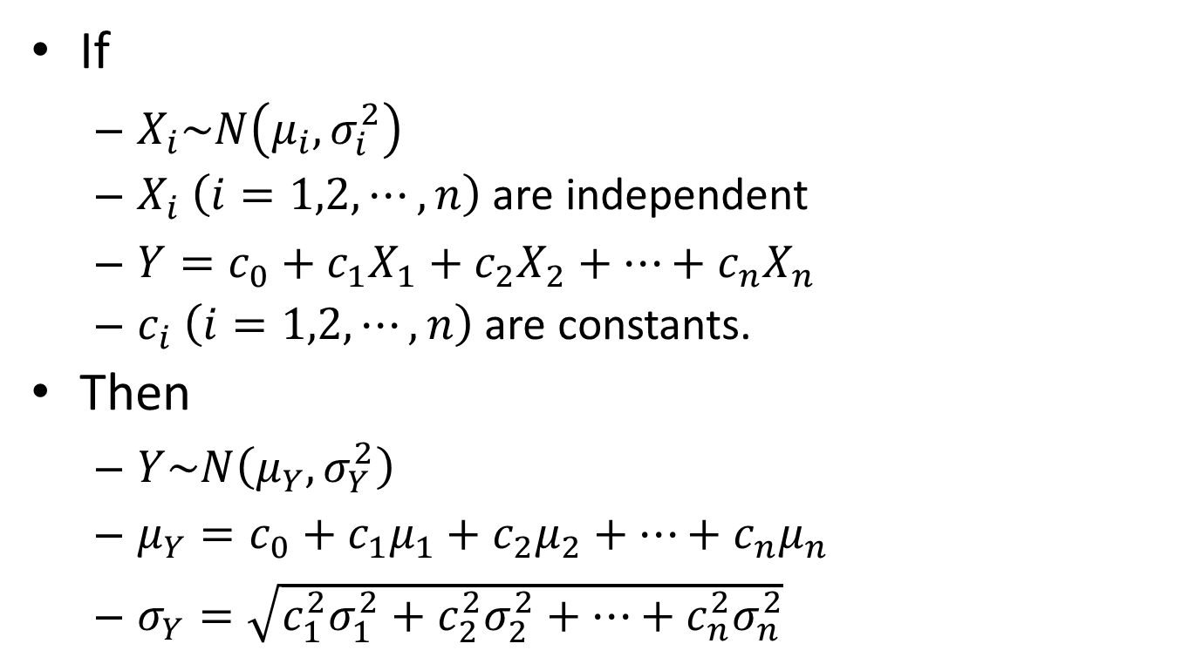
More Than One Random Variables
If
  $X_{i}\sim N\left(μ_{i},σ_{i}^{2}\right)$
  $X_{i}$ $\left(i=1,2,⋯,n\right)$ are independent
  $Y=c_{0}+c_{1}X_{1}+c_{2}X_{2}+⋯+c_{n}X_{n}$
  $c_{i} \left(i=1,2,⋯,n\right)$ are constants.
Then
  $Y\sim N\left(μ_{Y},σ_{Y}^{2}\right)$
  $μ_{Y}=c_{0}+c_{1}μ_{1}+c_{2}μ_{2}+⋯+c_{n}μ_{n}$
  $σ_{Y}=\sqrt{c_{1}^{2}σ_{1}^{2}+c_{2}^{2}σ_{2}^{2}+⋯+c_{n}^{2}σ_{n}^{2}}$

Slide 11
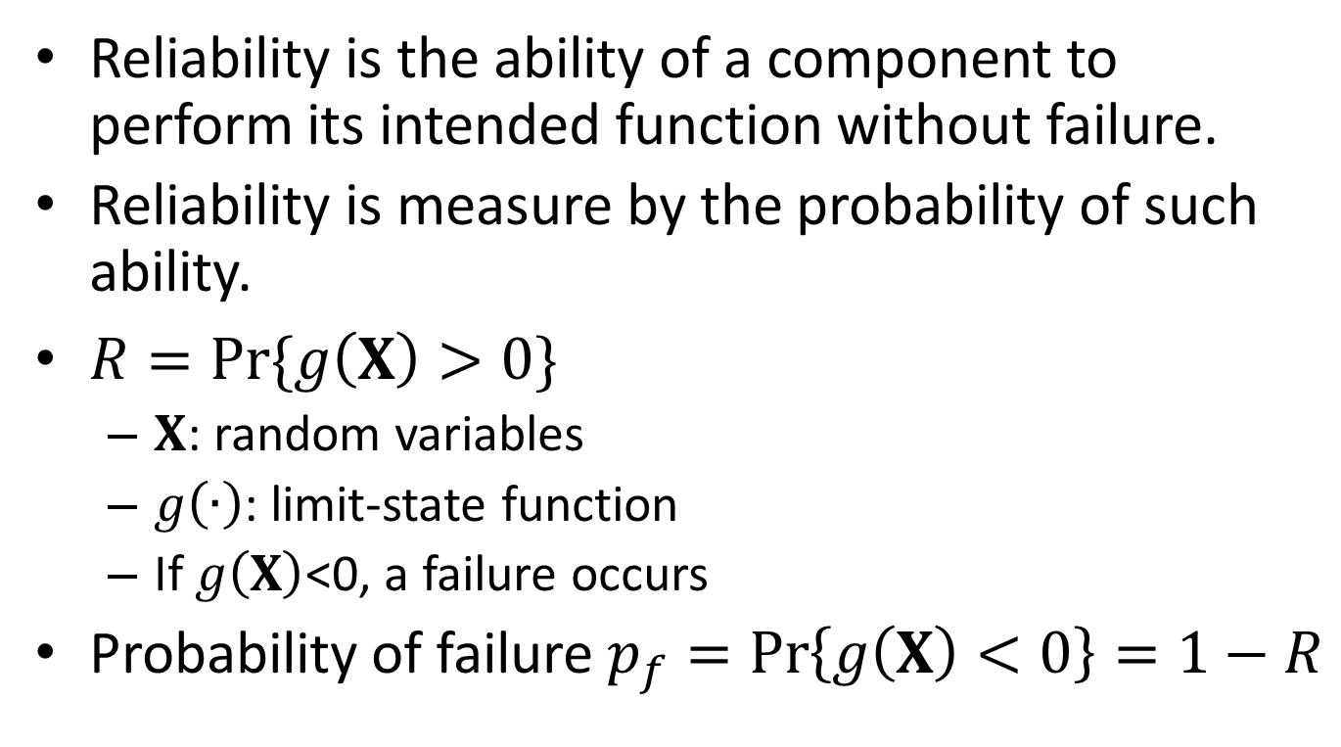
Reliability
Reliability is the ability of a component to perform its intended function without failure.
Reliability is measure by the probability of such ability.
$R=Pr⁡\{g\left(X\right)>0\}$
  $X$: random variables
  $g\left(∙\right)$: limit-state function
  If $g\left(X\right)$<0, a failure occurs
Probability of failure $p_{f}=\operatorname{Pr}\left\{g\left(X\right)<0\right\}=1−R$

Slide 12
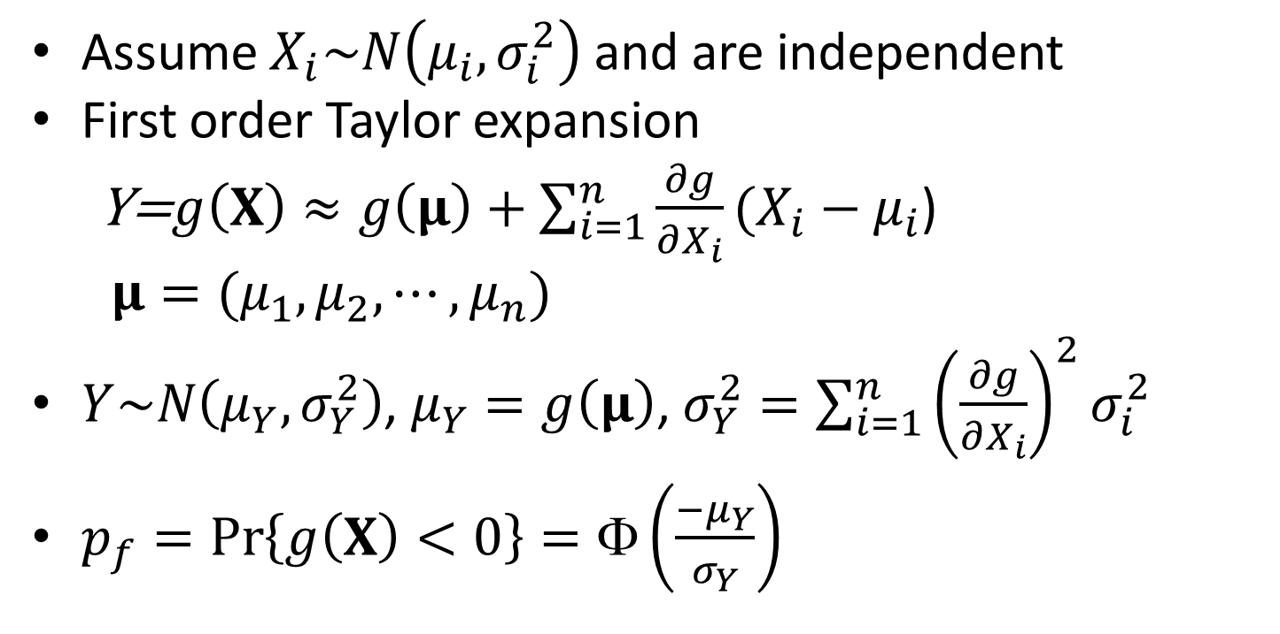
First Order Second Moment Method (FOSM)
Assume $X_{i}\sim N\left(μ_{i},σ_{i}^{2}\right)$ and are independent
First order Taylor expansion
Y=$g\left(X\right)≈g\left(μ\right)+\sum_{i=1}^{n}{\frac{∂g}{∂X_{i}}}(X_{i}−μ_{i}$)
$μ=(μ_{1},μ_{2},⋯,μ_{n})$
$Y\sim N\left(μ_{Y},σ_{Y}^{2}\right)$, $μ_{Y}=g\left(μ\right)$, $σ_{Y}^{2}=\sum_{i=1}^{n}{{\left(\frac{∂g}{∂X_{i}}\right)}^{2}}σ_{i}^{2}$
$p_{f}=\operatorname{Pr}\left\{g\left(X\right)<0\right\}=Φ\left(\frac{−μ_{Y}}{σ_{Y}}\right)$

Slide 13
Monte Carlo Simulation (MCS)*
A sampling-based simulation method
Distributions of input variables
Step 1: Sampling of random variables
Generating samples of random variables
Samples of input variables
Analysis Model
Step 2: Numerical Experimentation
Evaluating performance function
Samples of output variables
Step 3: Statistic Analysis on model output
Extracting probabilistic information
Probabilistic characteristics of output variables
*This topic is optional.

Slide 14
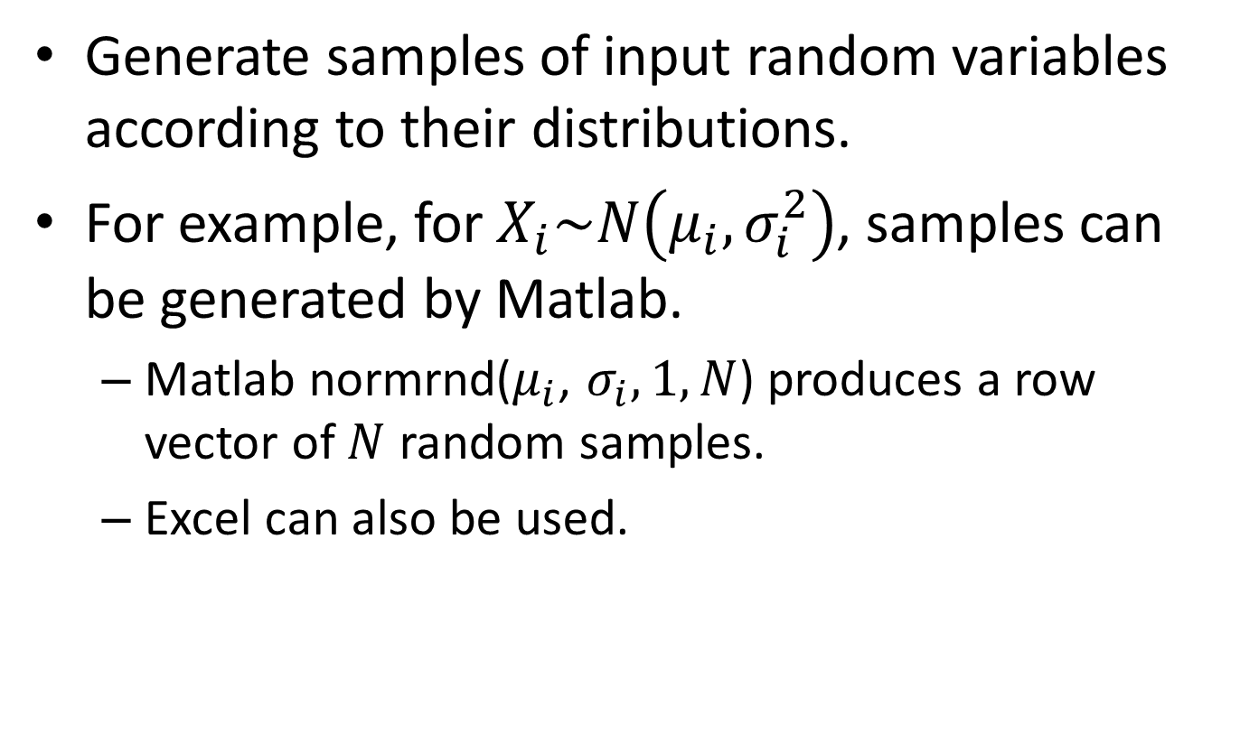
Step 1: Sampling on random variables
Generate samples of input random variables according to their distributions.
For example, for $X_{i}\sim N\left(μ_{i},σ_{i}^{2}\right)$, samples can be generated by Matlab.
  Matlab normrnd($μ_{i}$, $σ_{i},1,N$) produces a row vector of $N$ random samples.
  Excel can also be used.

Slide 15
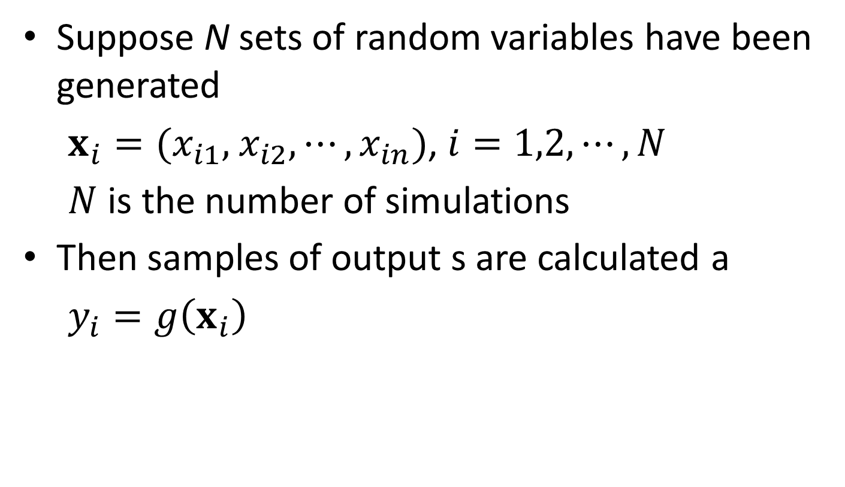
Step 2: Obtain Samples of Output
Suppose N sets of random variables have been generated
$x_{i}=(x_{i1},$ $x_{i2},⋯,x_{in})$, $i=1,2,⋯,N$
$N$ is the number of simulations
Then samples of output s are calculated a
$y_{i}=g\left(x_{i}\right)$

Slide 16
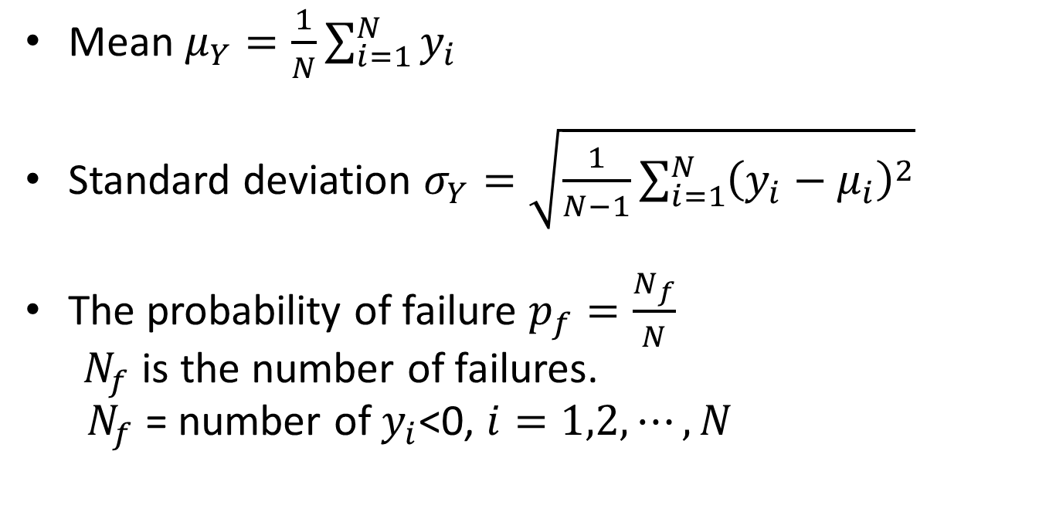
Step 3: Statistic Analysis on output
Mean $μ_{Y}=\frac{1}{N}\sum_{i=1}^{N}{y_{i}}$
Standard deviation $σ_{Y}=\sqrt{\frac{1}{N−1}\sum_{i=1}^{N}{{\left(y_{i}−μ_{i}\right)}_{}^{2}}}$
The probability of failure $p_{f}=\frac{N_{f}}{N}$
$N_{f}$ is the number of failures.
$N_{f}$ = number of $y_{i}$<0, $i=1,2,⋯,N$

Slide 17
FORM vs MCS
FORM is more efficient
FORM may not be accurate when a limit-state function is highly nonlinear
MCS is very accurate if the sample size is sufficiently large
MCS is not efficient

Slide 18
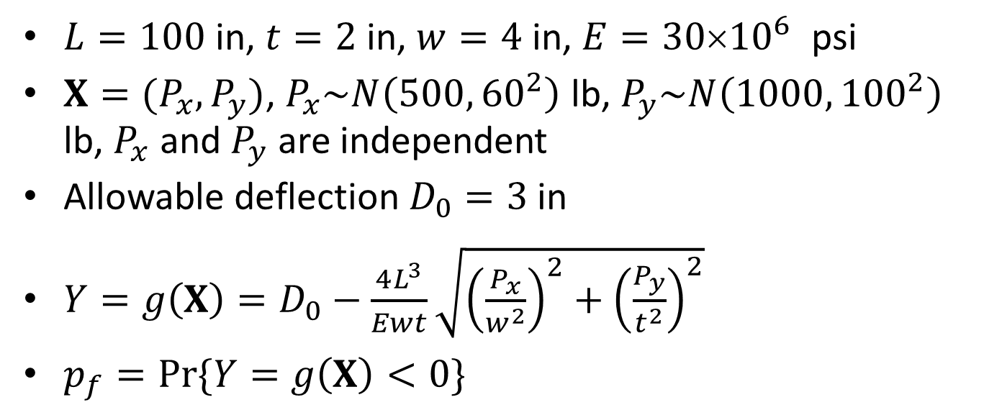
Example - FOSM
$L=100$ in, $t=2$ in, $w=4$ in, $E=30{10}^{6}$ psi
$X=(P_{x},P_{y})$, $P_{x}\sim N\left(500,{60}_{}^{2}\right)$ lb, $P_{y}\sim N\left(1000,{100}_{}^{2}\right)$ lb, $P_{x}$ and $P_{y}$ are independent
Allowable deflection $D_{0}=3$ in
$Y=g\left(X\right)=D_{0}−\frac{4L^{3}}{Ewt}\sqrt{{\left(\frac{P_{x}}{w^{2}}\right)}^{2}+{\left(\frac{P_{y}}{t^{2}}\right)}^{2}}$
$p_{f}=Pr⁡\{Y=g\left(X\right)<0\}$

Slide 19
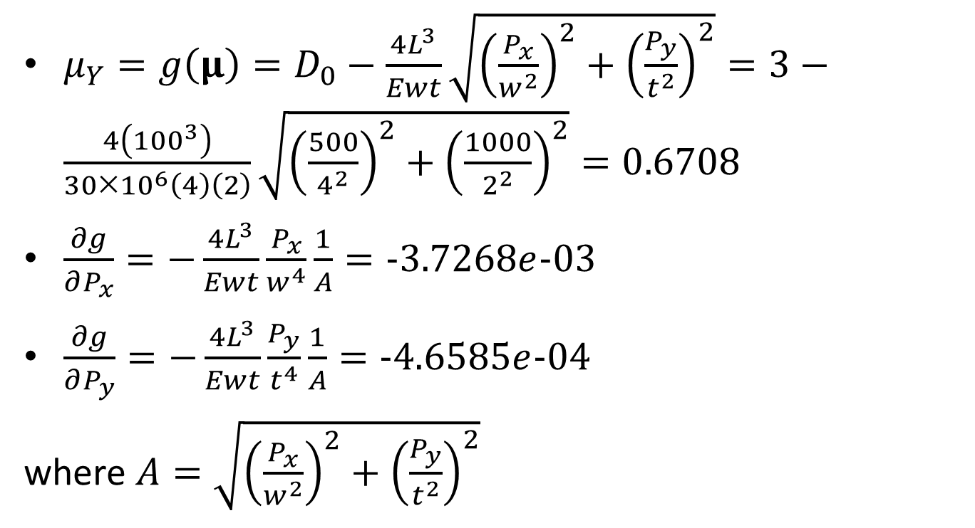
Example - FOSM
$μ_{Y}=g\left(μ\right)=D_{0}−\frac{4L^{3}}{Ewt}\sqrt{{\left(\frac{P_{x}}{w^{2}}\right)}^{2}+{\left(\frac{P_{y}}{t^{2}}\right)}^{2}}=3−\frac{4\left({100}^{3}\right)}{30×{10}^{6}\left(4\right)\left(2\right)}\sqrt{{\left(\frac{500}{4^{2}}\right)}^{2}+{\left(\frac{1000}{2^{2}}\right)}^{2}}=0.6708$
$\frac{∂g}{∂P_{x}}=−\frac{4L^{3}}{Ewt}\frac{P_{x}}{w^{4}}\frac{1}{A}=−3.7268e−03$
$\frac{∂g}{∂P_{y}}=−\frac{4L^{3}}{Ewt}\frac{P_{y}}{t^{4}}\frac{1}{A}=−4.6585e−04$
where $A=\sqrt{{\left(\frac{P_{x}}{w^{2}}\right)}^{2}+{\left(\frac{P_{y}}{t^{2}}\right)}^{2}}$

Slide 20
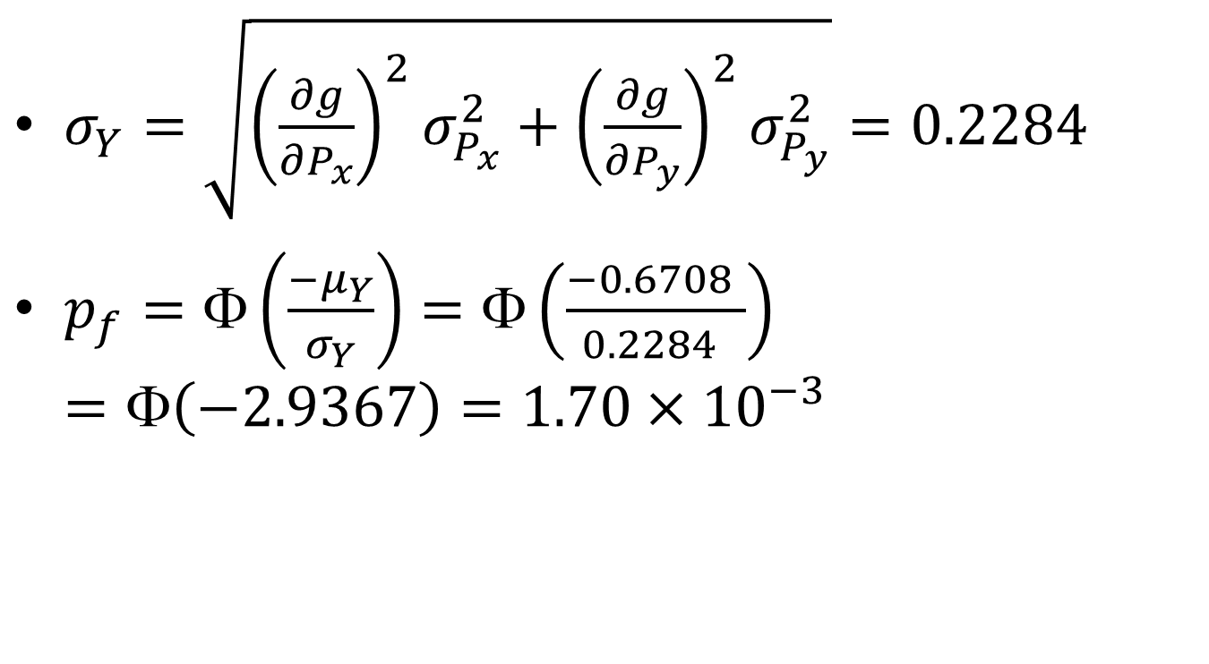
Example - FOSM
$σ_{Y}=\sqrt{{\left(\frac{∂g}{∂P_{x}}\right)}^{2}σ_{P_{x}}^{2}+{\left(\frac{∂g}{∂P_{y}}\right)}^{2}σ_{P_{y}}^{2}}=0.2284$
$p_{f}=Φ\left(\frac{−μ_{Y}}{σ_{Y}}\right)=Φ\left(\frac{−0.6708 }{0.2284 }\right)$ $=Φ\left(−2.9367\right)=1.70×{10}^{−3}$

Slide 21
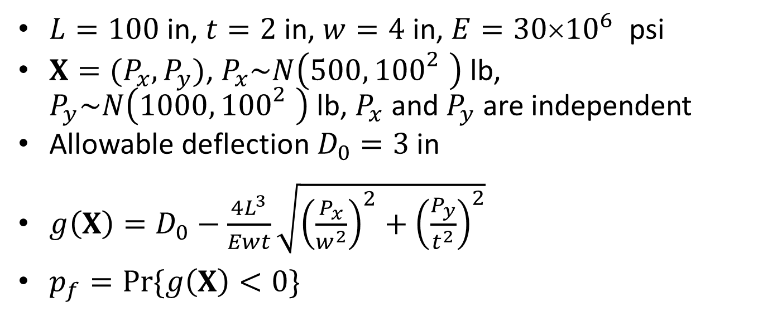
Example - MCS
$L=100$ in, $t=2$ in, $w=4$ in, $E=30{10}^{6}$ psi
$X=(P_{x},P_{y})$, $P_{x}\sim N\left(500,{100}_{}^{2}\right)$ lb, $P_{y}\sim N\left(1000,{100}_{}^{2}\right)$ lb, $P_{x}$ and $P_{y}$ are independent
Allowable deflection $D_{0}=3$ in
$g\left(X\right)=D_{0}−\frac{4L^{3}}{Ewt}\sqrt{{\left(\frac{P_{x}}{w^{2}}\right)}^{2}+{\left(\frac{P_{y}}{t^{2}}\right)}^{2}}$
$p_{f}=Pr⁡\{g\left(X\right)<0\}$

Slide 22
100 and 1000 Simulations

Slide 23
1e5 Simulations
More simulations, More accurate result

Slide 24
Reliability –Based Design (RBD)
Design without considering uncertainty: Low reliability
Design with considering uncertainty: high reliability
x₂
Failure Region
Nominal design point
Safe Region
Actual design points
x₁
x₂
Failure Region
Safe Region
x₁

Slide 25
RBD
RBD ensures that a design has the probability of failure less than an acceptable level, and
therefore ensures that events that lead to catastrophe are extremely unlikely.
RBD is achieved by maximizing cost and maintaining reliability at a required level.

Slide 26
Conclusions
For important mechanical components in important applications,
a factor of safety may not be sufficient to account for uncertainties;
it is imperative to consider reliability.
Uncertainty can be modeled probabilistically.
Reliability can be estimated by FOSM and MCS.

