Slide 1
Probabilistic Mechanism Analysis

Slide 2
Outline
Uncertainty in mechanisms
Why consider uncertainty
Basics of uncertainty
Probabilistic mechanism analysis
Examples
Probabilistic mechanism synthesis
Conclusions

Slide 3
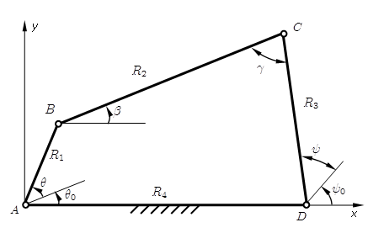

Uncertainty in Mechanisms
Lengths $R_{1}, R_{2}, R_{3}$, and $R_{4}$ are random variables due to manufacture imprecision

Slide 4
Uncertainty in Mechanisms
The joint clearances at A, B, C, and D are also random due to manufacture imprecision and installation errors.

Slide 5
Uncertainty in Mechanisms
Loads and material properties are also random.

Slide 6
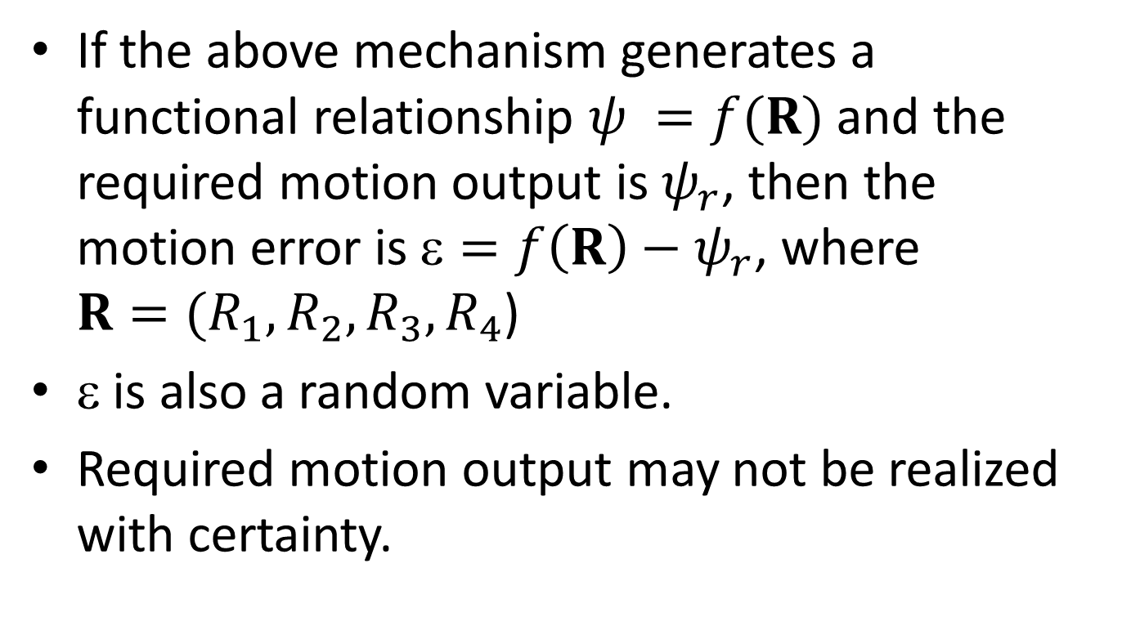
Impact of Uncertainty
If the above mechanism generates a functional relationship $ψ =f(R)$ and the required motion output is $ψ_{r}$, then the motion error is $=f\left(R\right)−ψ_{r}$, where $R=(R_{1},R_{2},R_{3},R_{4}$)
$$ is also a random variable.
Required motion output may not be realized with certainty.

Slide 7
Why Consider Uncertainty?
We know the true solution.
We know the effect of uncertainty.
We can design mechanisms whose performance is not sensitive to uncertainty
We can make more reliable decisions.
In this presentation, we focus on uncertainty only in R.

Slide 8
How Do We Model Uncertainty?
We use probability distributions to model parameters with uncertainty.

Slide 9
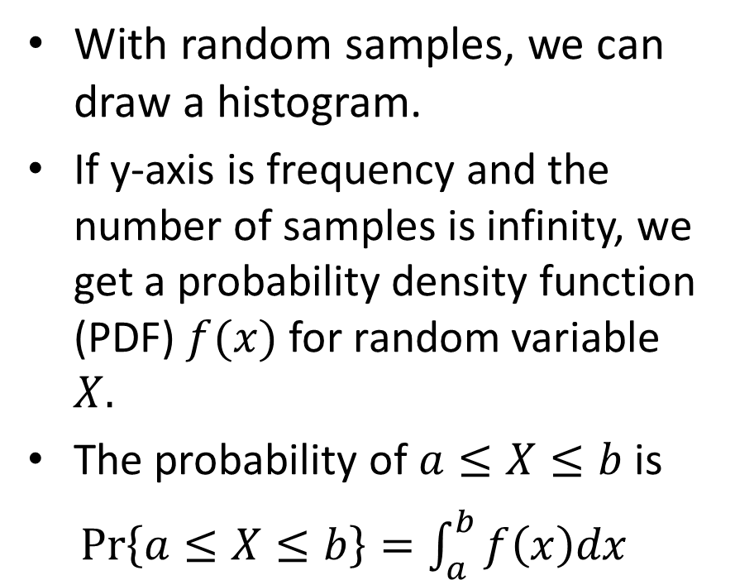
Probability Distribution
With random samples, we can draw a histogram.
If y-axis is frequency and the number of samples is infinity, we get a probability density function (PDF) $f(x)$ for random variable $X.$
The probability of $a≤X≤b$ is
$Pr\left\{a≤X≤b\right\}=\int_{a}^{b}{f\left(x\right)dx}$

Slide 10
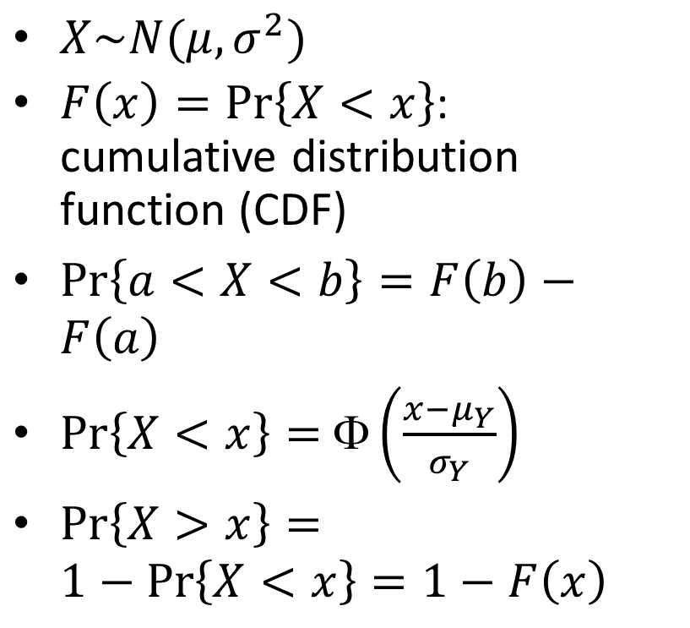
Normal Distribution
$X\sim N(μ,σ^{2})$
$F\left(x\right)=Pr\left\{X<x\right\}$: cumulative distribution function (CDF)
$Pr\left\{a<X<b\right\}=F\left(b\right)−F\left(a\right)$
$Pr\left\{X<x\right\}=$ $\left(\frac{x−μ_{Y}}{σ_{Y}}\right)$
$Pr\left\{X>x\right\}=1−Pr\left\{X<x\right\}=1−F\left(x\right)$

Slide 11
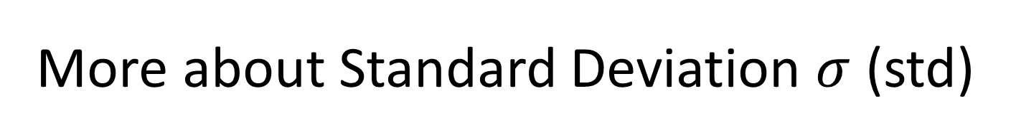
More about Standard Deviation $σ$ (std)
It indicates how data spread around the mean.
It is always non-negative.
High std means
  High dispersion
  High uncertainty
  High risk

Slide 12
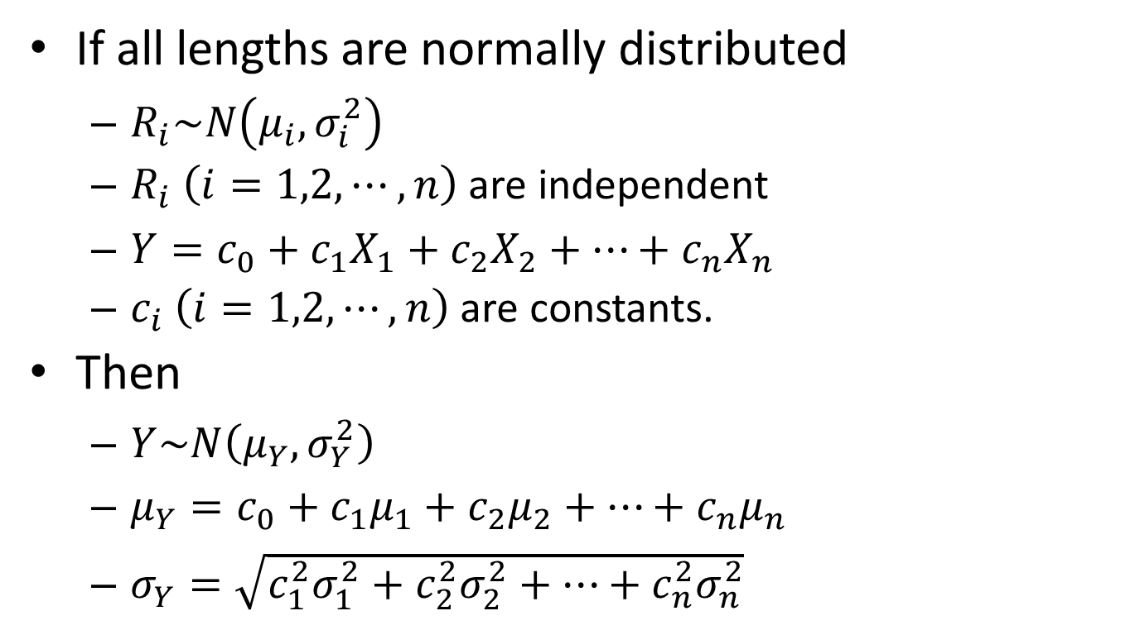
More Than One Random Variables
If all lengths are normally distributed
  $R_{i}\sim N\left(μ_{i},σ_{i}^{2}\right)$
  $R_{i}$ $\left(i=1,2,⋯,n\right)$ are independent
  $Y=c_{0}+c_{1}X_{1}+c_{2}X_{2}+⋯+c_{n}X_{n}$
  $c_{i} \left(i=1,2,⋯,n\right)$ are constants.
Then
  $Y\sim N\left(μ_{Y},σ_{Y}^{2}\right)$
  $μ_{Y}=c_{0}+c_{1}μ_{1}+c_{2}μ_{2}+⋯+c_{n}μ_{n}$
  $σ_{Y}=\sqrt{c_{1}^{2}σ_{1}^{2}+c_{2}^{2}σ_{2}^{2}+⋯+c_{n}^{2}σ_{n}^{2}}$

Slide 13
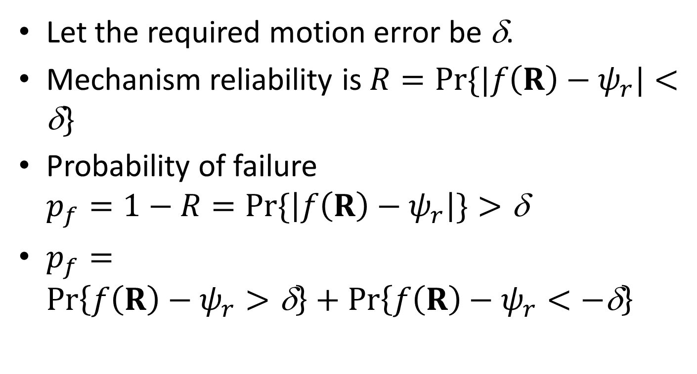
Mechanism Reliability
Let the required motion error be δ.
Mechanism reliability is $R=Pr⁡\{|f\left(R\right)−ψ_{r}|<\text{δ}\}$
Probability of failure $p_{f}=1−R=Pr⁡\{\left|f\left(R\right)−ψ_{r}\right|\}>\text{δ}$
$p_{f}=Pr\left\{f\left(R\right)−ψ_{r}>\text{δ}\right\}+Pr\left\{f\left(R\right)−ψ_{r}<−\text{δ}\right\}$

Slide 14
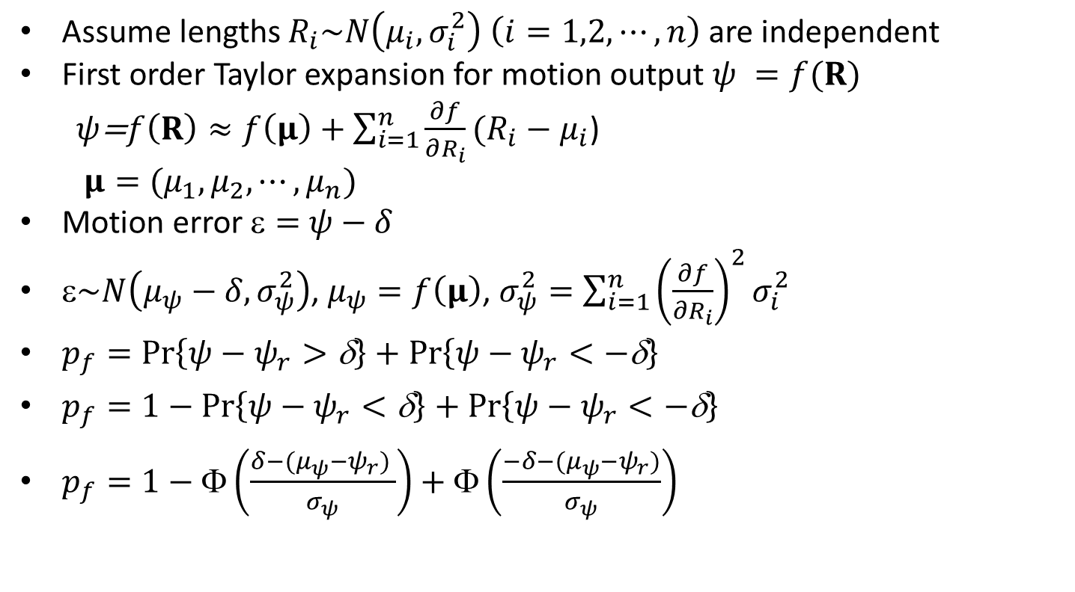
First Order Second Moment Method (FOSM)
Assume lengths $R_{i}\sim N\left(μ_{i},σ_{i}^{2}\right)$ $\left(i=1,2,⋯,n\right)$are independent
First order Taylor expansion for motion output $ψ =f(R)$
$ψ$=$f\left(R\right)≈f\left(μ\right)+\sum_{i=1}^{n}{\frac{∂f}{∂R_{i}}}(R_{i}−μ_{i}$)
$μ=(μ_{1},μ_{2},⋯,μ_{n})$
Motion error $=$ $ψ−δ$
$\sim N\left(μ_{ψ}−δ,σ_{ψ}^{2}\right)$, $μ_{ψ}=f\left(μ\right)$, $σ_{ψ}^{2}=\sum_{i=1}^{n}{{\left(\frac{∂f}{∂R_{i}}\right)}^{2}}σ_{i}^{2}$
$p_{f}=Pr\left\{ψ−ψ_{r}>\text{δ}\right\}+Pr\left\{ψ−ψ_{r}<−\text{δ}\right\}$
$p_{f}=1−Pr\left\{ψ−ψ_{r}<\text{δ}\right\}+Pr\left\{ψ−ψ_{r}<−\text{δ}\right\}$
$p_{f}=1−Φ\left(\frac{δ−(μ_{ψ}−ψ_{r}) }{σ_{ψ}}\right)+Φ\left(\frac{−δ−(μ_{ψ}−ψ_{r})}{σ_{ψ}}\right)$

Slide 15
Monte Carlo Simulation (MCS)*
A sampling-based simulation method
Distributions of input variables
Step 1: Sampling of random variables
Generating samples of random variables
Samples of input variables
Analysis Model
Step 2: Numerical Experimentation
Evaluating performance function
Samples of output variables
Step 3: Statistic Analysis on model output
Extracting probabilistic information
Probabilistic characteristics of output variables
*This topic is optional.

Slide 16
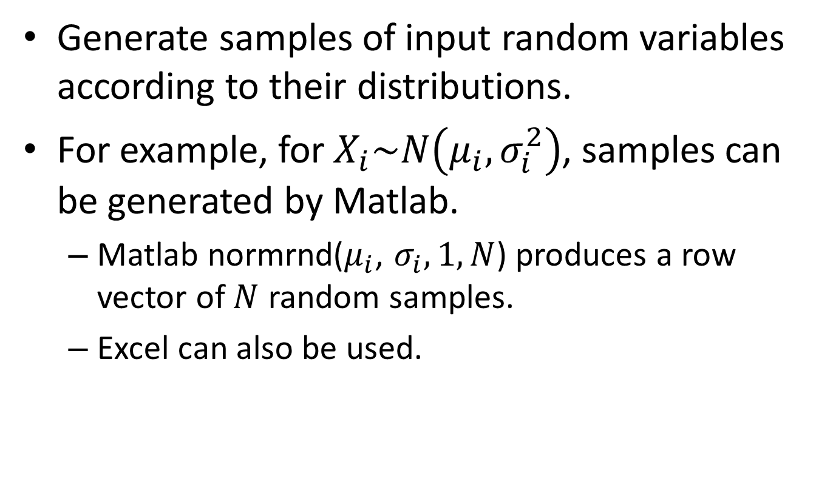
Step 1: Sampling on random variables
Generate samples of input random variables according to their distributions.
For example, for $X_{i}\sim N\left(μ_{i},σ_{i}^{2}\right)$, samples can be generated by Matlab.
  Matlab normrnd($μ_{i}$, $σ_{i},1,N$) produces a row vector of $N$ random samples.
  Excel can also be used.

Slide 17
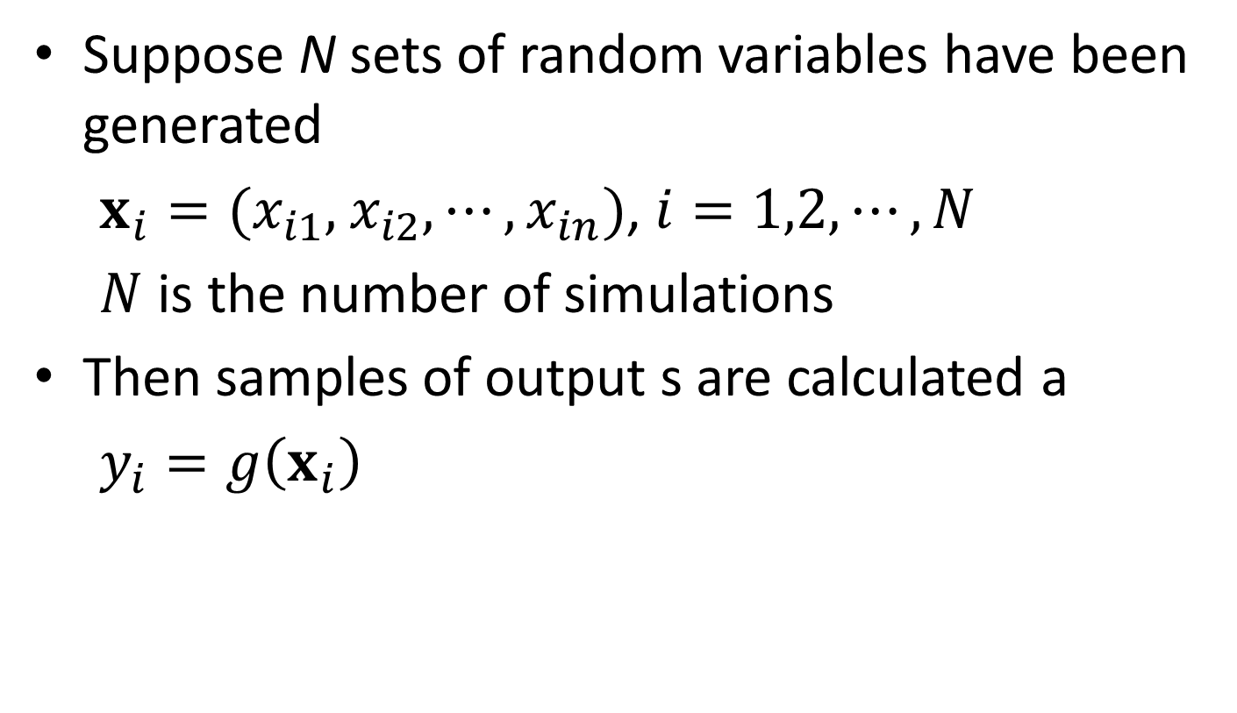
Step 2: Obtain Samples of Output
Suppose N sets of random variables have been generated
$x_{i}=(x_{i1},$ $x_{i2},⋯,x_{in})$, $i=1,2,⋯,N$
$N$ is the number of simulations
Then samples of output s are calculated a
$y_{i}=g\left(x_{i}\right)$

Slide 18
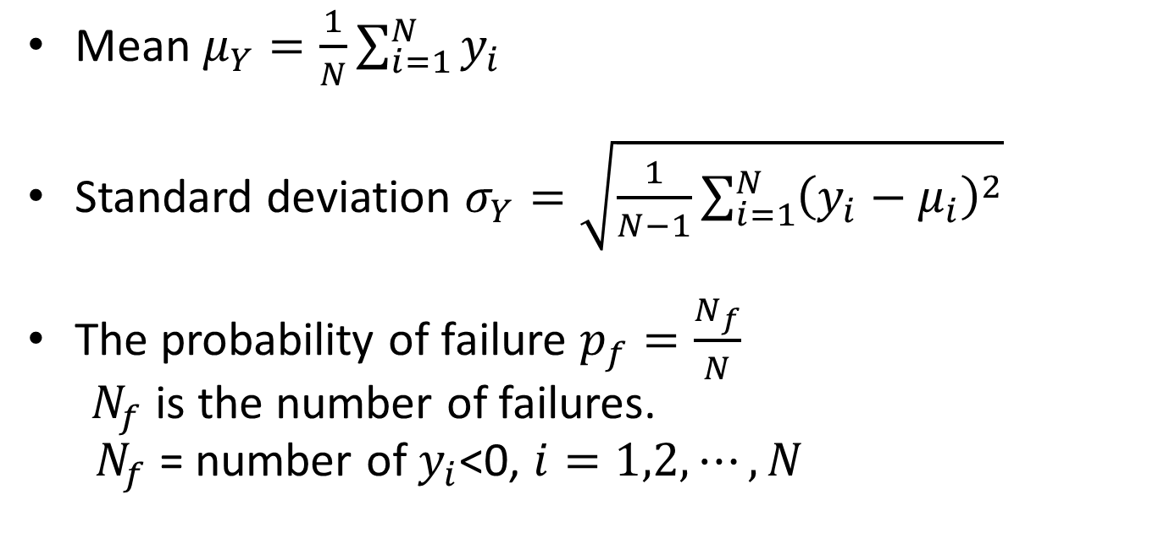
Step 3: Statistic Analysis on output
Mean $μ_{Y}=\frac{1}{N}\sum_{i=1}^{N}{y_{i}}$
Standard deviation $σ_{Y}=\sqrt{\frac{1}{N−1}\sum_{i=1}^{N}{{\left(y_{i}−μ_{i}\right)}_{}^{2}}}$
The probability of failure $p_{f}=\frac{N_{f}}{N}$
$N_{f}$ is the number of failures.
$N_{f}$ = number of $y_{i}$<0, $i=1,2,⋯,N$

Slide 19
FORM vs MCS
FORM is more efficient
FORM may not be accurate when a limit-state function is highly nonlinear
MCS is very accurate if the sample size is sufficiently large
MCS is not efficient

Slide 20


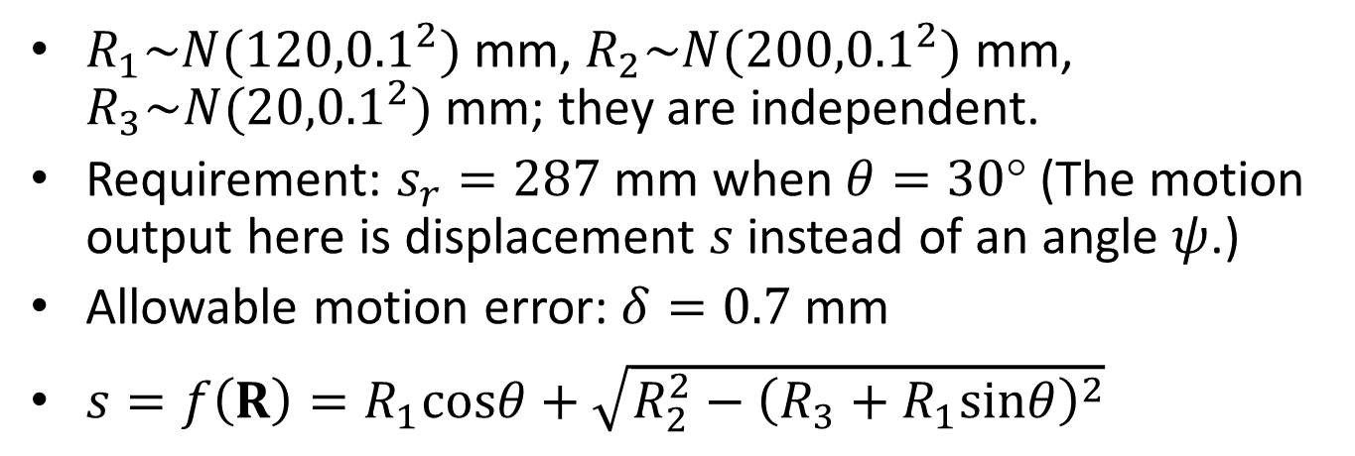



Example - FOSM
B
$$R_{1}$$
$$R_{2}$$
A
$$θ$$
$$R_{3}$$
C
$$s$$
$R_{1}\sim N({120,0.1}^{2})$ mm, $R_{2}\sim N({200,0.1}^{2})$ mm, $R_{3}\sim N({20,0.1}^{2})$ mm; they are independent.
Requirement: $s_{r}=287$ mm when $θ=30$° (The motion output here is displacement $s$ instead of an angle $ψ$.)
Allowable motion error: $δ=0.7$ mm
$s=f\left(R\right)=R_{1}cosθ+\sqrt{R_{2}^{2}−{\left(R_{3}+R_{1}sinθ\right)}^{2}}$

Slide 21
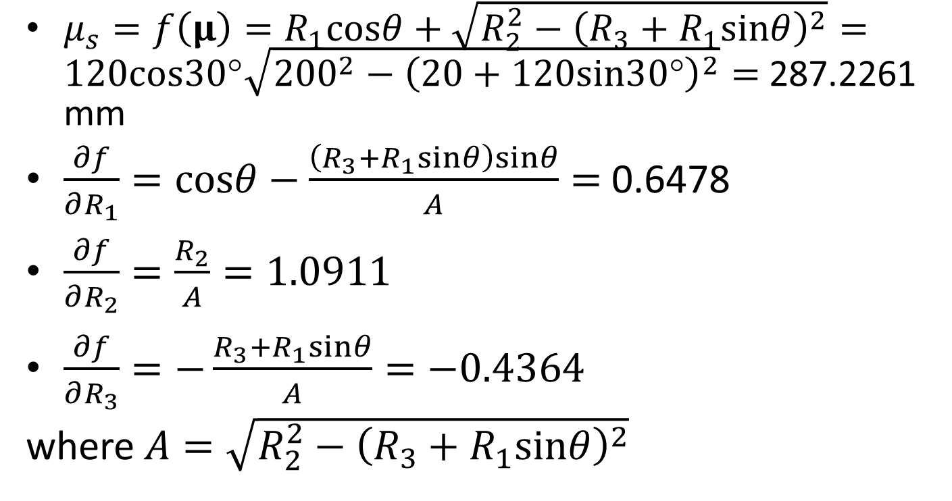
Example - FOSM
$μ_{s}=f\left(μ\right)=R_{1}cosθ+\sqrt{R_{2}^{2}−{\left(R_{3}+R_{1}sinθ\right)}^{2}}=120cos30\text{°}\sqrt{{200}^{2}−{\left(20+120sin30\text{°}\right)}^{2}}=$ 287.2261 mm
$\frac{∂f}{∂R_{1}}=cosθ−\frac{\left(R_{3}+R_{1}sinθ\right)sinθ}{A}=$ 0.6478
$\frac{∂f}{∂R_{2}}=\frac{R_{2}}{A}=1.0911$
$\frac{∂f}{∂R_{3}}=−\frac{R_{3}+R_{1}sinθ}{A}=−0.4364$
where $A=\sqrt{R_{2}^{2}−{\left(R_{3}+R_{1}sinθ\right)}^{2}}$

Slide 22
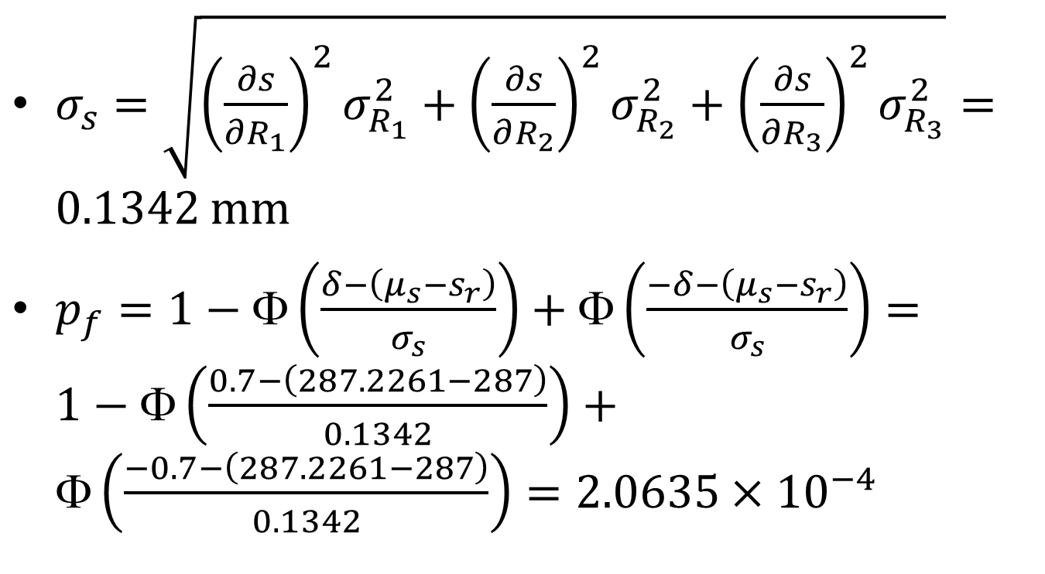
Example - FOSM
$σ_{s}=\sqrt{{\left(\frac{∂s}{∂R_{1}}\right)}^{2}σ_{R_{1}}^{2}+{\left(\frac{∂s}{∂R_{2}}\right)}^{2}σ_{R_{2}}^{2}+{\left(\frac{∂s}{∂R_{3}}\right)}^{2}σ_{R_{3}}^{2}}=0.1342$ mm
$p_{f}=1−Φ\left(\frac{δ−\left(μ_{s}−s_{r}\right)}{σ_{s}}\right)+Φ\left(\frac{−δ−\left(μ_{s}−s_{r}\right)}{σ_{s}}\right)=$ $1−Φ\left(\frac{0.7−\left(287.2261−287\right)}{0.1342}\right)+Φ\left(\frac{−0.7−\left(287.2261−287\right)}{0.1342}\right)=2.0635×{10}^{−4}$

Slide 23
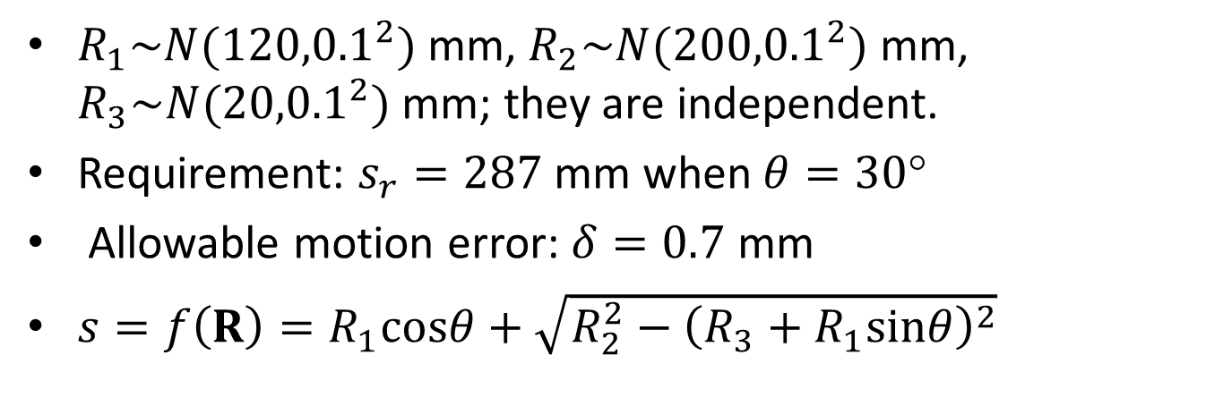
Example - MCS
B
$$R_{1}$$
$$R_{2}$$
A
$$θ$$
$$R_{3}$$
C
$$s$$
$R_{1}\sim N({120,0.1}^{2})$ mm, $R_{2}\sim N({200,0.1}^{2})$ mm, $R_{3}\sim N({20,0.1}^{2})$ mm; they are independent.
Requirement: $s_{r}=287$ mm when $θ=30$°
Allowable motion error: $δ=0.7$ mm
$s=f\left(R\right)=R_{1}cosθ+\sqrt{R_{2}^{2}−{\left(R_{3}+R_{1}sinθ\right)}^{2}}$

Slide 24
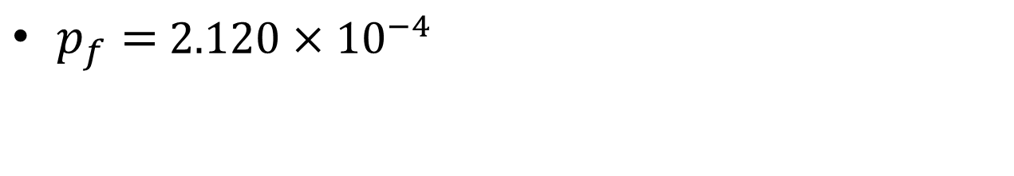
1e6 Simulations
$p_{f}=$ $2.120×{10}^{−4}$

Slide 25
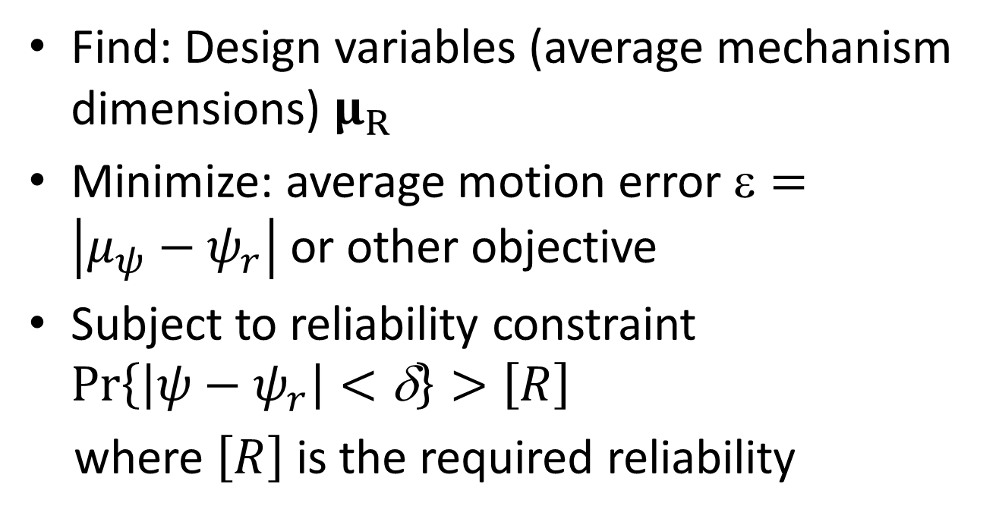
Reliability–Based Mechanism Synthesis
Find: Design variables (average mechanism dimensions) $μ_{R}$
Minimize: average motion error $=\left|μ_{ψ}−ψ_{r}\right|$ or other objective
Subject to reliability constraint $\operatorname{Pr}\left\{\left|ψ−ψ_{r}\right|<\text{δ}\right\}>\left[R\right]$
where $\left[R\right]$ is the required reliability

Slide 26
Conclusions
For important mechanisms in important applications, it is imperative to consider reliability.
Uncertainty can be modeled probabilistically.
Reliability can be estimated by FOSM and MCS.
Same methodologies can also be used for cams, gears, and other mechanisms.

