Slide 1
Robust Design and Reliability-Based Design
ME 4761 Engineering Design
2015 Spring
Xiaoping Du

Slide 2
Outline
Definition of robustness
Introductory examples
Statistics
How to achieve robustness
Examples
Related methodology: reliability-based design
Conclusions

Slide 3
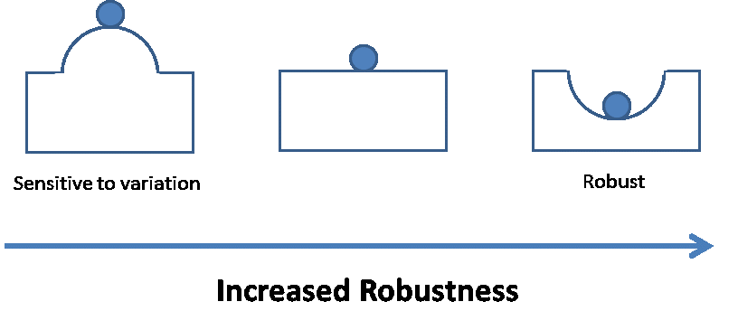
Robust Design
If a design can work properly even when subjected to variation, it is robust.
Variation (uncertainty) may be introduced by
  manufacturing processes
  environment
  parts from outside suppliers
  end user

Slide 4
Robustness
The robustness of a product is the ability that its performances are not affected by the uncertain inputs or environment conditions (noises).
Robustness is insensitivity to uncertainty.
A robust product can work under large uncertainties.

Slide 5
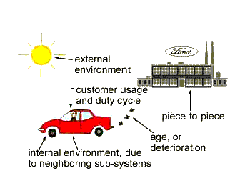
Variation (Uncertainty)
Piece-to-piece variation
Customer usage and duty cycle
Human errors
Model inaccuracy
Uncertainty
Knowledge
Complete ignorance
Present state of knowledge
Complete knowledge

Slide 6
An Example: Cantilever Beam
P
C
B
A
A - A
h₁
h₂
b₁
l₂
l₁
A
b₂
The material strength
The maximum stress
Factor of safety
Reality: everything is uncertain
Load: P=(2001.4, 1531.3, 2534.6, ….) kN
Yield strength: Sy=(120.5, 101.3, 131.2, 170.9,…) MPa
Dimension: h₁= 100±0.01 mm
Dimension: b₁= 50±0.01 mm, ….

Slide 7
Principle of Robust Design
Minimize the effect of uncertainty (variation) without eliminating the cause of uncertainty.
How?
By changing design variables to make the performance not sensitive to uncertainty.

Slide 8
Example: Tile Manufacturing
Output: Tile dimensions
Problem: Large variability in dimensions
Uncertainty source: Huge variation in temperature
Possible solutions
  Screening
  Redesign the kiln
  Too expensive
Robust design solution
  Do not control the temperature
  Change design variables: increasing the lime content of the clay from 1% to 5%
  Inexpensive
Phadke: Quality Engineering Using Robust Design, 1989

Slide 9
Benefits of Robust Design
Product performance insensitive to material variation –> use of low grade material and components
Product performance insensitive to manufacturing variation -> reduced labor and manufacturing cost
Product performance insensitive to the variation in operating environment -> higher reliability and lower operation cost

Slide 10
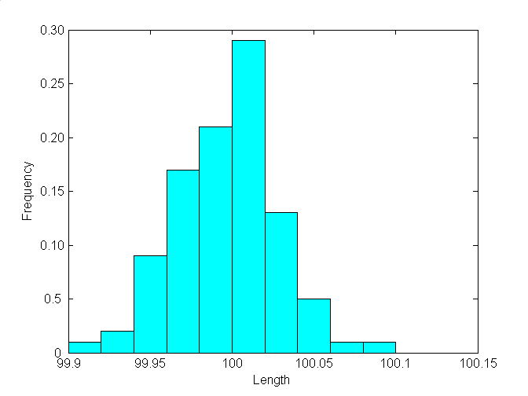
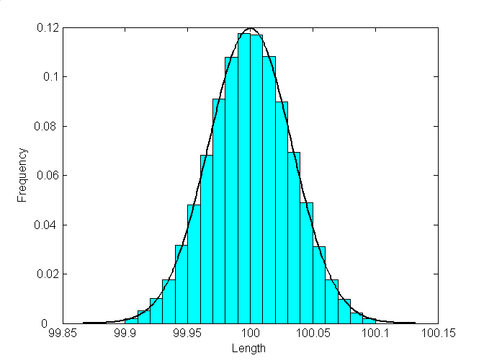
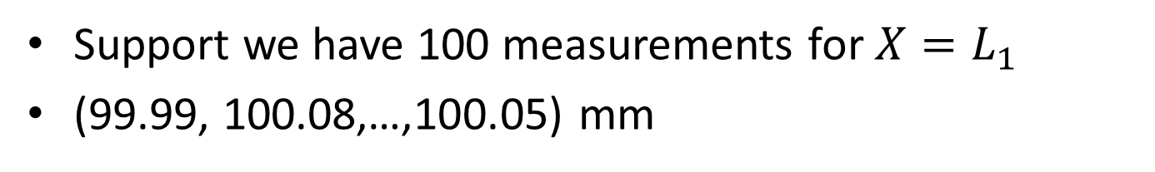
How Do We Quantify Uncertainty?
Support we have 100 measurements for $X{=L}_{1}$
(99.99, 100.08,…,100.05) mm
Average
Dispersion
Histogram
Probability density (distribution)

Slide 11

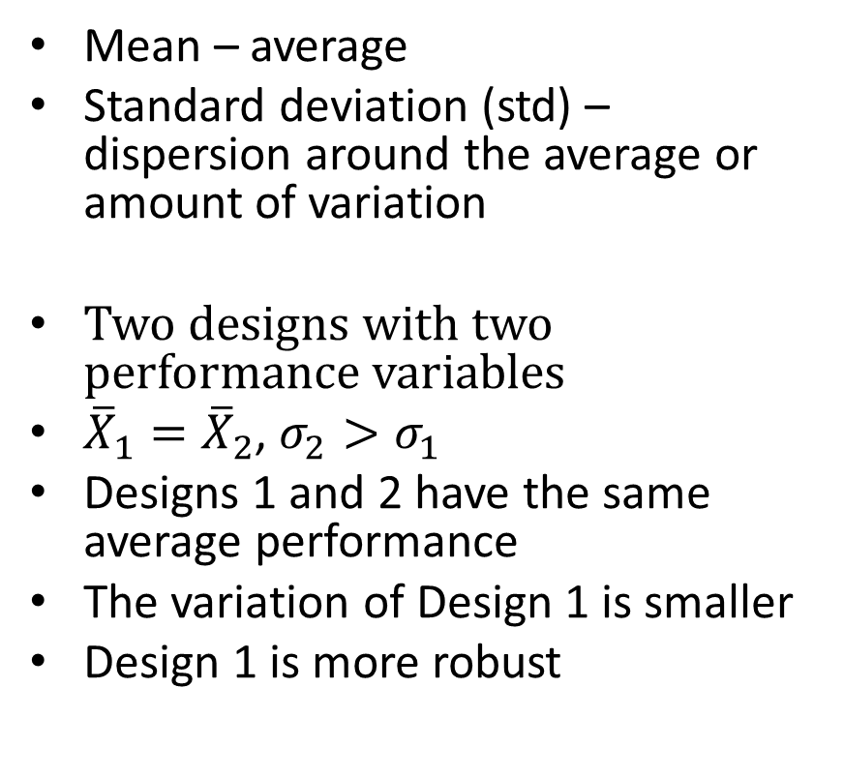



Probability Distribution
Design 1
${\overline{X}}_{1}$, $σ_{1}$
Mean – average
Standard deviation (std) – dispersion around the average or amount of variation
Two designs with two performance variables
${\overline{X}}_{1}={\overline{X}}_{2}$, $σ_{2}>σ_{1}$
Designs 1 and 2 have the same average performance
The variation of Design 1 is smaller
Design 1 is more robust
$${\overline{X}}_{1}$$
Design 2
${\overline{X}}_{2}$, $σ_{2}$
$${\overline{X}}_{2}$$

Slide 12
TV Example
In 1970s, Americans showed a preference for television sets made by Sony-Japan over those made by Sony-USA.
The color density was a major performance.
  Target ± tolerance = m ± 5.
Sony-Japan sets: 0.3% defective sets (outside the tolerance limits)
Sony-USA sets: virtually NO sets outside the tolerance limits.
Why?
Phadke: Quality Engineering Using Robust Design, 1989

Slide 13
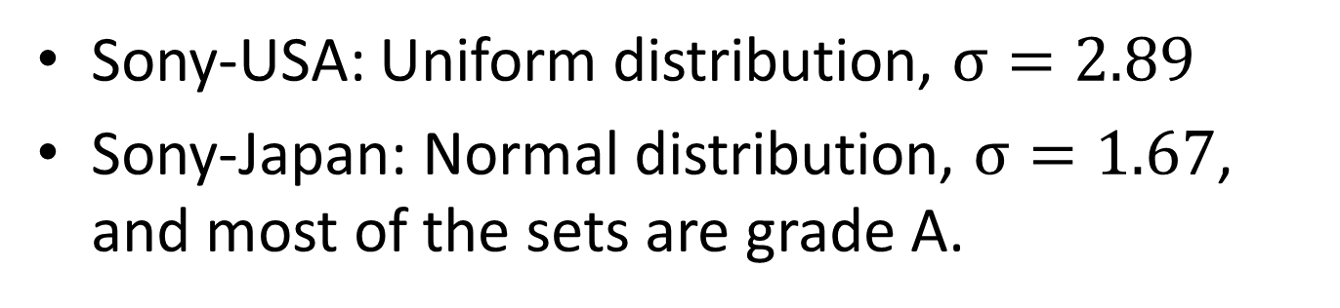
TV Example
Sony-USA: Uniform distribution, $σ=2.89$
Sony-Japan: Normal distribution, $σ=1.67$, and most of the sets are grade A.
Phadke: Quality Engineering Using Robust Design, 1989

Slide 14
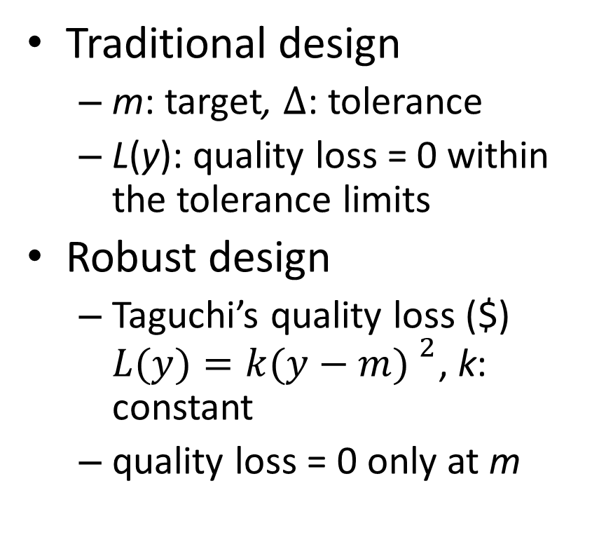
How to Evaluate Robustness?
Traditional design
  m: target, $∆$: tolerance
  L(y): quality loss = 0 within the tolerance limits
Robust design
  Taguchi’s quality loss ($) $L(y)=k{(y−m) }^{2}$, k: constant
  quality loss = 0 only at m
L(y)
m-
m
m+
y
L(y)
m-
m
m+
y

Slide 15
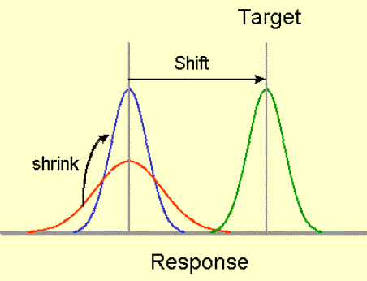

Expected Quality Loss
  Expected (average) quality loss
  $E(L)=k[{\left(\overline{Y}−m\right) }^{2}+σ_{Y}^{2}$]
  Minimizing $E\left(L\right)$ will bring the average performance to the target and reducing variation $σ_{Y}$ simultaneously.
Final design
Initial design

Slide 16
Robust Design
Increasing average performance
Increasing robustness
Decreasing variation

Slide 17
Other Types of Quality Loss
What we’ve discussed is the “nominal-the-better” type
The “smaller-the-better” type
  cost, stress, energy consumption
The “larger-the-better” type
  life, reliability, strength, efficiency
L(y)
0
y
L(y)
0
y

Slide 18
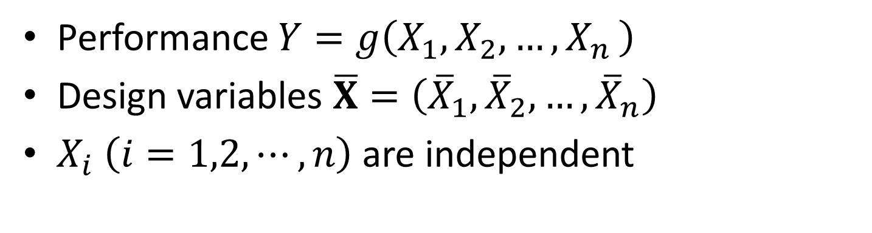
How to Select Design Variables to Achieve Robustness?
Performance $Y=g\left(X_{1},X_{2},{…,X}_{n}\right)$
Design variables $\overline{X}=\left({\overline{X}}_{1},{\overline{X}}_{2},…,{\overline{X}}_{n}\right)$
$X_{i}$ $\left(i=1,2,⋯,n\right)$ are independent

Slide 19
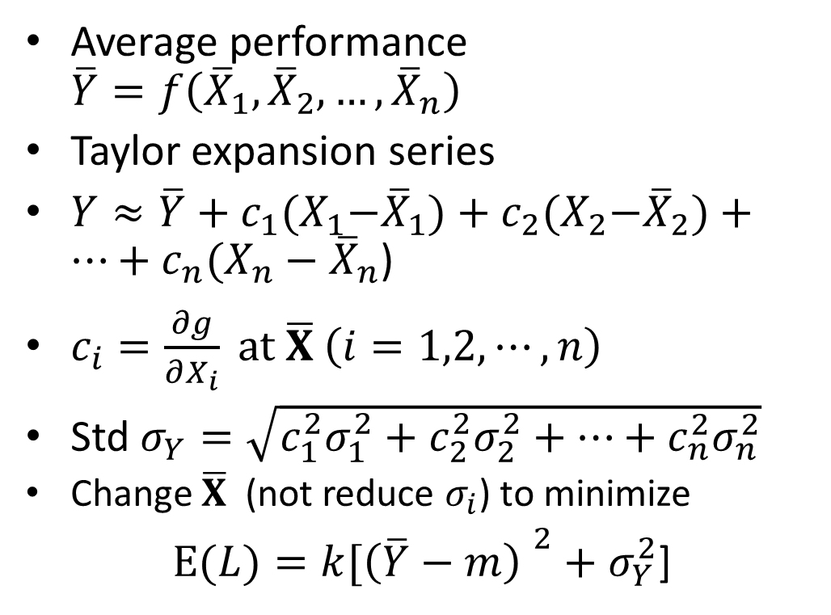
Parameter Design
Average performance $\overline{Y}=f\left({\overline{X}}_{1},{\overline{X}}_{2},…,{\overline{X}}_{n}\right)$
Taylor expansion series
$Y≈\overline{Y}+c_{1}{(X}_{1}−{\overline{X}}_{1})+c_{2}{(X}_{2}−{\overline{X}}_{2})+⋯+c_{n}(X_{n}−{\overline{X}}_{n}$)
$c_{i}=\frac{∂g}{∂X_{i}} at \overline{X} \left(i=1,2,⋯,n\right)$
Std $σ_{Y}=\sqrt{c_{1}^{2}σ_{1}^{2}+c_{2}^{2}σ_{2}^{2}+⋯+c_{n}^{2}σ_{n}^{2}}$
  Change $\overline{X}$ (not reduce $σ_{i}$) to minimize
  $E(L)=k[{\left(\overline{Y}−m\right) }^{2}+σ_{Y}^{2}$]
Sensitivity
Y
0
X
Taylor expansion

Slide 20
More about Sensitivity
Insensitive
(robust)
Output y
Sensitive
Input x

Slide 21
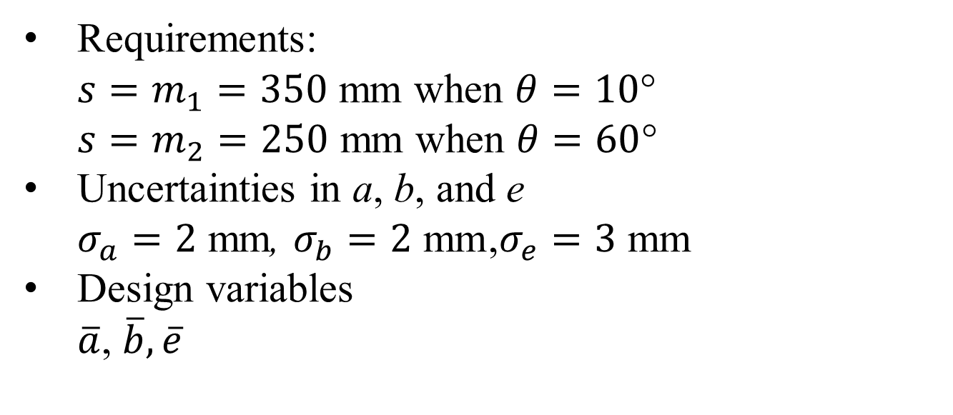
Example: Robust Mechanism Synthesis
Requirements:
  $s=m_{1}=350$ mm when $θ=10$°
  $s=m_{2}=250$ mm when $θ=60$°
Uncertainties in a, b, and e
  $σ_{a}=2$ mm, $σ_{b}=2 \text{mm}$,$σ_{e}=3 \text{mm}$
Design variables
$\overline{a}$, $\overline{b}, \overline{e}$
B
a
b
θ
A
e
C
N
N

Slide 22
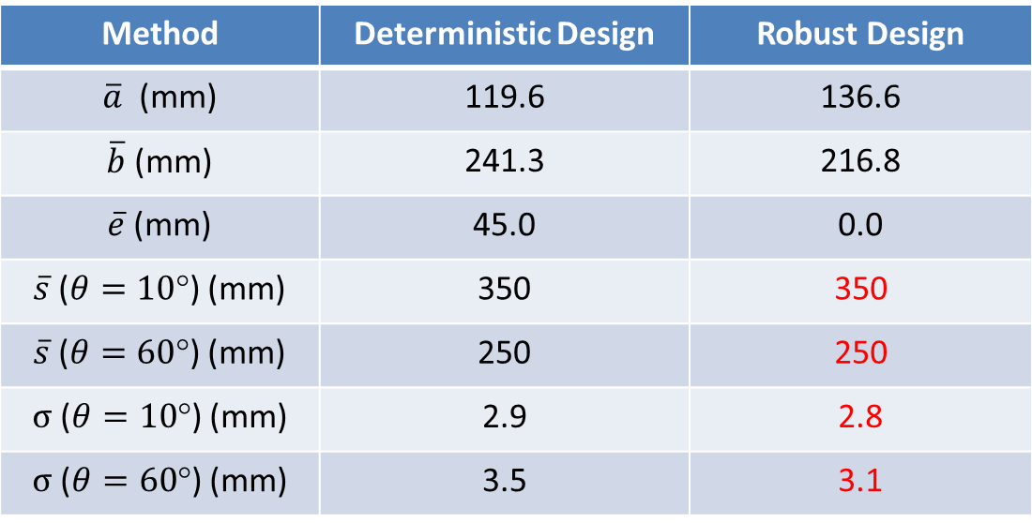

Results
Transmission angle > 45°
  Minimize $\sum_{i=1}^{2}{k[{\left({\overline{s}}_{i}−m_{i}\right) }^{2}+σ_{si}^{2}}$]
Method | Deterministic Design | Robust Design
$\overline{a}$ (mm) | 119.6 | 136.6
$\overline{b}$ (mm) | 241.3 | 216.8
$\overline{e}$ (mm) | 45.0 | 0.0
$\overline{s}$ ($θ=10$°) (mm) | 350 | 350
$\overline{s}$ ($θ=60$°) (mm) | 250 | 250
$σ$ ($θ=10$°) (mm) | 2.9 | 2.8
$σ$ ($θ=60$°) (mm) | 3.5 | 3.1

Slide 23
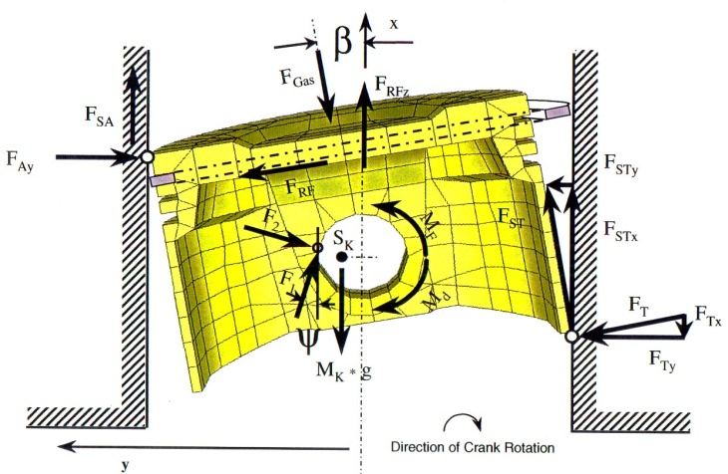
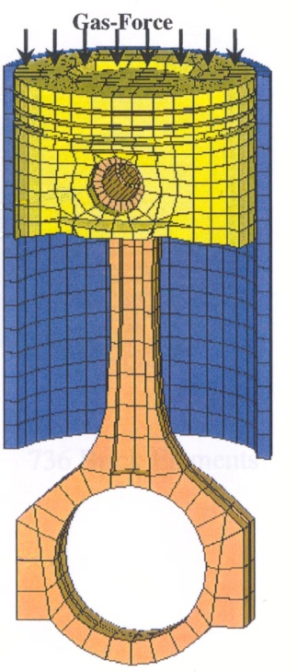
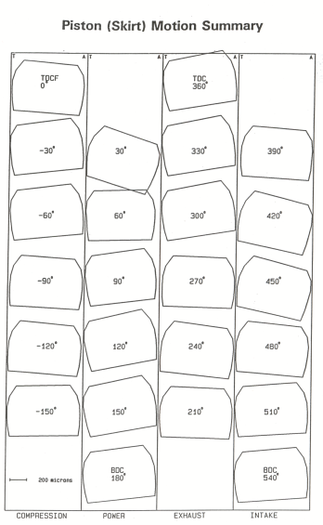
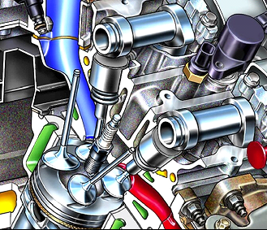
Example 2 - Piston Engine Robust Design
Liner
f – Slap noise
G - Friction
 | Baseline | Optimal
Mean of f | 54.5 dB | 54.2 dB
Std of f | 2.04 dB | 0.76 dB
Prob | 0.65 | 0.99

Slide 24
Other Method
Operating Window Methods
Developed by Xerox.
The operating window is the set of conditions under which the system operates without failure.
A wider window can accommodate larger uncertainties.
Robustness is achieved by making the operating window larger.

Slide 25
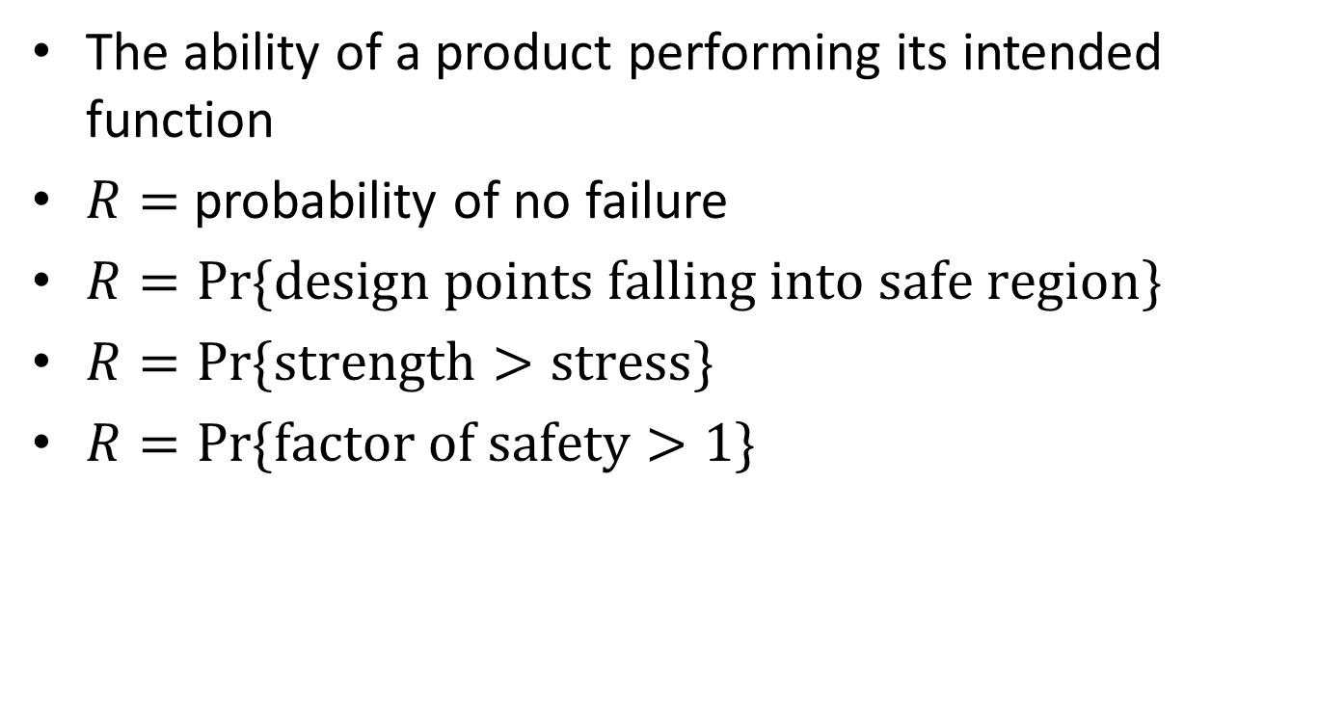
Related Issue: Reliability (R)
The ability of a product performing its intended function
$R=$ probability of no failure
$R=Pr⁡\{design points falling into safe region\}$
$R=Pr⁡\{strength>stress\}$
$R=Pr⁡\{factor of safety>1\}$
x₂
Failure region
Boundary
Deterministic optimal point
Safe region
x₁

Slide 26
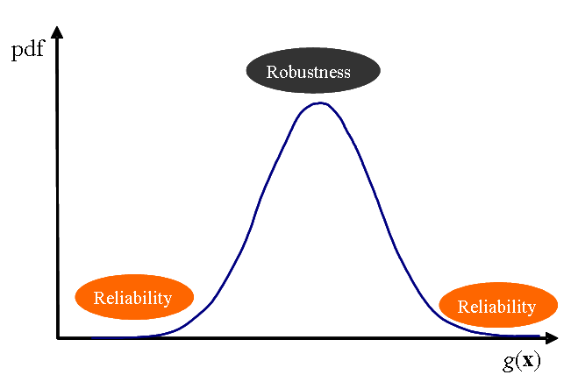

Reliability vs. Robustness
Everyday fluctuations around the mean – deterioration, degradation, quality loss
Extreme events at tails – failure, catastrophe
Reliability issue
  Motherboard failure
  Broken hard disk
Robustness issue
  Overheating
  Noise

Slide 27
How to Design for Reliability?
Conceptual design
  Failure mode and effects analysis (FMEA) (IDE 20 & ME 161)
Parameter design
  Reliability-based design
x₂
x₂
Failure Region
Failure Region
Safe Region
Safe Region
x₁
x₁

Slide 28
Software Tools
iSIGHT
MSC – Robust Design
  Robust Design for Whirlpool Products
  http://www.mscsoftware.com/success/details.cfm?Q=285&sid=282
Ansys – Monte Carlo Simulation
ADAMS – Design of Experiments

Slide 29
Conclusions
Robust design -> insensitivity to uncertainties
  Insensitive to material variations-> use of low grade materials and components -> low material cost
  Insensitive to manufacturing variations -> no tightened tolerances -> low manufacturing and labor cost
  Insensitive to variations in operation environment -> low operation cost
Robust design -> increased performance, quality, and reliability at reduced cost
Robustness and reliability can be built into products during early stages of design.

Slide 30
More Information
Visit the website of Engineering Uncertainty Repository at http://www.mst.edu/~dux/repository.
Contact me
  Toomey Hall 272
  dux@mst.edu

